Slide 1
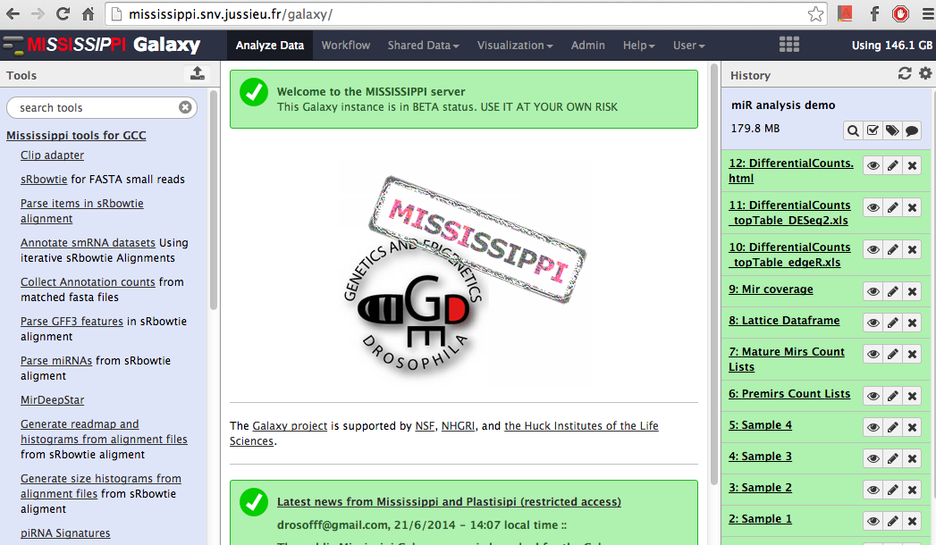
Mississippi tools – a set of miRNA, siRNA, piRNA analysis tools
Poster 6
also available at the testtoolshed!

Slide 2
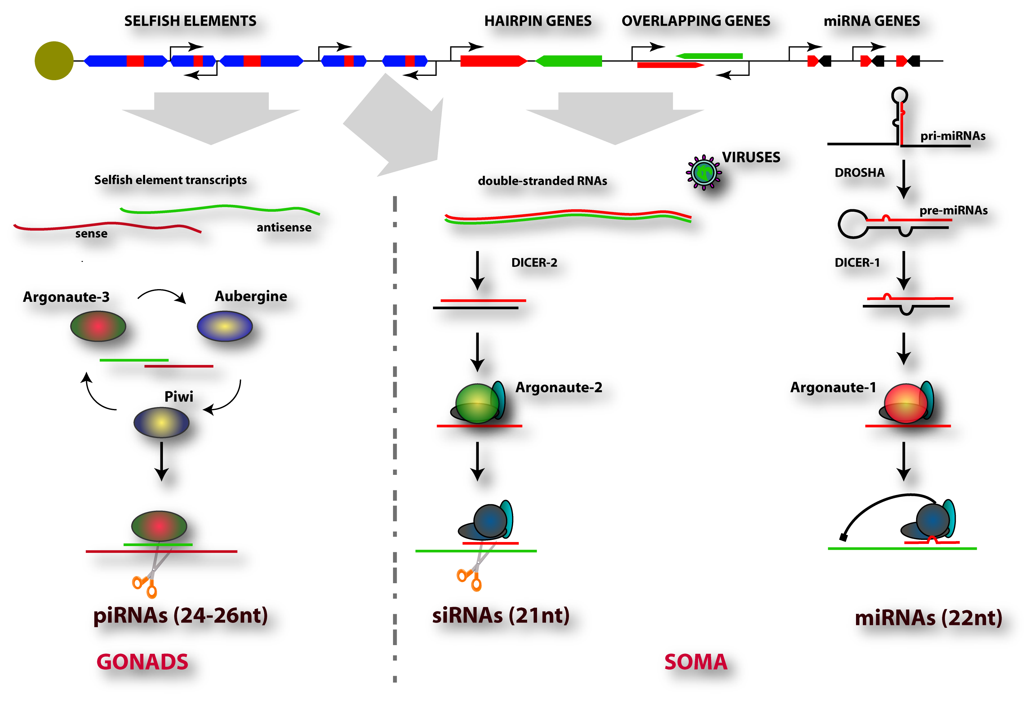
Size matters for small RNAs!

Slide 3
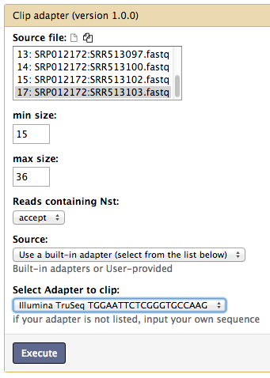
Basic simplifications / improvements: clipping

Slide 4
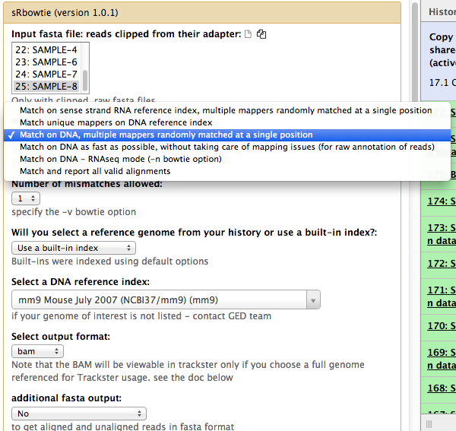
Basic simplifications / improvements: mapping

Slide 5
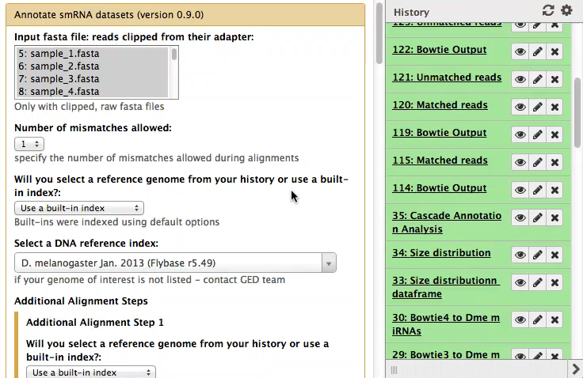
Cascade: quick overview of small RNA targes

Slide 6
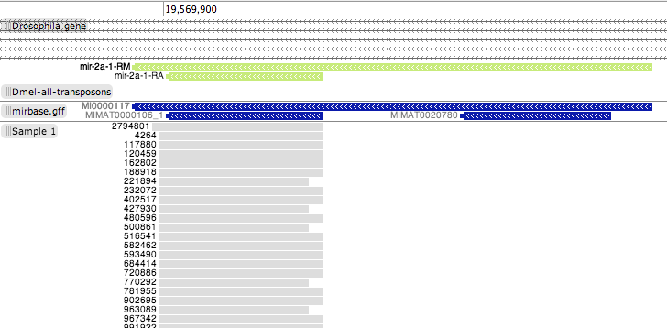
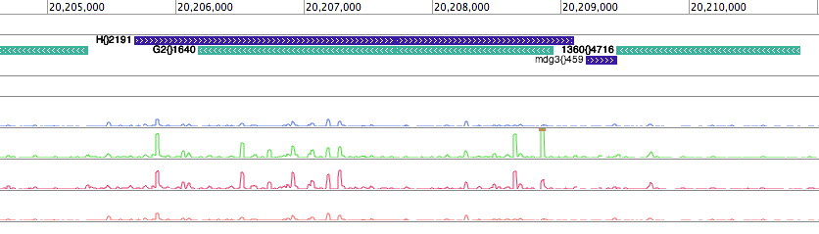
What trackster can’t do (yet?)
miRNA
Transposable
Elements

Slide 7
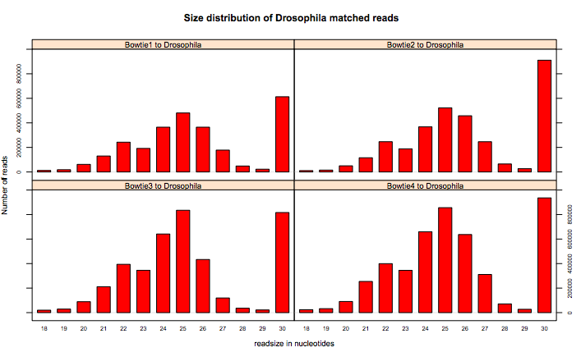

Slide 8
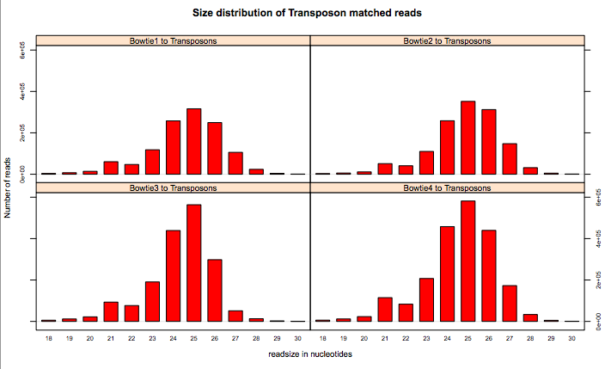

Slide 9
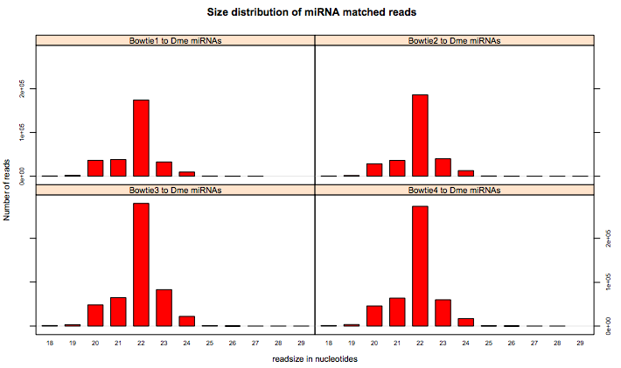

Slide 10
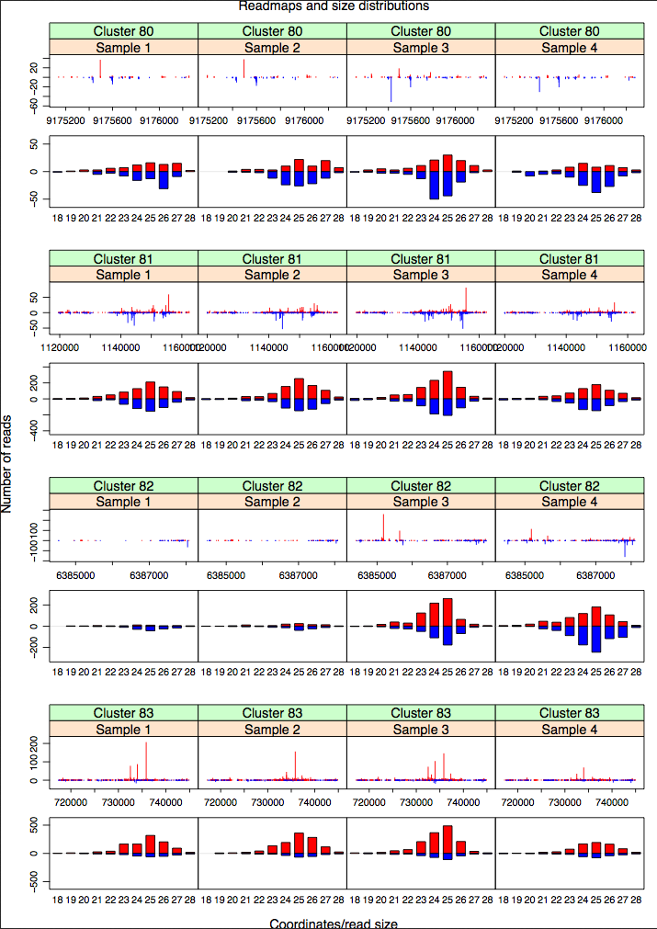
Inspecting a large number of smallRNA properties … in a few plots

Slide 12

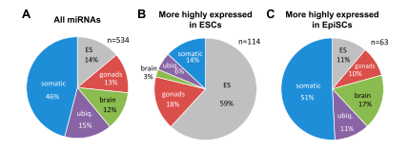
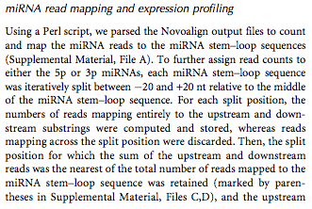
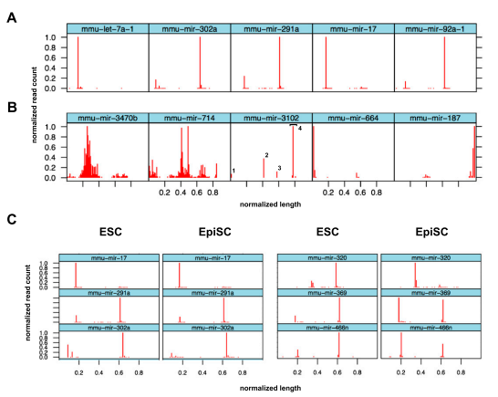

Slide 13
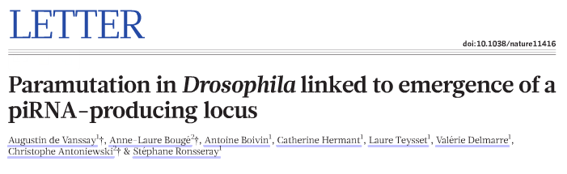
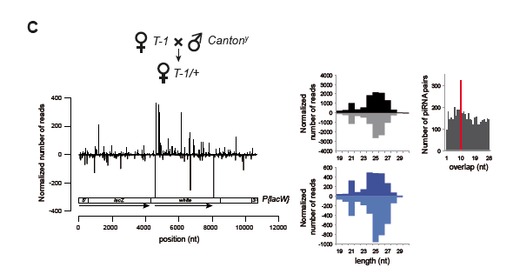
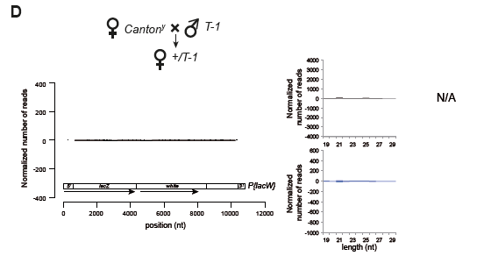

Slide 14


mississippi.fr
mississippi toolsuite in testtollshed
Poster 6
Christophe ANTONIEWSKI
Clement CARRE
Bruno DA SILVA
Margarita ANGELOVA
Safia DEDDOUCHE

