Slide 1
Galaxy in Plant Pathology: Not everything is NGS data
Peter Cock & Leighton Pritchard
Galaxy Community Conference
Lunteren, The Netherlands
25 May 2011

Slide 2
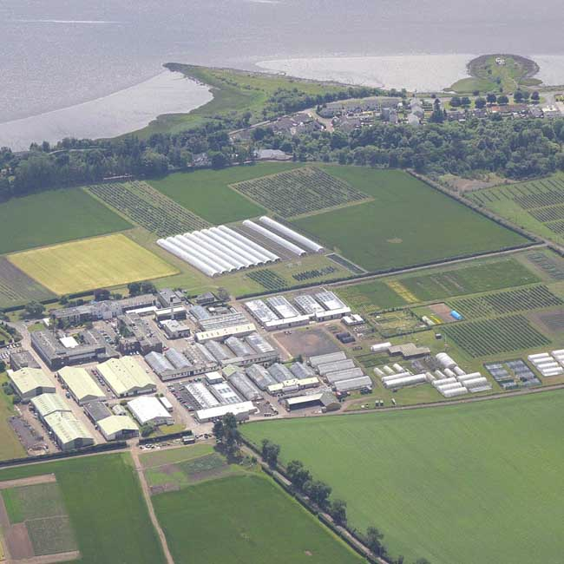
JHI Plant Pathology
We work on a range of organisms
Plant Viruses
Bacteria
Oomycetes
Fungi
Nematodes
Aphids (as virus vectors)
Many genome sequences now available
JHI Dundee site, formerly SCRI (Scottish Crop Research Institute)

Slide 3
Common themes – e.g. Effectors
I will use “effector” to mean a pathogen produced protein which in some way manipulates the host plant
The details depend on the type of organism, but we want to identify effector genes, e.g.
Similarity to known effectors (e.g. with BLAST)
Signal peptides
Localization signals
Possible horizontal gene transfer (e.g. different GC%)
Part of larger task of automated gene annotation, e.g.
HMMER or RPS-BLAST domain searches

Slide 4
Why Galaxy?
Hi Peter, could you run a big BLAST job for me?
Everyone using standalone BLAST is not practical
Want local BLAST web interface with multiple-query support
Group XXX have just published the YYY genome – could you look for ZZZ proteins please?
With a suitable interface, lots of analyses are simple enough for non-bioinformaticians to run and interpret
You remember that analysis we did last year? I want to do it again on this new genome
Running old scripts on new data is tedious
Workflows should be reproducible

Slide 5
Why Galaxy?
Could you run tool XXXX on this data please?
Getting the tool:
Many tools are Unix/Linux only (mostly Windows at JHI)
Running the tool:
Most tools lack any GUI or web interface
Using the results:
Many tools produce their own output formats
So, we run it via Galaxy instead

Slide 6
Why Galaxy?
Plus points for us:
Don’t have to worry about local software installation
Uniform web based GUI for wrapped tools
Coupling tools together as sharable repeatable workflows
Sharing the same data version (better than email/shared drives)
Open Source (extendable, free)
Almost any tool can be added
Downsides:
Missing tools (have to invest time wrapping them)
Bugs in Galaxy (both for end users and tool wrapping)
Investment in training users

Slide 7
JHI Plant Pathology Server
Dedicated Linux server (16 core, 32 GB RAM)
Wiki (general and Lab specific)
GBrowse (Genome browser)
Local BLAST databases (wwwblast)
Galaxy
PostgreSQL
Python 2.6 (not CentOS provided Python 2.4)
Compute cluster (not used yet due to firewall issues)

Slide 8
Effector Protein Analysis
Pathogen
Effector in transit:
Active effector:
Export
Injection
e.g. Type III secretion
e.g. protease inhibitors (block plant defence)
Import
Plant host
Host nucleus
e.g. transcriptional regulators
Localisation
Golgi

Slide 9
Protein Analysis Tools in our Galaxy
All take a FASTA protein file as input, return a tabular file.
Sequence similarity
BLAST
Transmembrane domains
TMHMM
Signal Peptides/Motifs
SignalP
EffectiveT3
RXLR
Nuclear Localisation
PredictNLS
NLStradamus
Nucleolus Localisation
NoD
Sub-cellular Localisation
PSORTB
WoLF PSORT

Slide 10
NCBI BLAST+
We wanted standard NCBI BLAST+ tools in Galaxy, so wrote wrappers, now included with Galaxy
Working on Reciprocal Best Hits (RBH) tool for finding putative orthologues etc (will be on Galaxy Tool Shed)

Slide 11
Protein Sequence analysis tools

Slide 12
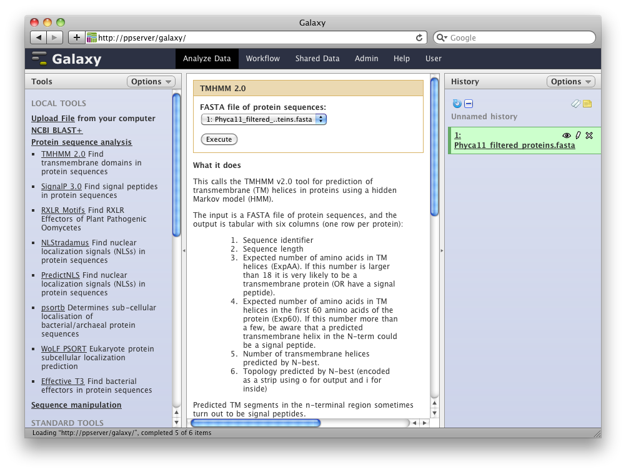
Transmembrane Domains (TMHMM)
Python wrapper around TMHMM 2.0
Converts the output into tab separated
Runs tool in parallel
Avoids 4000 sequence limit
Wrapper is on the Galaxy Tool Shed
http://www.cbs.dtu.dk/services/TMHMM/ - Sonnhammer et al. (1998), Krogh et al. (2001)

Slide 13
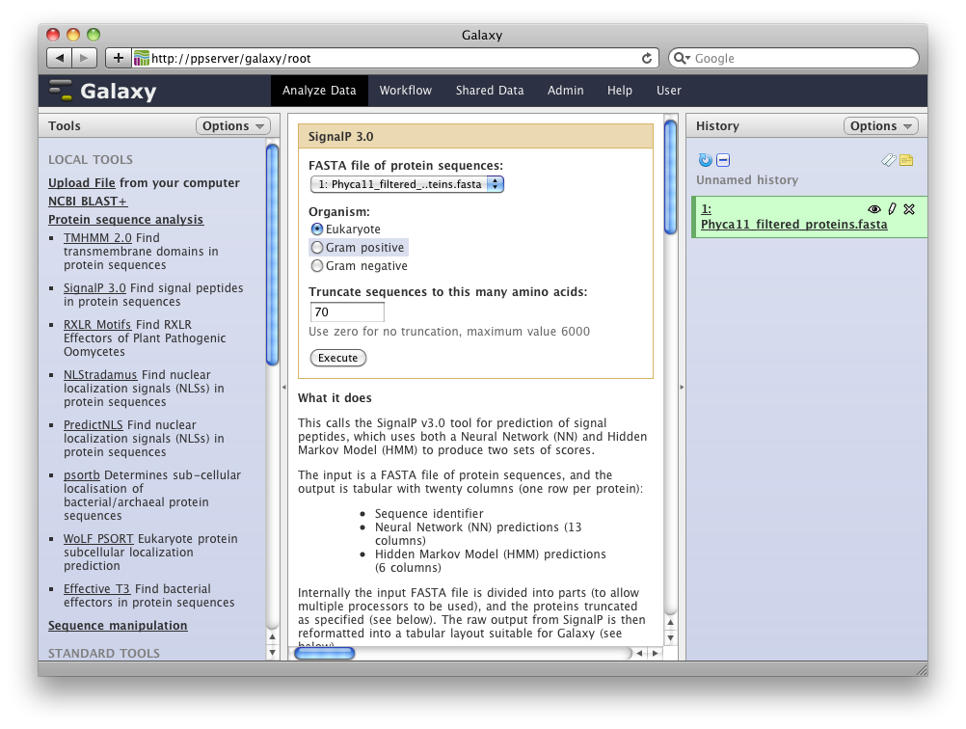
Signal Peptides (SignalP)
Python wrapper around SignalP 3.0
Converts the output into tab separated
Runs tool in parallel
Wrapper is on the Galaxy Tool Shed
http://www.cbs.dtu.dk/services/SignalP-3.0/ - Bendtsen et al. (2004)

Slide 14
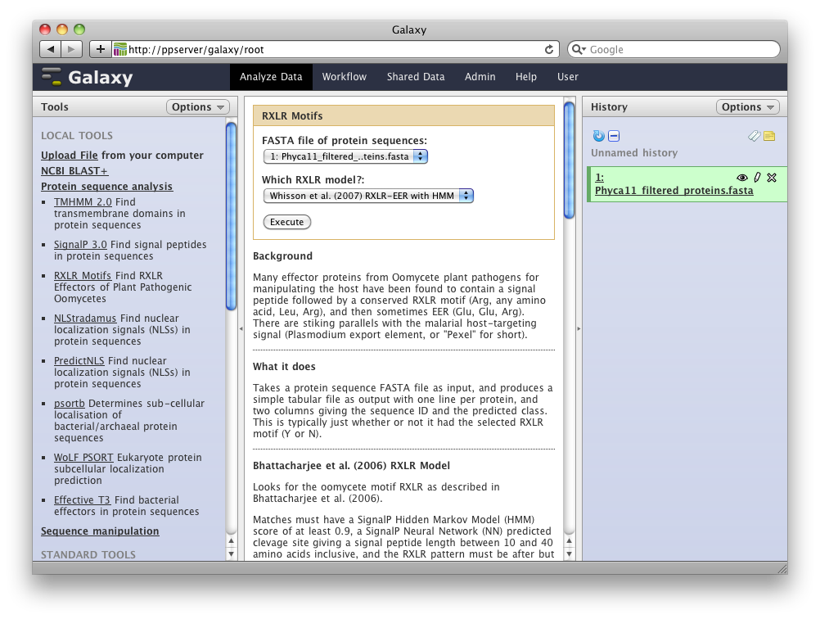
Oomycete RXLR Motifs
Python script using regular expressions, SignalP 3.0 and HMMER 2.3.2
Gives tab separated output
Uses our SignalP wrapper internally
Available on the Galaxy Tool Shed*
* Submitted 20 May 2011

Slide 15
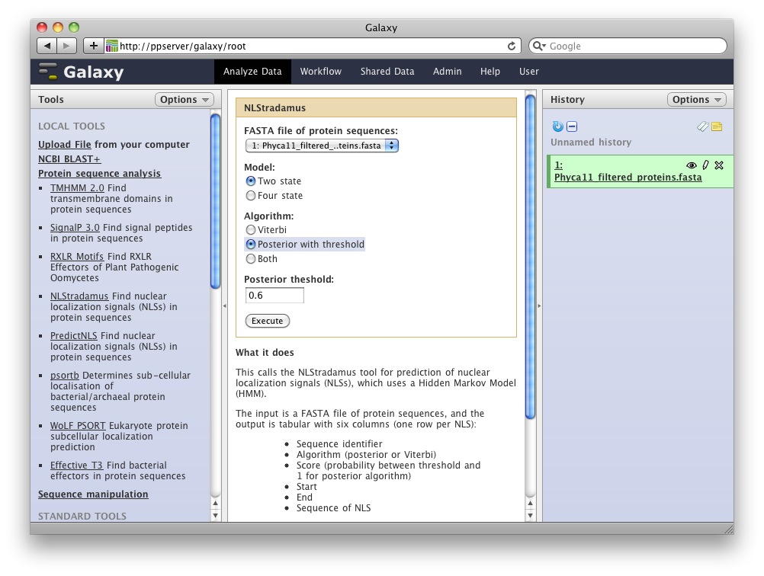
Nuclear Localisation Signals: NLStradamus
Author added tab separated output, so very simple wrapper
Wrapper is on the Galaxy Tool Shed
http://www.moseslab.csb.utoronto.ca/NLStradamus - Nguyen et al. (2009)

Slide 16
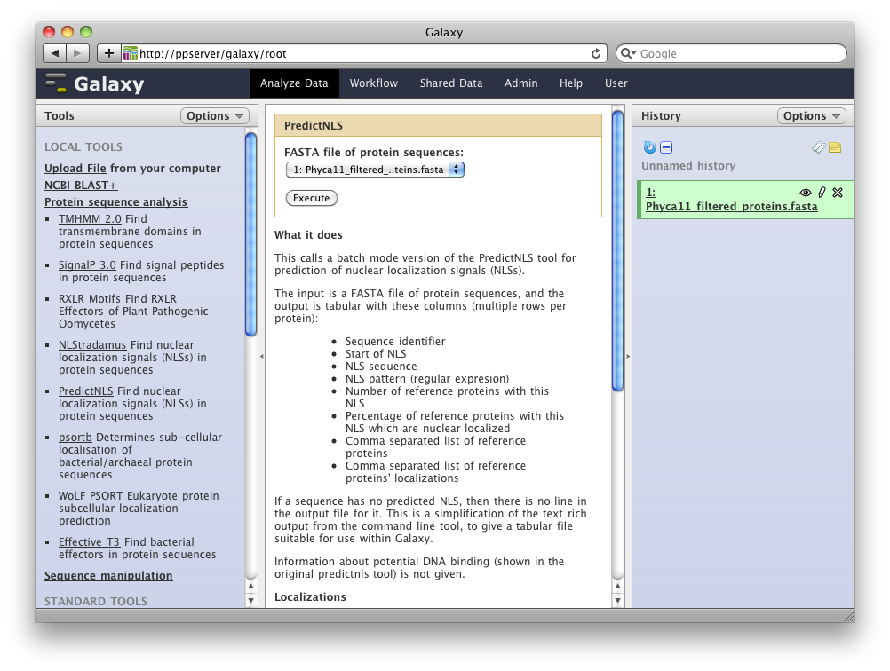
Nuclear Localisation Signals: PredictNLS
PredictNLS v1.0.17 lacks batch mode, in dialogue with Rost Lab to extend this…
Currently using own reimplementation in Python
Intend to share wrapper on the Galaxy Tool Shed
http://www.predictprotein.org/ - http://www.rostlab.org/ - Murat et al. (2000)

Slide 17
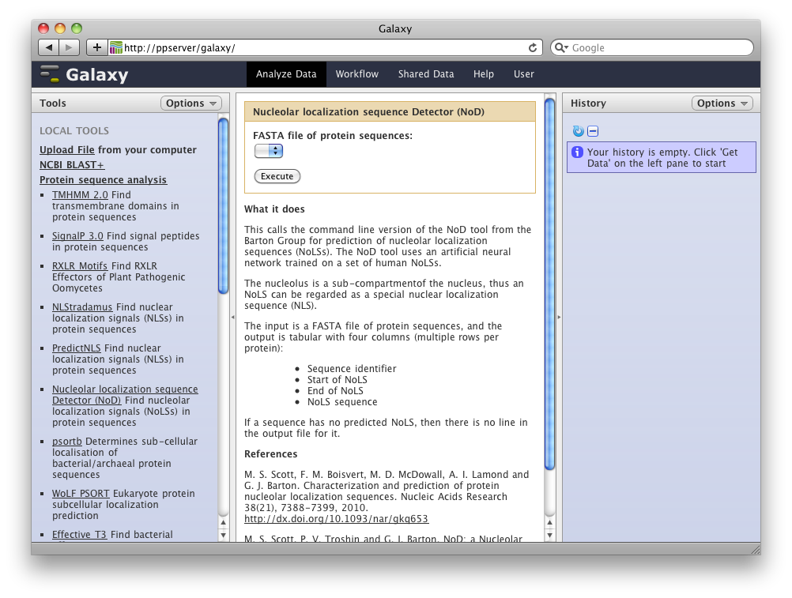
Nucleolar Localisation Signals: NoD
Author added tab separated output, so very simple wrapper
Waiting for official release of updated tool before sharing wrapper on the Galaxy Tool Shed
http://www.compbio.dundee.ac.uk/www-nod/ - Scott et al. (2010), Scott et al. (submitted)

Slide 18
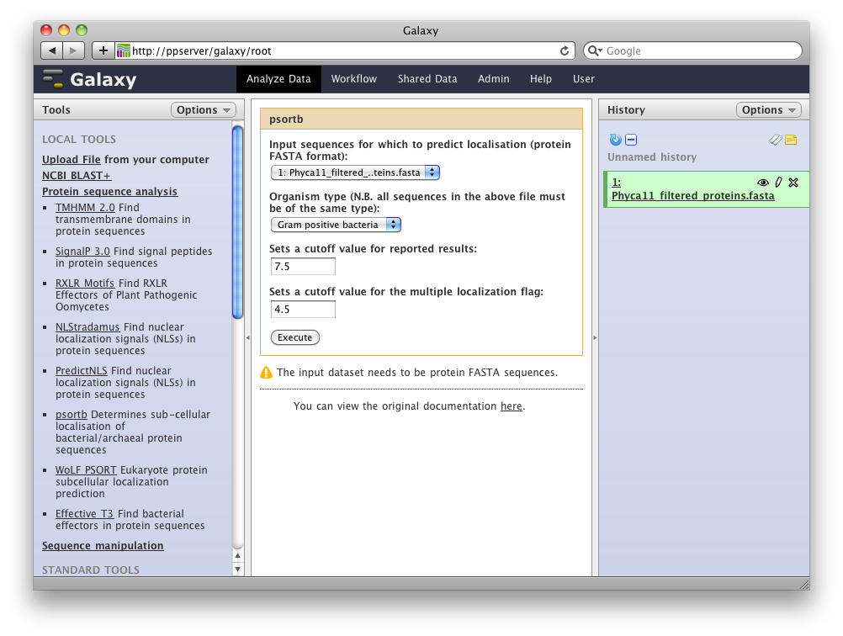
Prokaryotic Sub-cellular Localisation: PSORTb
Using Konrad Paszkiewicz’s wrapper from Galaxy Tool Shed
Tool provides tab separated output, so simple wrapper
http://www.psort.org/ - Yu et al. (2010)

Slide 19
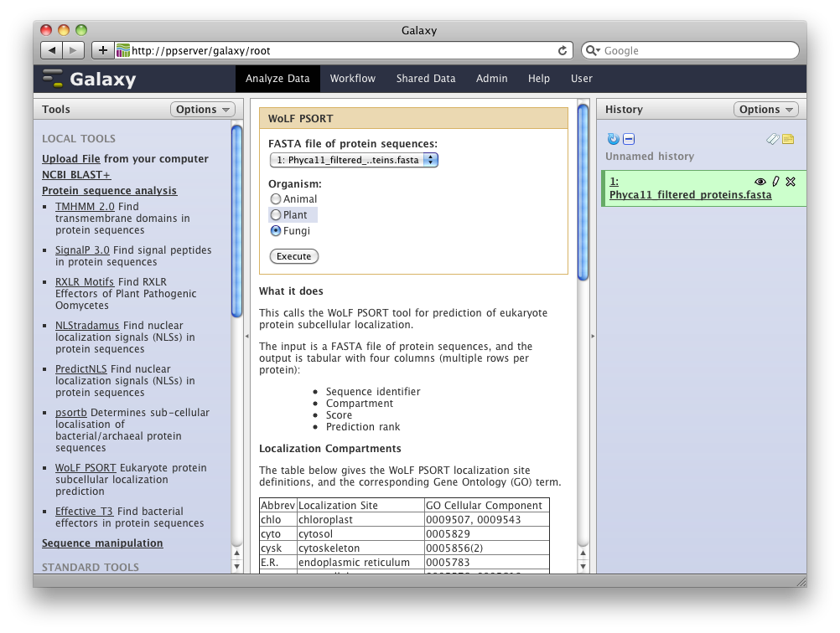
Eukaryotic Sub-cellular Localisation: WoLF PSORT
Python wrapper for WoLF PSORT 2.0
Converts the output into tab separated
Runs tool in parallel
Wrapper is on the Galaxy Tool Shed
http://wolfpsort.org/ - Horton et al. (2006), Horton et al. (2007)

Slide 20
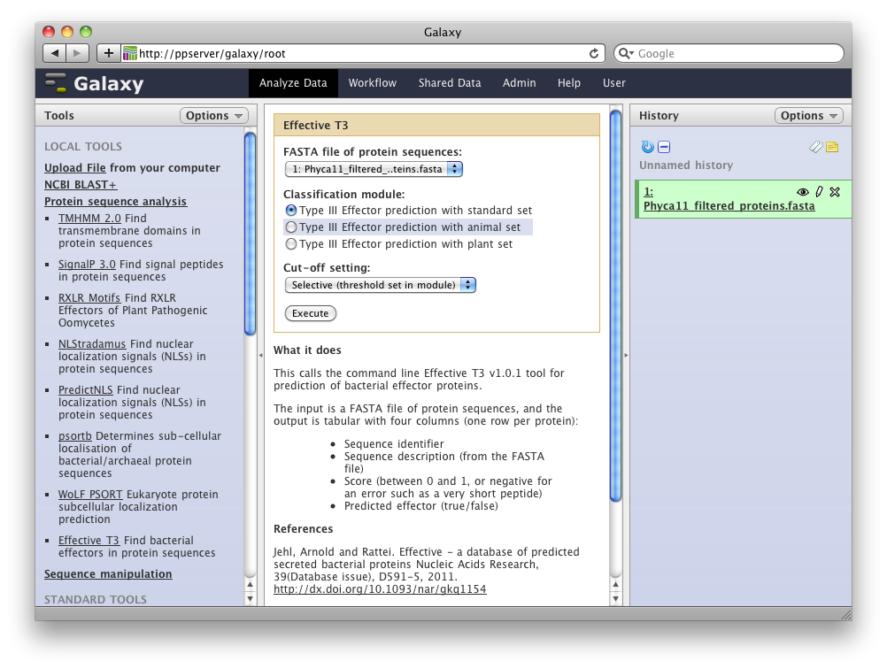
Type III Secretion Signals: EffectiveT3
Python wrapper for EffectiveT3 v1.0.1
Converts the output into tab separated
Wrapper is on the Galaxy Tool Shed*
http://effectors.org/ - Arnold et al. (2009), Jehl et al. (2011) - *Wrapper submitted 20 May 2011

Slide 21
Observations from Wrapping Tools
Tabular output for Galaxy
Most tools’ output needed reformatting
Some tools are not threaded
I use a Python wrapper script to divide the input (using subprocess rather than multiprocessing module for Python 2.4 compatibility)
Interaction with tool authors can be productive and informative, and improve their tools
To tool authors
Offer tabular output (if appropriate)
Better error handling (e.g. zero length sequences)

Slide 22
Workflow example - RXLR motifs
Important translocation motif in oomycetes
We have implemented three methods in Galaxy:
Bhattacharjee et al. (2006)
Win et al. (2007)
Whisson et al. (2007)
Venn Diagram comparing the three methods

Slide 23
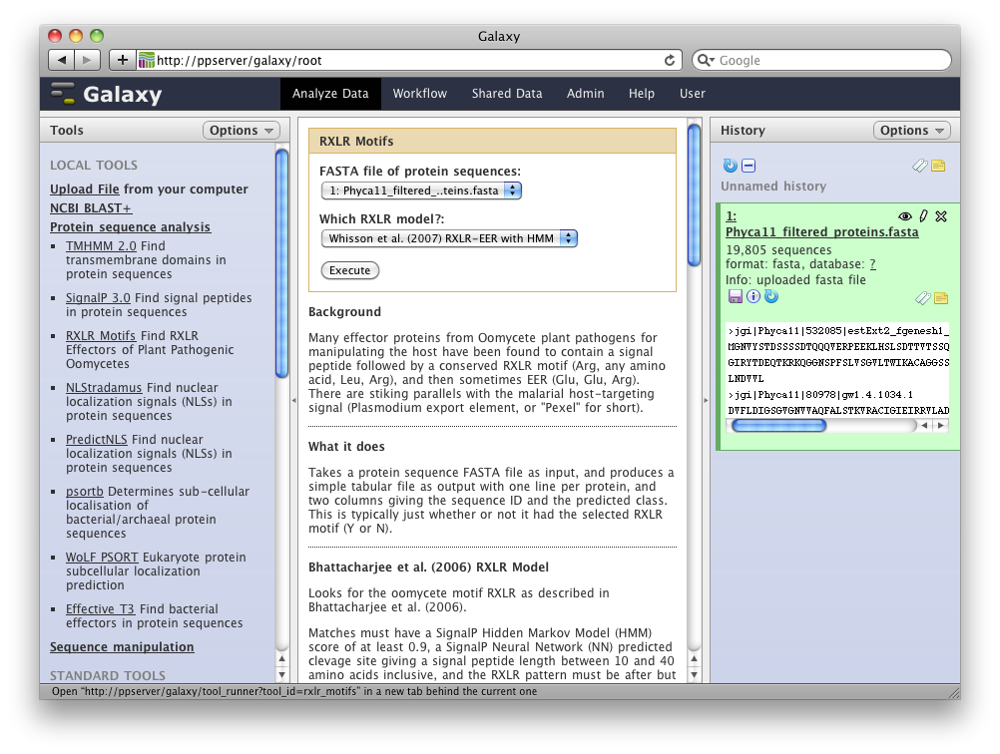

Slide 24
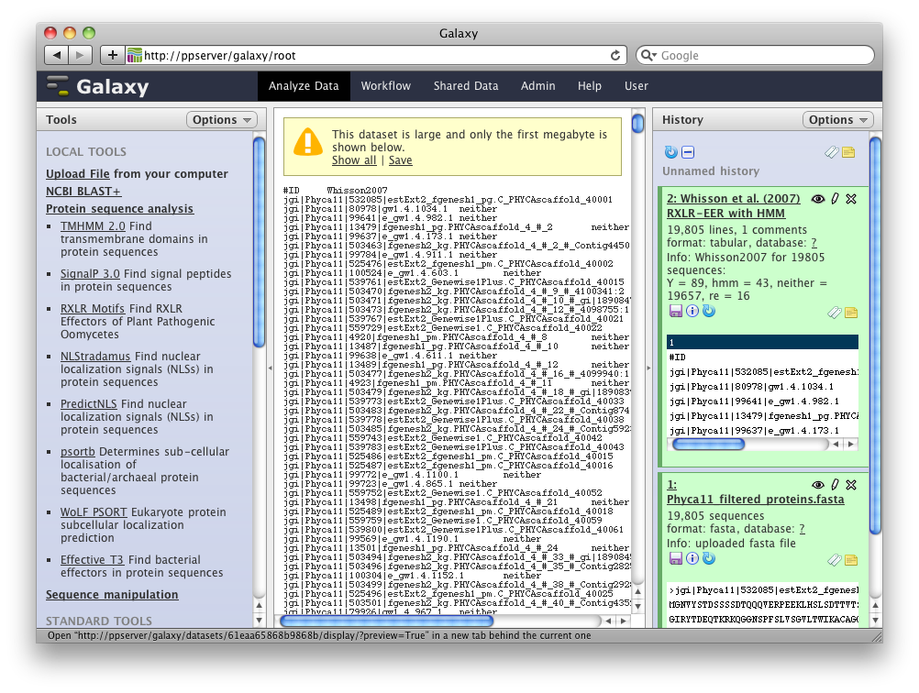

Slide 25
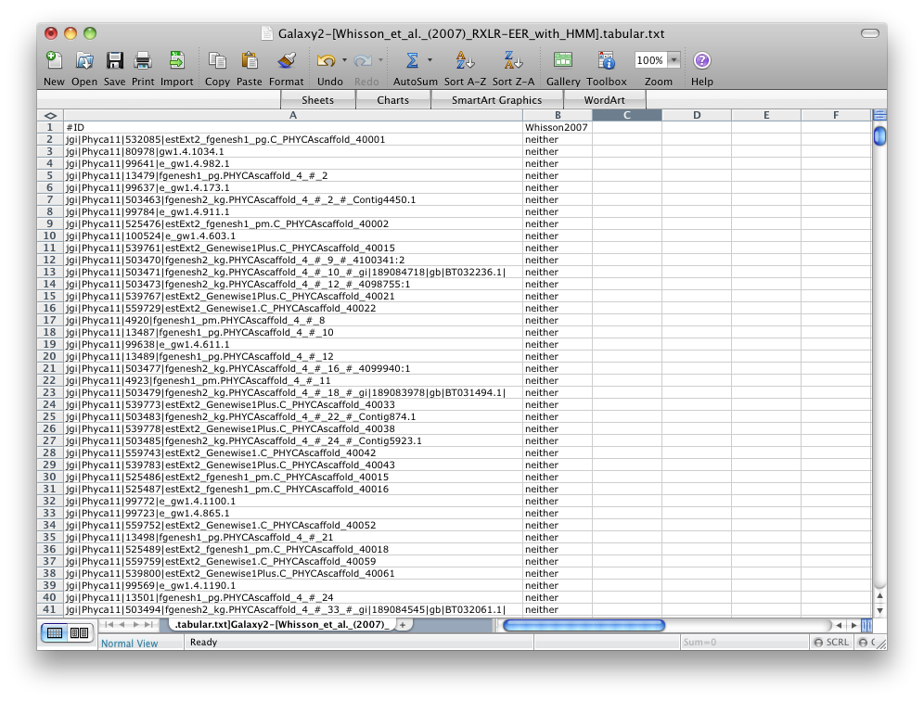

Slide 26
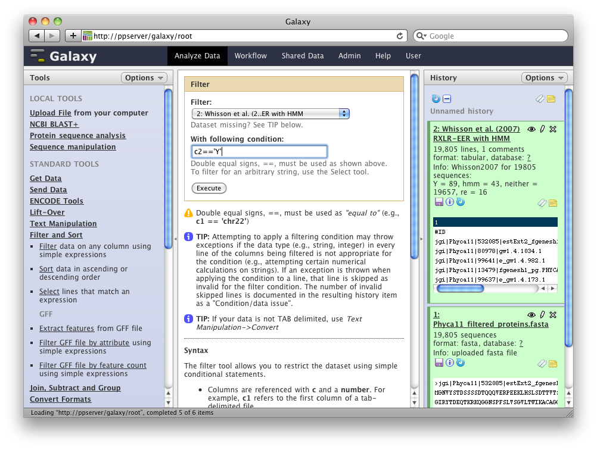

Slide 27
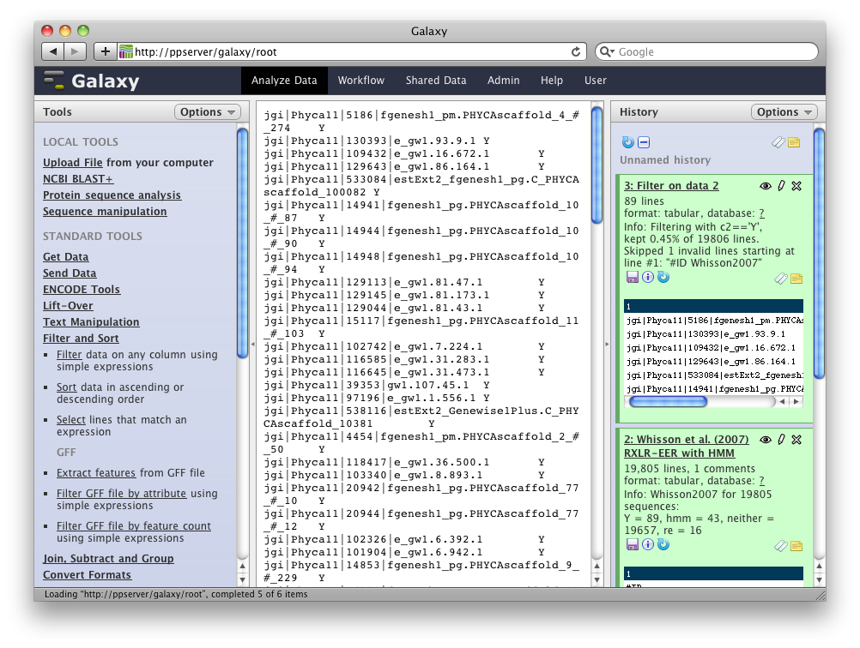

Slide 28
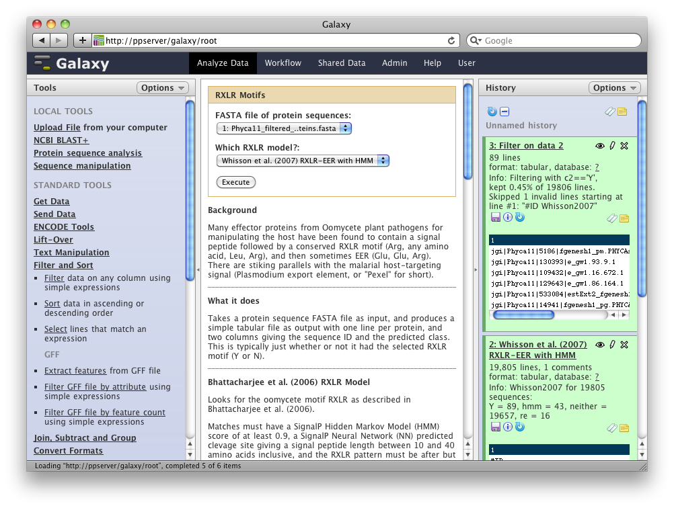

Slide 30
Next few steps omitted…
Repeated RXLR search & filter using other two models
Labelled some history entries

Slide 31
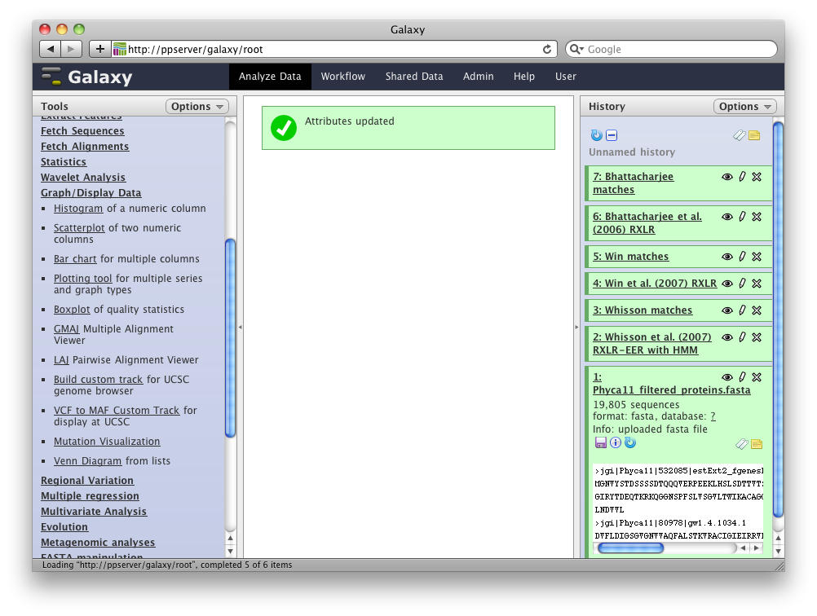
Python script using rpy
R library limma handles the plotting
Wrapper is on the Galaxy Tool Shed

Slide 32
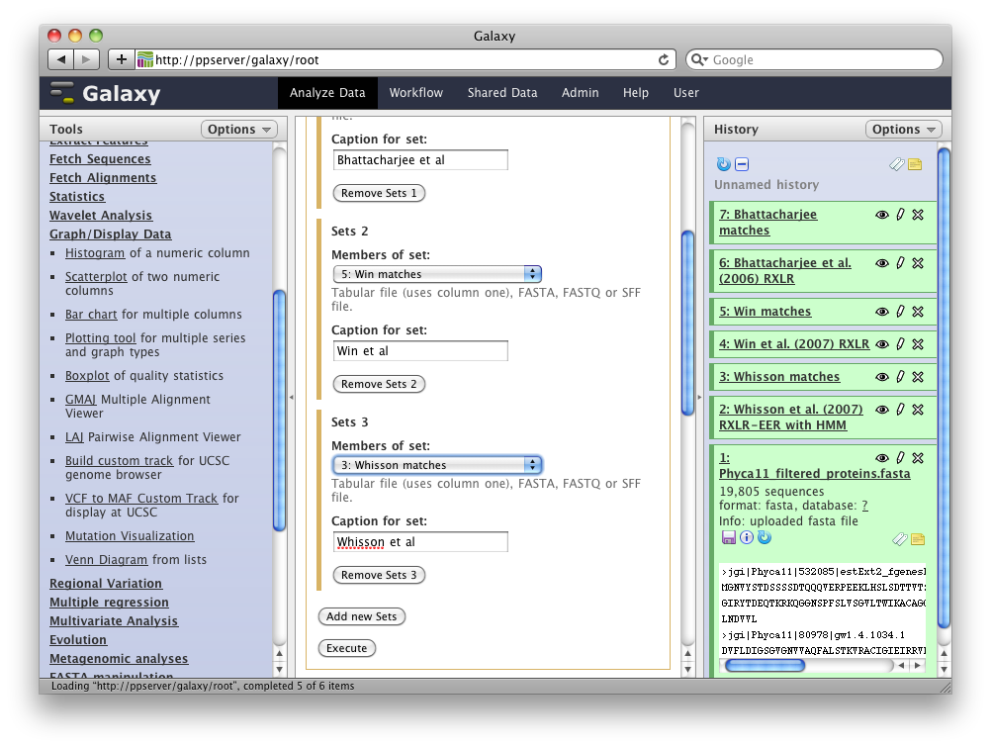

Slide 33
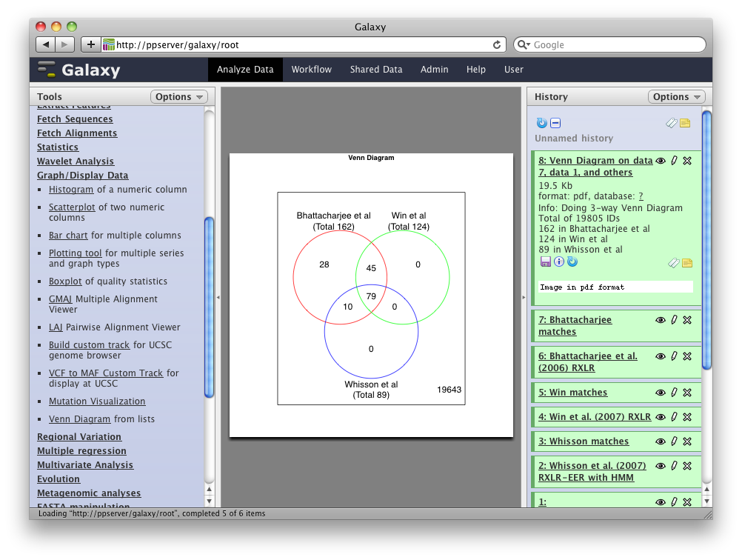

Slide 34
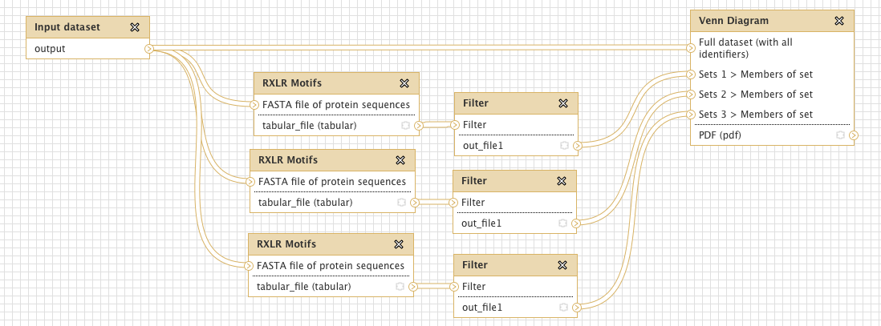
Repeating analysis as a Workflow

Slide 35
RXLRs in Phytophthora draft genomes
P. capsici
(19,805 proteins)
P. sojae
(19,027 proteins)
P. ramorum
(15,743 proteins)

Slide 36
Example – Finding effector proteins
Start with a FASTA file of proteins
Run signal peptide prediction
Select proteins with signal peptide
Run transmembrane prediction
Select proteins without transmembrane (TM) domains
Get FASTA file of proteins with signal peptide but not TM

Slide 37
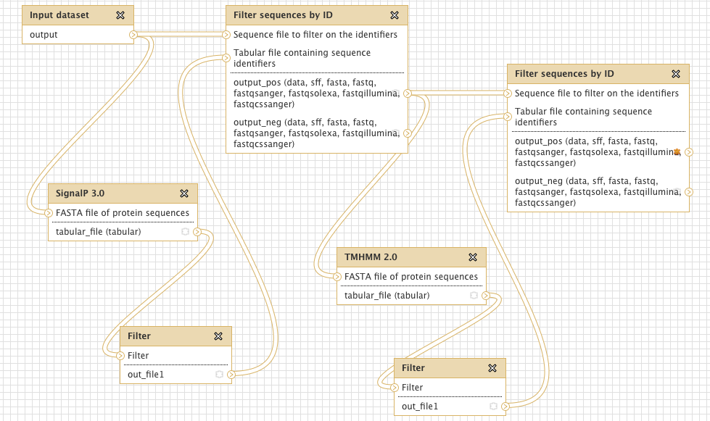
Workflow Editor – Effector finding

Slide 38
Acknowledgements
Helpful tool authors:
Alex Nguyen (NLStradamus)
Laszlo Kajan (PredictNLS)
Peter Troshin, Michelle Scott (NoD)
JHI Testers:
John Jones, Remco Stam, Julietta Jupe
The Galaxy Developers & mailing list community

