Slide 1
Deploying Galaxy for use with High Throughput Screening
Grainne Kerr
Signaling and Functional Genomics

Slide 2
RNA interference (RNAi)
dsRNA (>27 nt)
Dicer
siRNA (18 – 21 nt)
RISCs
RISC targets homologous mRNA
Targeted degradation

Slide 3
RNAi and Screening
Target genes with
  Long double stranded DNA (dsDNA)
  Small interfering DNA (siDNA)
Success depends on:
  Specificity (homology to target and non-targets, interferon response, concentration dependant cytotoxic responses)
  Efficiency (GC content, repeats, target site accessibility etc)
Gene silencing – a reverse engineering approach
Notes:
Efficiency:
GC conent (30 – 52%)
Low internal stability at sese strand 3’ terminus
Absense of inverted repeats
Base preferences at certain positions
Chemical modifications
Target site accessibilty
Specificity (sequence independent)
Interforn response
Concentration dependent effects
Specificity (sequence dependant)
Perfect homogy to unintended transcripts
Perfect homology to ‘seed’
Imperfect homology
Genome wide RNAi experiments – two functions really:
1 – for screens – the goal is identification of a few new core components of specifically designed assay – then they will be taken forward for more in depth research
2 – for surveys – the aim here is the systematic mapping of phenotypic profiles and possible genetic interaction networks.

Slide 4
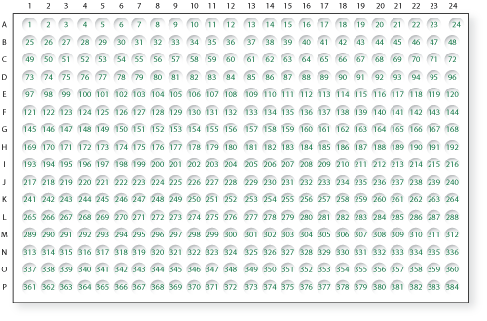
High Throughput Screening
Systematic silencing of whole genome
  Every gene is targeted.
  Phenotypic luminescence readout
Notes:
Experimental perturbations on a genome wide scale….
Phenotype readout – typically a fluorescence readout ….

Slide 5
Experimental Steps
RNAi Library Design
Library Annotation
Genome Annotation
Cell based assay format
Screen Description
Plate List
Plate Config
Large scale experiment
Screen Data Files
Screen Log Files
Computational analysis
Analysis Reports

Slide 6
Experimental Steps
RNAi Library Design
Library Annotation
Genome Annotation
Cell based assay format
Screen Description
Plate List
Plate Config
Large scale experiment
Screen Data Files
Screen Log Files
Computational analysis
Analysis Reports
Notes:
Obvious that there is a lot of manipulation of files and data between steps
Library annotation files….
Values for each gene, in replicates ….
Design of siRNA or dsRNA reagents
Normalization of plates
Determination of significant changes in phenotype
Grouping and finding patterns in the significant hits
Long term storage, retrieval and presentation of results

Slide 7
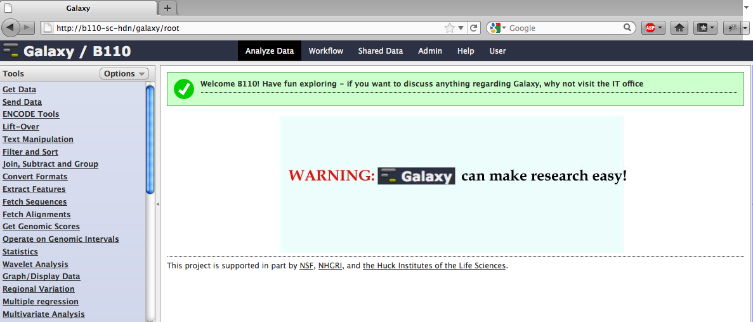
Galaxy’s role in HTS
Glues different stages together

Slide 8
Computational Analysis
Design of siRNA or dsRNA reagents
Normalization of plates
Determination of significant changes in phenotype
Grouping and finding patterns in the significant hits
Retrieval and presentation of results

Slide 9



Overview
Design of reagents
Analysis of the read-out data
Selecting and analysis of “hit” genes

Slide 10
NEXT RNAi
Automated design and evaluation of RNAi sequences on a genome wide scale
Thomas Horn, Thomas Sandmann and Michael Boutros.
Design and evaluation of genome-wide libraries for RNAi screens. Genome Biol. 2010 Jun 15;11(6):R61.

Slide 11
NEXT-RNAi Workflow
Target sequence
Feature tables
Low-complexity filter
In silico dicing
Prediction of specificity and efficiency
Discarding of siRNAs below threshold
Design of long dsRNAs primers
Ranking of designs
Homology, feature and genome mapping
Flat files, HTML report, GBrowse

Slide 12
NEXT RNAi Input and dependencies
Fasta file of target sequences
Target-group file (e.g. SNP’s, transcript variants)
Requirements:
  Bowtie – sequence specificity
  Primer3 – evaluate the primers
Optional
  BLAST
  BLAT – align longer sequences
  RNAfold – evaluate the 3d structure
  Mdust – evaluate primer sequences
Notes:
NEXT RNAI is a powerful workflow that does a lot.

Slide 13
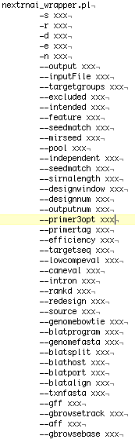
NEXT RNAi in Galaxy
Why Galaxy?
  Number of input parameters
  Number of dependent choices
  Guidance of choices – conditional inputs in Galaxy
  GUI - Not command line
  Incorporation into workflows

Slide 14
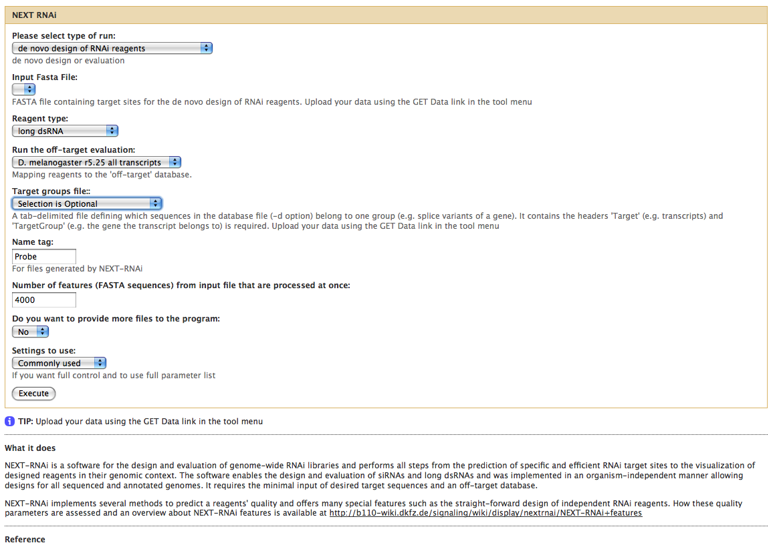
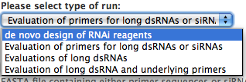

NEXT RNAi in Galaxy
Notes:
Guides the user threw the maze of inputs
The more complicated parameters are hidden from the user until required.

Slide 15
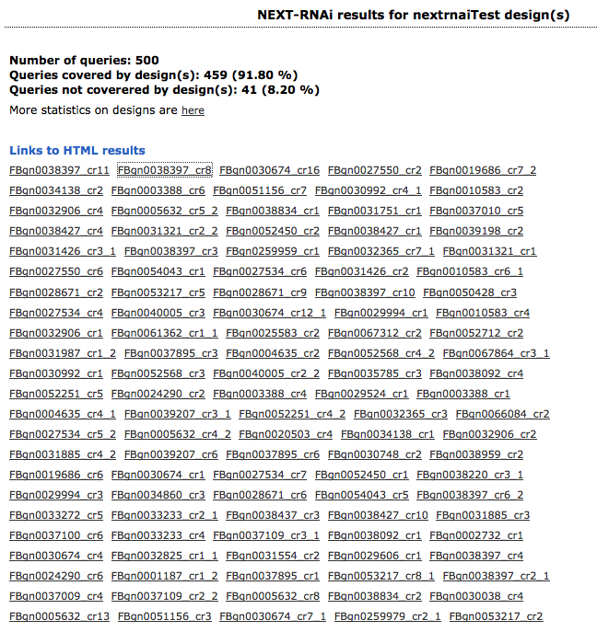
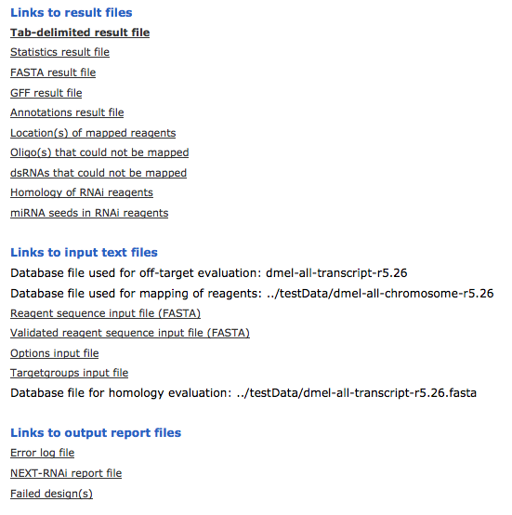
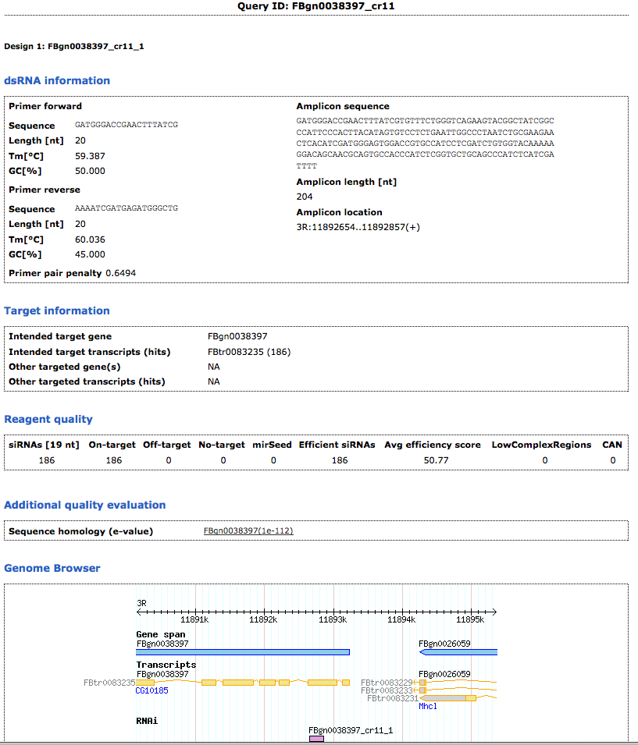
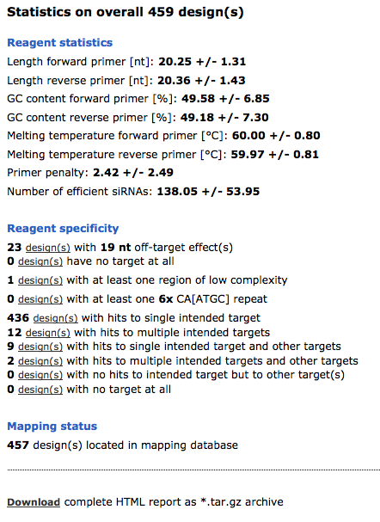
NEXT-RNAI Output
Notes:
Outputs – tab delimited text file, comprehensive html report, including a graphical display of designs in gbrowse.
Furhter information is given in GFF and fasta files.
Note – a lot of information

Slide 16
NEXT RNAi in Galaxy Summary
Allows for the rapid batch design of RNAi libraries for:
  Genome wide set
  Defined batch of genes
Evaluation of commercial libraries
Re-evaluation of libraries with release of updated genome annotation
Notes:
There are tools available to design dsRNA’s or siRNAs on a gene by gene basis – but this is different as it allows the user to do it in a rapid and high throughput manner.
Uses multiple parameters, not just sequence specificity.
Can be used to create multiple siRNAs per gene to give independent phenotypes.
Reannotation of libraries – when updated genome annotation is released….

Slide 17
cellHTS
Systematic analysis of screens
  Phenotypic results range from single numerical value to multiple dimensional images
Standardization of experimental information
Standardization of analysis
Boutros, M., L. Bras, and W. Huber. (2006). Analysis of cell-based RNAi screens. Genome Biology 7:R66.
Notes:
Standardisation of analysis within the lab possible – no home custom remedies – makes integration possible

Slide 18
cellHTS
Import raw data files
Per plate quality control
Data normalization
Scoring of phenotypes
Annotation and analysis
Notes:
Raw data files = the row / well / luminesence value from reader. There is 1 file for each replicate measurement per plate. There is usually a separate set of files for each reporter.

Slide 19
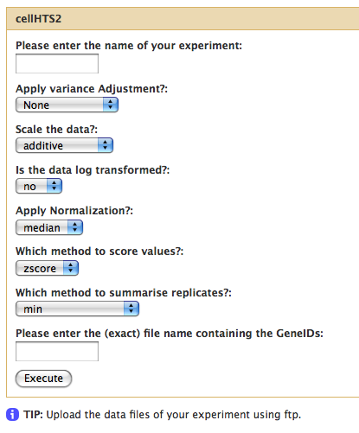
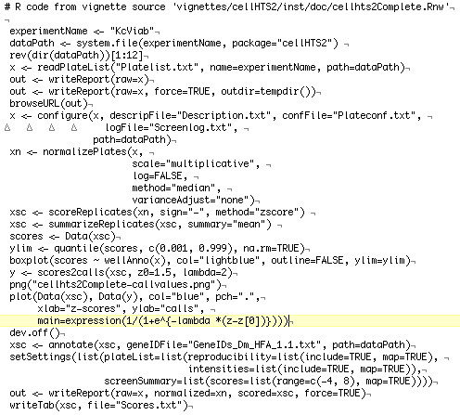
cellHTS in Galaxy
Vs.

Slide 20
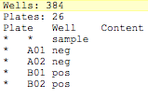
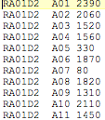
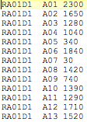
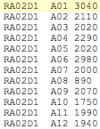
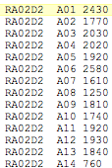
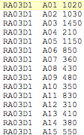
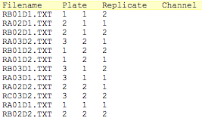
cellHTS in Galaxy
Notes:
Cell HTS is good – but need to input a lot of files

Slide 21
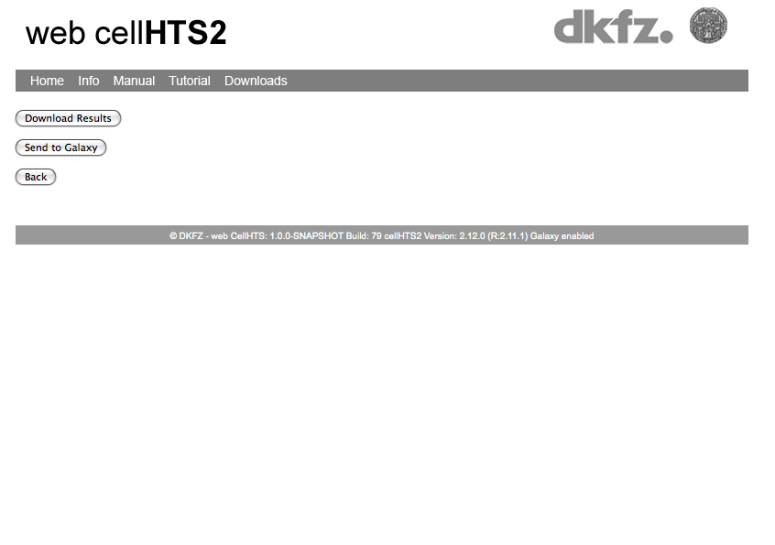
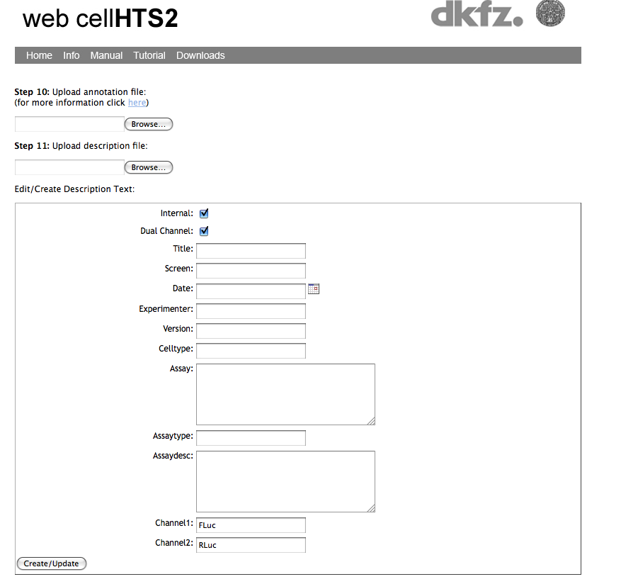
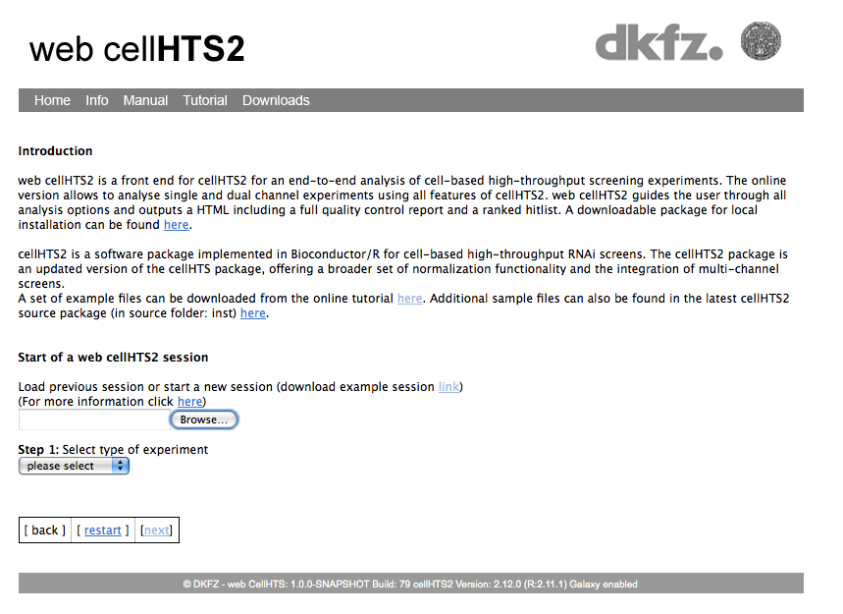
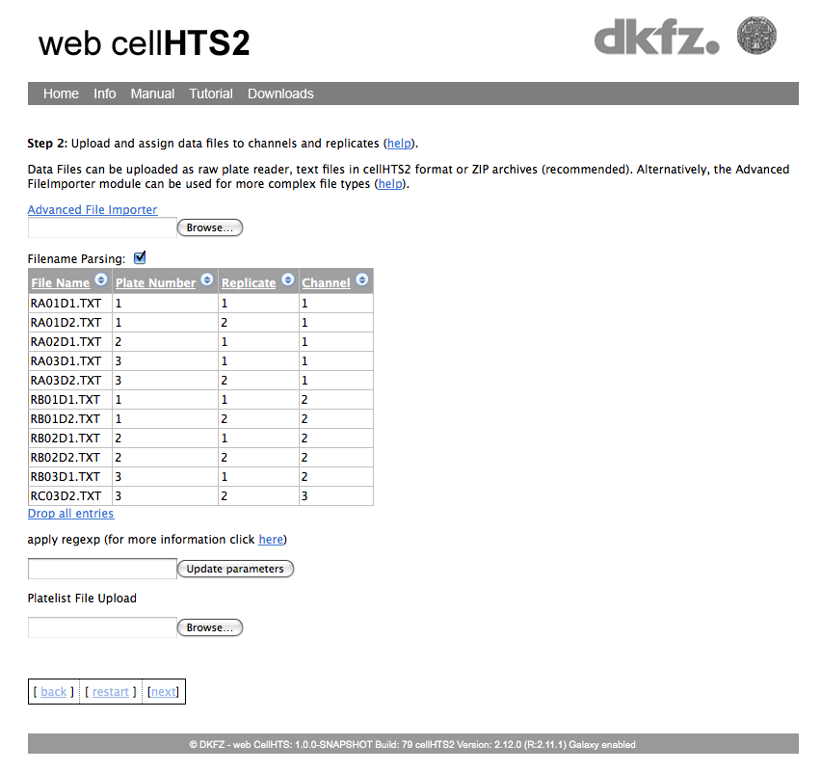
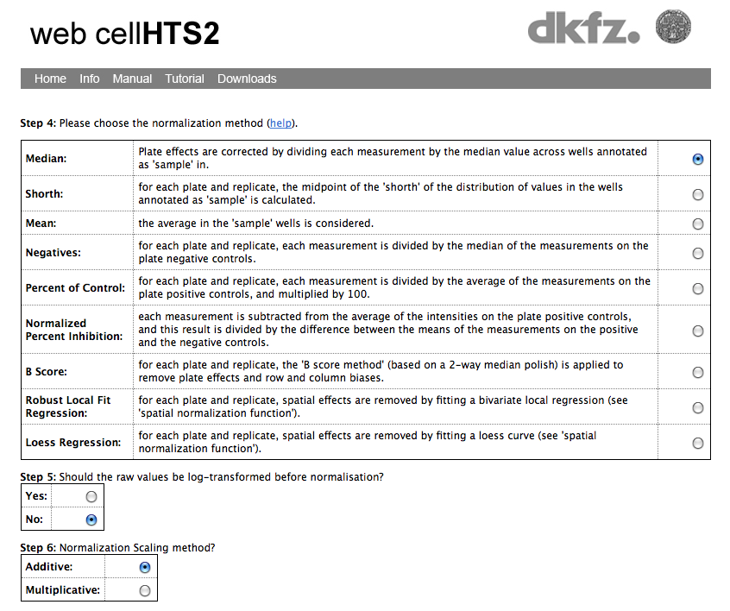
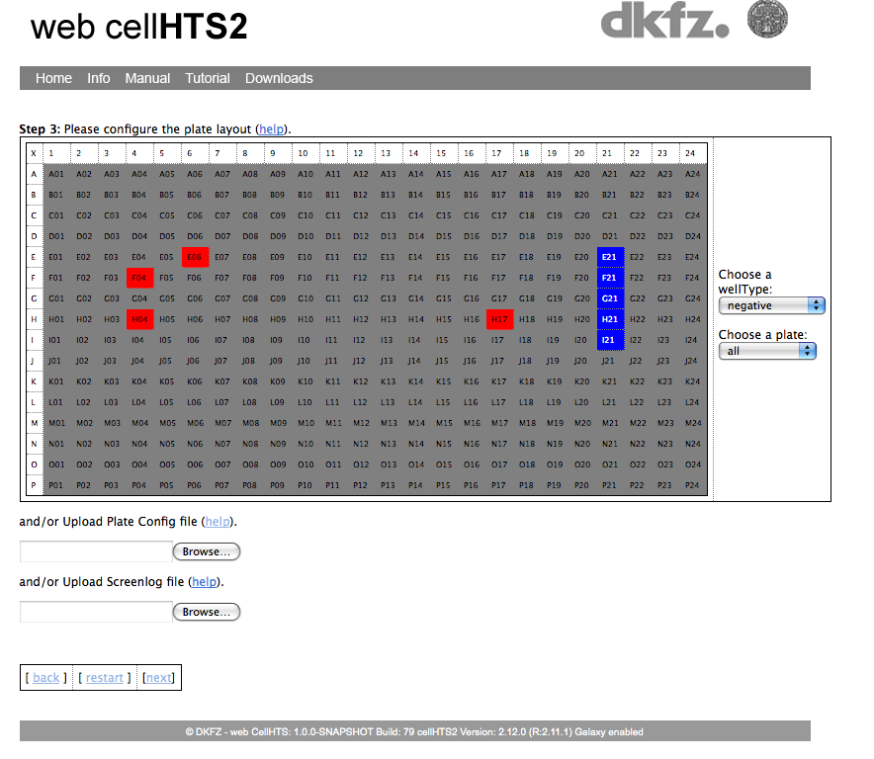
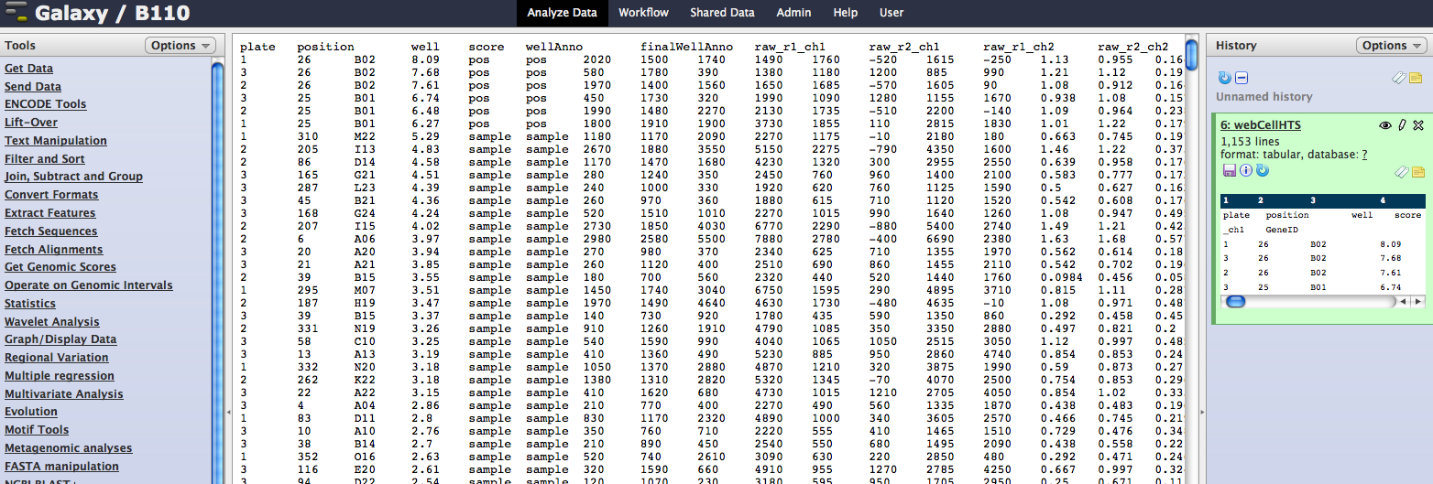
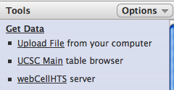
webcellHTS
Web based interactive guide to create input files.
Notes:
Creation of input files is error prone and daunting for the novice user, and prone to errors. This is a user friendly interface to doing creating the files. Guides the user through the steps.

Slide 22
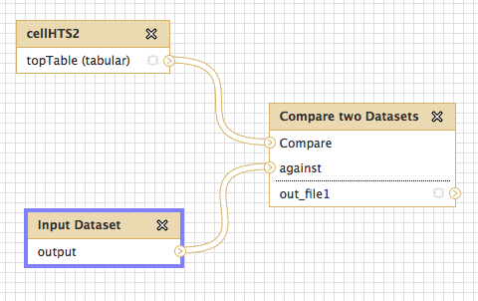
HTS Workflows
Annotation Libraries storage

Slide 23
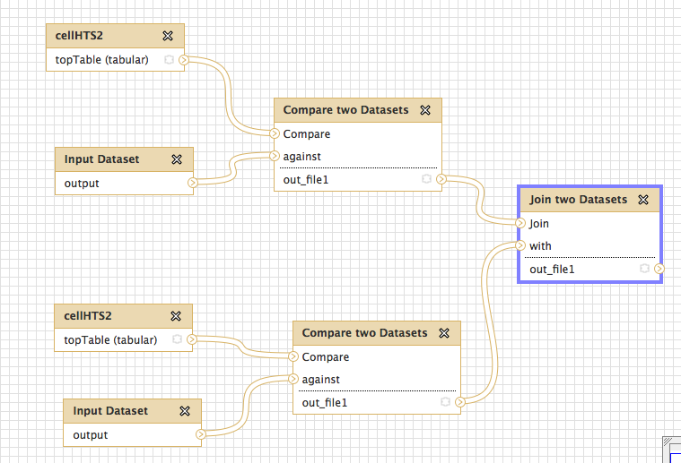
HTS Workflows
Standardizing analysis

Slide 24
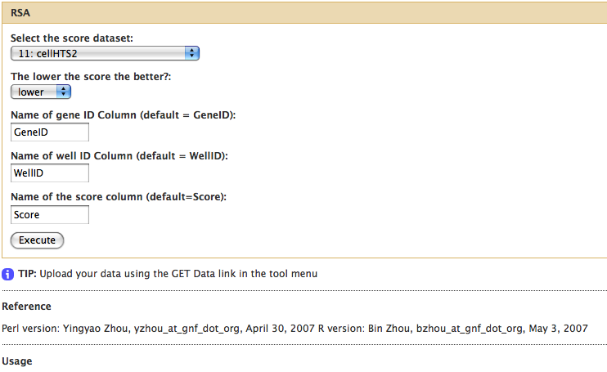
HTS Workflows
Incorporation with other specific screening analysis tools e.g. Redundant siRNA activity analysis (RSA)
König et al. A probability based approach for the analysis of large-scale RNAi screens, Nature Methods, 2007
Notes:
e.g. cell HTS -> RSA -> join with data libraries, join with data from other screens.
Very complicated analysis being simplified greatly into a few steps …
RSA written in perl, cellHTS written in R – no problem…..
Check for viability and/or effect……
“Present analysis methodologies for large scale RNAi datasets typically rely on ranking screening data and are based on singel siRNA activity or significance value.
These analysis focus on the identification of highly active siRNAs (wells), which tupcally fall within the top 1% of the assayed activities and ignore much of the remainder of the dataset. Furthermore these strategies do not exploit redundancies in the genome-sclae libraries, which typically contain 2-4 siRNAs per gene. Thus, it is difficult to systematically identify genes for which multiple siRNAs are active across a screen, which do not fall within an upper threshold (i.e. a moderately active siRNA).” Koenig et al. Nature Methods

Slide 25
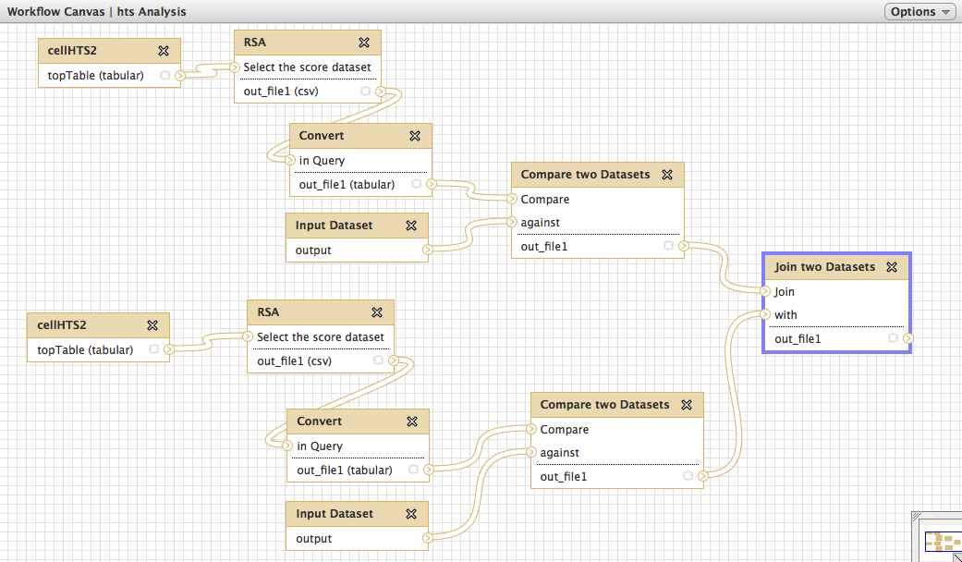
HTS Workflows

Slide 26
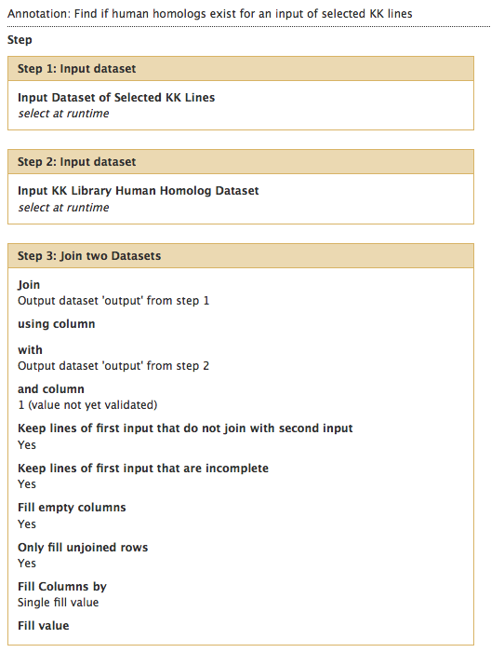
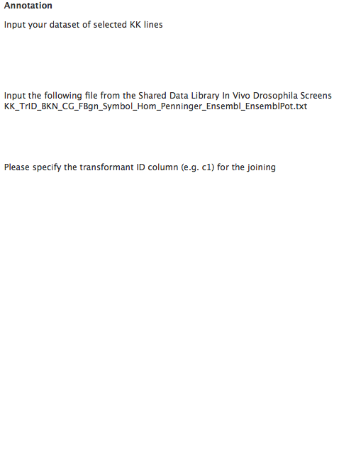
HTS Workflows
Notes:
Simple joins are very useful!!!

Slide 27

Outlook
Continue to develop and improve tools
Expand tools to deal with wider range of screen data e.g. double knockdowns
Training courses to develop familiarity with other tools Galaxy has to offer

Slide 28
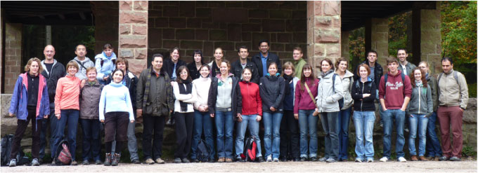
Acknowledgements
Michael Boutros
Thomas Horn
Chen Chen
Oliver Pelz
Thomas Sandmann
The IT team in Signaling and Functional Genomics

