Slide 1
Extension of Galaxy to Utilize Web Services and A Semantic Suggestion Engine
Alok Dhamanaskar, Akshay Choche, Michael E. Cotterell, Jie Zheng, Christian Stoeckert Jr., Jessica C. Kissinger and John A. Miller
University of Georgia and University of Pennsylvania, USA
Alok
Dhamanaskar
Akshay
Choche
Michael
Cotterell
Chris
Stoeckert
John
Miller

Slide 2
The Motivation:
Galaxy is currently restricted to tools/data resources that are wrapped specifically for Galaxy and manually added either via and tool wrapper and addition to tools_conf.xml or addition via the tool shed.
Wouldn’t it be nice if Galaxy could utilize any tool that is publicly exposed via a Web service with just a click?

Slide 3
What are Web services?
A web service is any piece of software that makes itself available over the internet and uses a standardized XML messaging system. XML is used to encode all communications to a web service. For example, a client invokes a web service by sending an XML message, then waits for a corresponding XML response. Because all communication is in XML, web services are not tied to any one operating system or programming language--Java can talk with Perl; Windows applications can talk with Unix applications.
Web services come in two flavors:
SOAP services described by WSDL XML documents
RESTful services described by WADL XML documents
Notes:
This is just like tools in Galaxy that are wrapped with XML

Slide 4
http://www.biocatalogue.org

Slide 5
Enabling Galaxy to Invoke Web services
Prerequisites:
SSH/Terminal Access to Galaxy Installation
Java 7 SE or EE (Oracle or OpenJDK)
Python 2.6+
JPype Python Library
Notes:
Python 2.6+ shouldn’t be a problem because that’s the minimal version that Galaxy requires.
JPype can usually be easily installed using your system’s package manager (e.g., “yum install” on Redhat or Fedora based systems and “apt-get install” on Debian or Ubuntu based systems). Otherwise, it can be compiled from source.

Slide 6
Enabling Galaxy to Invoke Web services
Installation is Easy!
1. Set Environment Variables
Notes:
Heads Up - The towheaded boy is known as "Vault Boy" from the popular video game series "Fallout." He's here to walk us through the installation process.
In order for the installation script to work, the JAVA_HOME and GALAXY_HOME environment variables need to be set. They are used by our tool to disambiguate path information when running scripts and Java programs.
In the screenshot, $(pwd) just means put the value of the pwd command here. pwd stands for "present working directory." Since we're in the Galaxy directory in the screenshot, using $(pwd) in the "export" command is an easy way to set the environment variable. If you know the full path to your Galaxy installation, you can use that instead.
Note: You may want to add these exports to the .profile file of the user used to launch Galaxy. Otherwise, you'll need to modify your run.sh file.

Slide 7
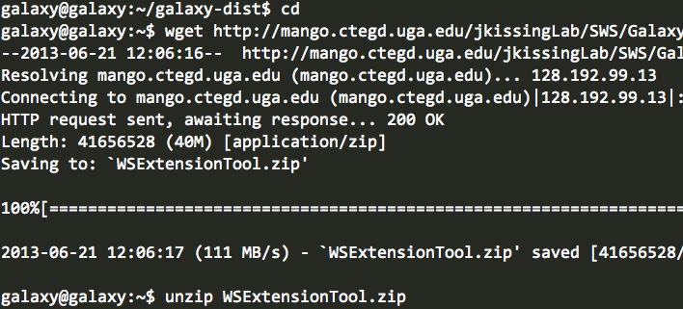
Enabling Galaxy to Invoke Web services
Installation is Easy!
1. Set Environment Variables
2. Download Installation Script
Notes:
Downloading the script it easy.
Visit our website and copy the download URL.
Download the zip file directly to your Galaxy server using a tool like wget OR download the zip file to your computer and upload it to your Galaxy server.
Unzip the zip file…

Slide 8
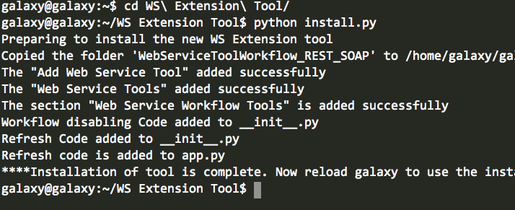
Enabling Galaxy to Invoke Web services
Installation is Easy!
1. Set Environment Variables
2. Download Installation Script
3. Run Installation Script
Notes:
“cd”/Go into the installation directory and execute the installation script.
Follow the prompts to install the tool!

Slide 9
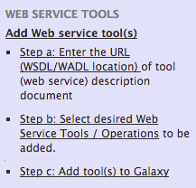
Enabling Galaxy to Invoke Web services
Installation is Easy!
1. Set Environment Variables
2. Download Installation Script
3. Run Installation Script
Now the Web Service tool
has been installed and added
to Galaxy’s tool_conf.xml file.
tool_conf.xml
However, you need to
Restart Galaxy
for tool_conf.xml changes to take effect!
Web Service Tool
Notes:
“cd”/Go into the installation directory and execute the installation script.
Follow the prompts to install the tool!

Slide 10
Enabling Galaxy to Invoke Web services
Installation is Easy!
1. Set Environment Variables
2. Download Installation Script
3. Run Installation Script
Now the Web Service tool
has been installed and added
to Galaxy’s tool_conf.xml file.
tool_conf.xml
However, you need to
Restart Galaxy
for tool_conf.xml changes to take effect!
Web Service Tool
Notes:
“cd”/Go into the installation directory and execute the installation script.
Follow the prompts to install the tool!

Slide 11
Galaxy
Architecture
with
Web Services
tool_conf.xml
Web Service Python Script
Workflow Client
XMLs
JPype
Web Service Invocation Library
Web Service
Galaxy
JVM
Web
Notes:
Slide Organization – The different areas of the slide represent the realm of each component when a workflow is run. JVM = Java Virtual Machine
tool_conf.xml – The file, already included in Galaxy, that is used to define the list of tools displayed on the left-hand side of the Galaxy UI as well as point to the individual tool XML files.
Workflow Client XMLs – Tool wrappers for the individual Web service “operations” that have been added by our “Add Web Service” tool. These files describe the mandatory and optional inputs and outputs of the individual Web service operations as described in their Web service’s WSDL/SAWSDL or WADL/SAWADL document. These XML files all point to a single Python script (described below) that gets run in order to invoke the Web service operation when a workflow is run. These XML files are stored in a subdirectory under the tools directory within Galaxy.
JPype – A Python library that enables scripts to startup a JVM and execute code contained in Java programs/libraries. This approach was taken because (to the best of the development teams knowledge) Java has more mature, generic Web service invocation libraries than Python.
Web Service – A Web service containing an operation (can be thought of as a “tool” in the Galaxy sense) you wish to invoke.
The benefits of this architecture is that is the least intrusive approach to invoking Web service (that we could think of) since each Web service operation becomes and acts like an ordinary Galaxy tool.
The only overhead in our approach is the need to use the JVM.

Slide 12
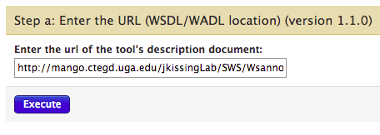
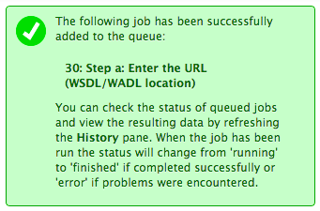
Using Web Services in Galaxy
Notes:
In this example, a WSDL for clustalw was pasted into the text field.
After the job generated from clicking “Execute” is finished, the user can then move on to “Step b”

Slide 13
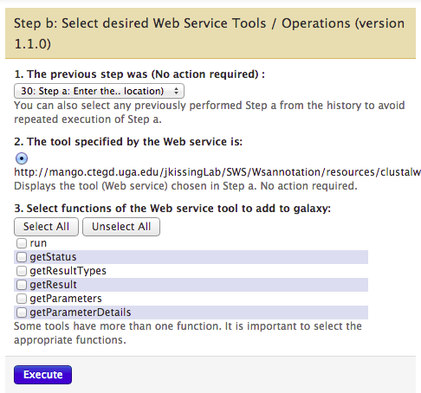
Using Web Services in Galaxy
tool_conf.xml
Workflow Client
XMLs
Generates Workflow Client XML Files
Notes:
“The previous step was [..]” – This allows a user to select a Web service that was added earlier, if one exists in the current workflow history.
“The tool specified by the Web service is” – used to verify that the previous step actual does specify a web service. This should display a URL to a WSDL/SAWSDL or WADL/SAWADL if correct.
“Select functions [..]” – Used to select the operations provided by the Web service that the user wishes to add to Galaxy as tools.
Clicking on “Execute” creates a job which is added to the queue. This job generates the Workflow Client XML files that interact with the Web service Python script. “Links” or “References” to these XML files are added to Galaxy’s tool_conf.xml file.

Slide 14
Using Web Services in Galaxy
Does Nothing!
Need to
Restart Galaxy
for tool_conf.xml changes to take effect
tool_conf.xml
Workflow Client
XMLs
Notes:
This step doesn’t actually do anything write now! It doesn’t even add a job to the queue.
One idea would be to add a job to the queue that would either reload the “tool_conf.xml” for all users on their next page refresh or restart the Galaxy instance.
In either case, the Web service operations are not available as tools until the tool_conf.xml file is reloaded.

Slide 15
Using Web Services in Galaxy
Does Nothing!
Need to
Restart Galaxy
for tool_conf.xml changes to take effect
tool_conf.xml
Workflow Client
XMLs
Notes:
This step doesn’t actually do anything write now! It doesn’t even add a job to the queue.
One idea would be to add a job to the queue that would either reload the “tool_conf.xml” for all users on their next page refresh or restart the Galaxy instance.
In either case, the Web service operations are not available as tools until the tool_conf.xml file is reloaded.

Slide 16
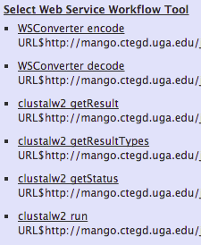
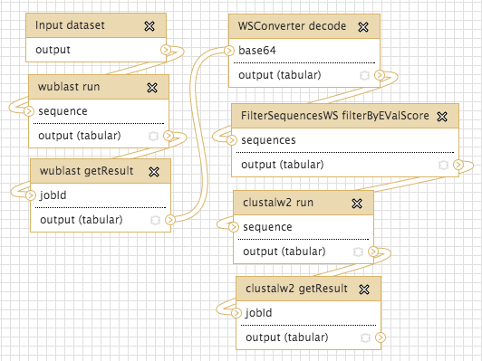
Web Services can be used in Workflows
Notes:
After restarting Galaxy, the Web service operations will appear as tools on the left-hand side of the Galaxy UI.
You can use them just as you would any other tool.
The user of the partial workflow above wants to generate a phylogenetic tree based on a collection of sequences. He or she has yet to send the output of clustalw to tools such as phylip.

Slide 17
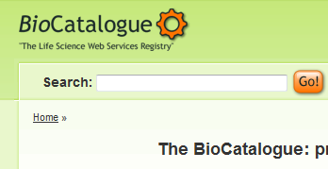
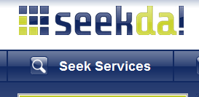
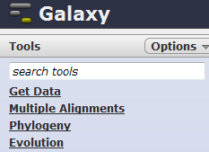
Find Services / Tools for My Workflow
Seems like a lot of services to look through !
I wonder if I missed any ?
# = 2486
#354
#93
Sequence Alignment
Search
Total Services = 483 with maybe 1000s of operations
# = 28606
#0
#36
# = 393
Popular Web service Registries
Tools available in Galaxy +
Tools in the Galaxy Tool-shed
Service Discovery

Slide 18
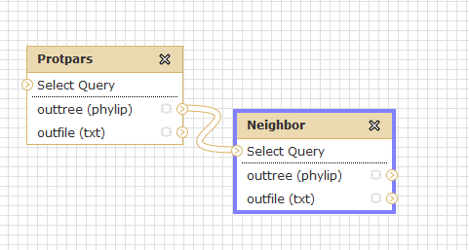
Find Input-Output Compatible Services
I selected 2 of those operations, entered them in my workflow designer, but when I tested, it didn’t work.
Type1
Type2
Input output Matching Problem

Slide 19
Connect the Newly Added Service into the Workflow
Wish I could figure out which service operation(s) might fill the gap in my workflow.
?
?
?
Why can’t the software make a suggestion?
Workflow design / service composition

Slide 20
Semantically Annotated Web Services
wublast.sawsdl – Semantically Annotated WSDL for WU-BLAST
http://purl.obolibrary.org/obo/OBIws_0000082
standard error
sequence similarity expectation value
signal peptide prediction threshold value
is-a
is-a
quantatative confidence value
is-a
Ontology – OBIws
Notes:
You may want to switch the order of this slide and the next depending on how you want to build up the motivation.
The top of the slide shows an excerpt from wublast.sawsdl – operation “run”, input parameter “exp”… it includes the sawsdl:modelReference to the corresponding ontology term in OBIws, an extension of OBI.

Slide 21
Workflow Client
XMLs
Workflow Canvas
Architecture
with
Service Suggestion
jQuery & JSON
Galaxy
SAWSDLs
SSE Web Service
Ontologies
Web
Notes:
Slide Organization – The different areas of the slide represent the realm of each component when a workflow is run. On this slide, sold arrows denote a “used by” relationship. Dashed arrows denote a “references this other thing” relationship.
Workflow Canvas – this is the part of Galaxy where the user creates/edits/composes a workflow.
jQuery & JSON – Using a JavaScript library called jQuery, we added a button to the canvas editor for service suggestion. This requires minimal modifications to existing mako files (you only need to add two mako includes to the editor.mako file). The user interface for service suggestion (shown later) let’s you request service suggestions from the SSE Web Service based on the current configuration of your workflow and the (Web) services (tools) you have available. The “query” or interaction with the SSE Web Service is done via a method known as JSONP (JSON Padding) (also, JSON = JavaScript Object Notation). This allows the SSE Web Service to be hosted on a different server if needed (Usually browsers won’t let you make remote AJAX calls, but you can get artound this with JSONP).
SSE Web Service – this Web service contains operations for interacting with the Service Suggestion Engine. It supports forward, backward, and bidirectional suggestion and also provides operations for retrieving documentation and sample values for service parameters (think inputs to a tool/service).
Ontologies – these are the ontologies containing the terms referenced in the SAWSDLs/SAWADLs.

Slide 22
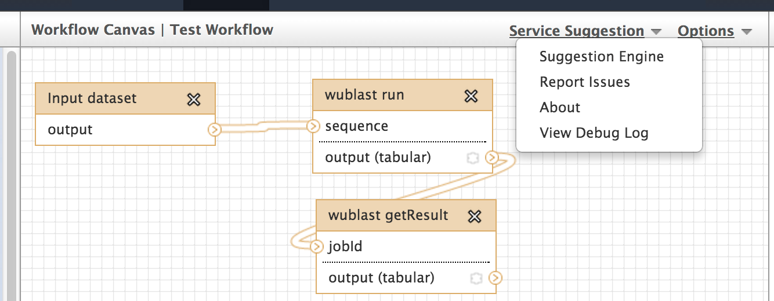
Service Suggestion
Modified the UI using minimal mako modifications
and some jQuery magic!

Slide 23
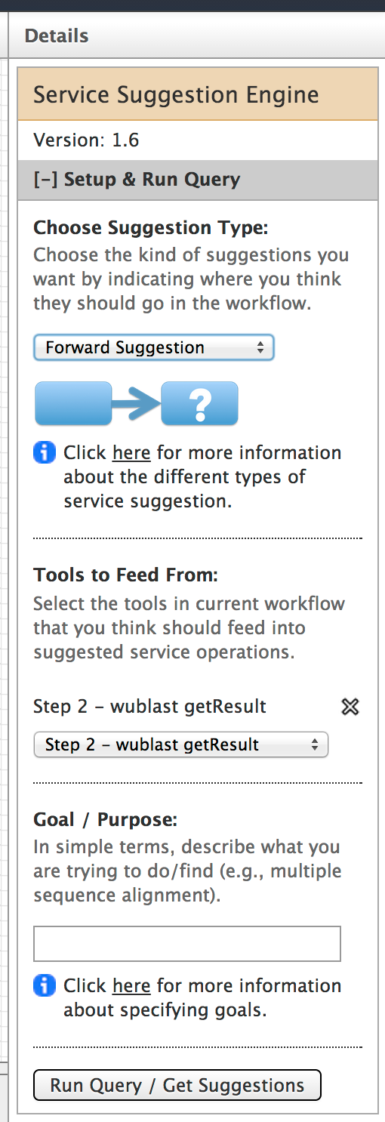
Service Suggestion
1. Choose the type of suggestion you want
Forward Suggestion
Backward Suggestion
Bidirectional Suggestion
Notes:
Should explain what the three different kinds of suggestion are. In this scenario, we’re going to choose “forward suggestion” because it fits well with the partial workflow shown on the previous slide.

Slide 24
Service Suggestion
1. Choose the type of suggestion you want
2. Select Relevant Tools
The tools currently on the canvas will appear in one ore more dropdown lists (depending on suggestion type).
Select specific ones to utilize for suggestion or choose “all”.

Slide 25
Service Suggestion
1. Choose the type of suggestion you want
2. Select relevant tools
Optionally, specify a goal

Slide 26
Service Suggestion
1. Choose the type of suggestion you want
If you’re not sure what something means then click on “help” to display a modal help dialog.
2. Select relevant tools
Optionally, specify a goal

Slide 27
Service Suggestion
1. Choose the type of suggestion you want
Once you’ve specified what you want, click on “Run Query” to get suggestions
2. Select relevant tools
Optionally, specify a goal
3/4. Run the query to get suggestions!

Slide 28
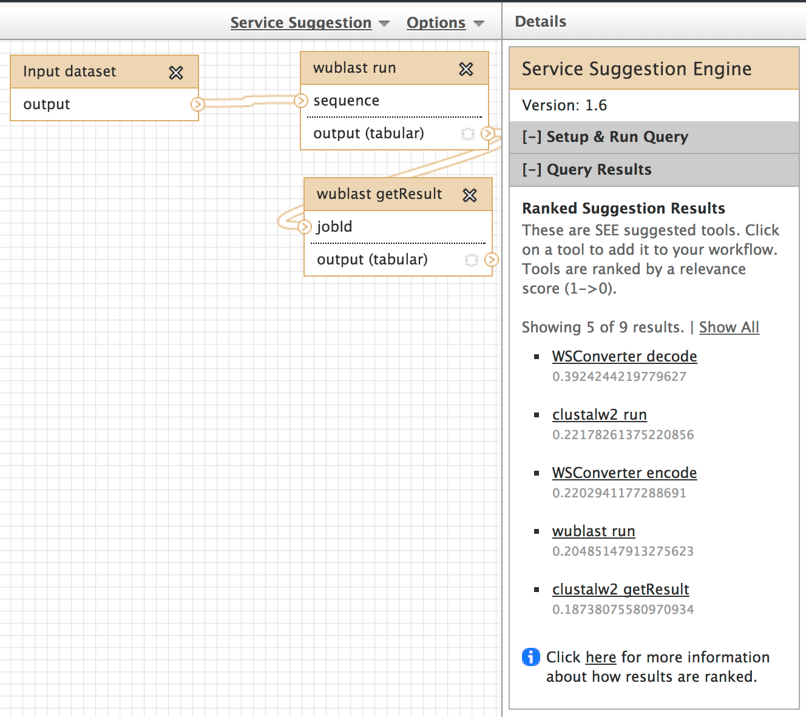
Annotated services are displayed in the results, ranked by how well they satisfy the suggestion query.
Notes:
The reason that decode is the next tool/operation/service that’s suggested is because the output of the WU-BLAST getResult operation is base64 encoded. Decode converts base64-encoded text to plain text.

Slide 29
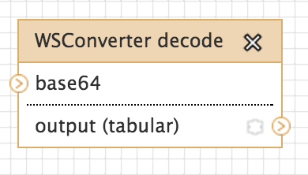
Clicking on a tool adds it to the canvas!

Slide 30
Why not annotate Galaxy Tools to enable the SSE?
tabular_to_fasta.xml – Example of a Semantically Annotated Galaxy Tool
All we need to do is add modelReferences to a tool’s XML file!
comma separated values data format specification
sequence data format specification
MIME type specification
is-a
is-a
data format specification
is-a
Ontology – OBIws
Notes:
Currently, we annotate the service description documents of the Web services. These documents are just XML documents. There’s no reason why we can’t annotate the XML files of the Galaxy tools themselves, including existing tools. We even have a tool that will soon be able to help you do it (RadiantWeb).
The manual annotation process is as simple as importing the SAWSDL namespace and adding “modelReference”’s to the tool’s inputs and outputs.

Slide 31
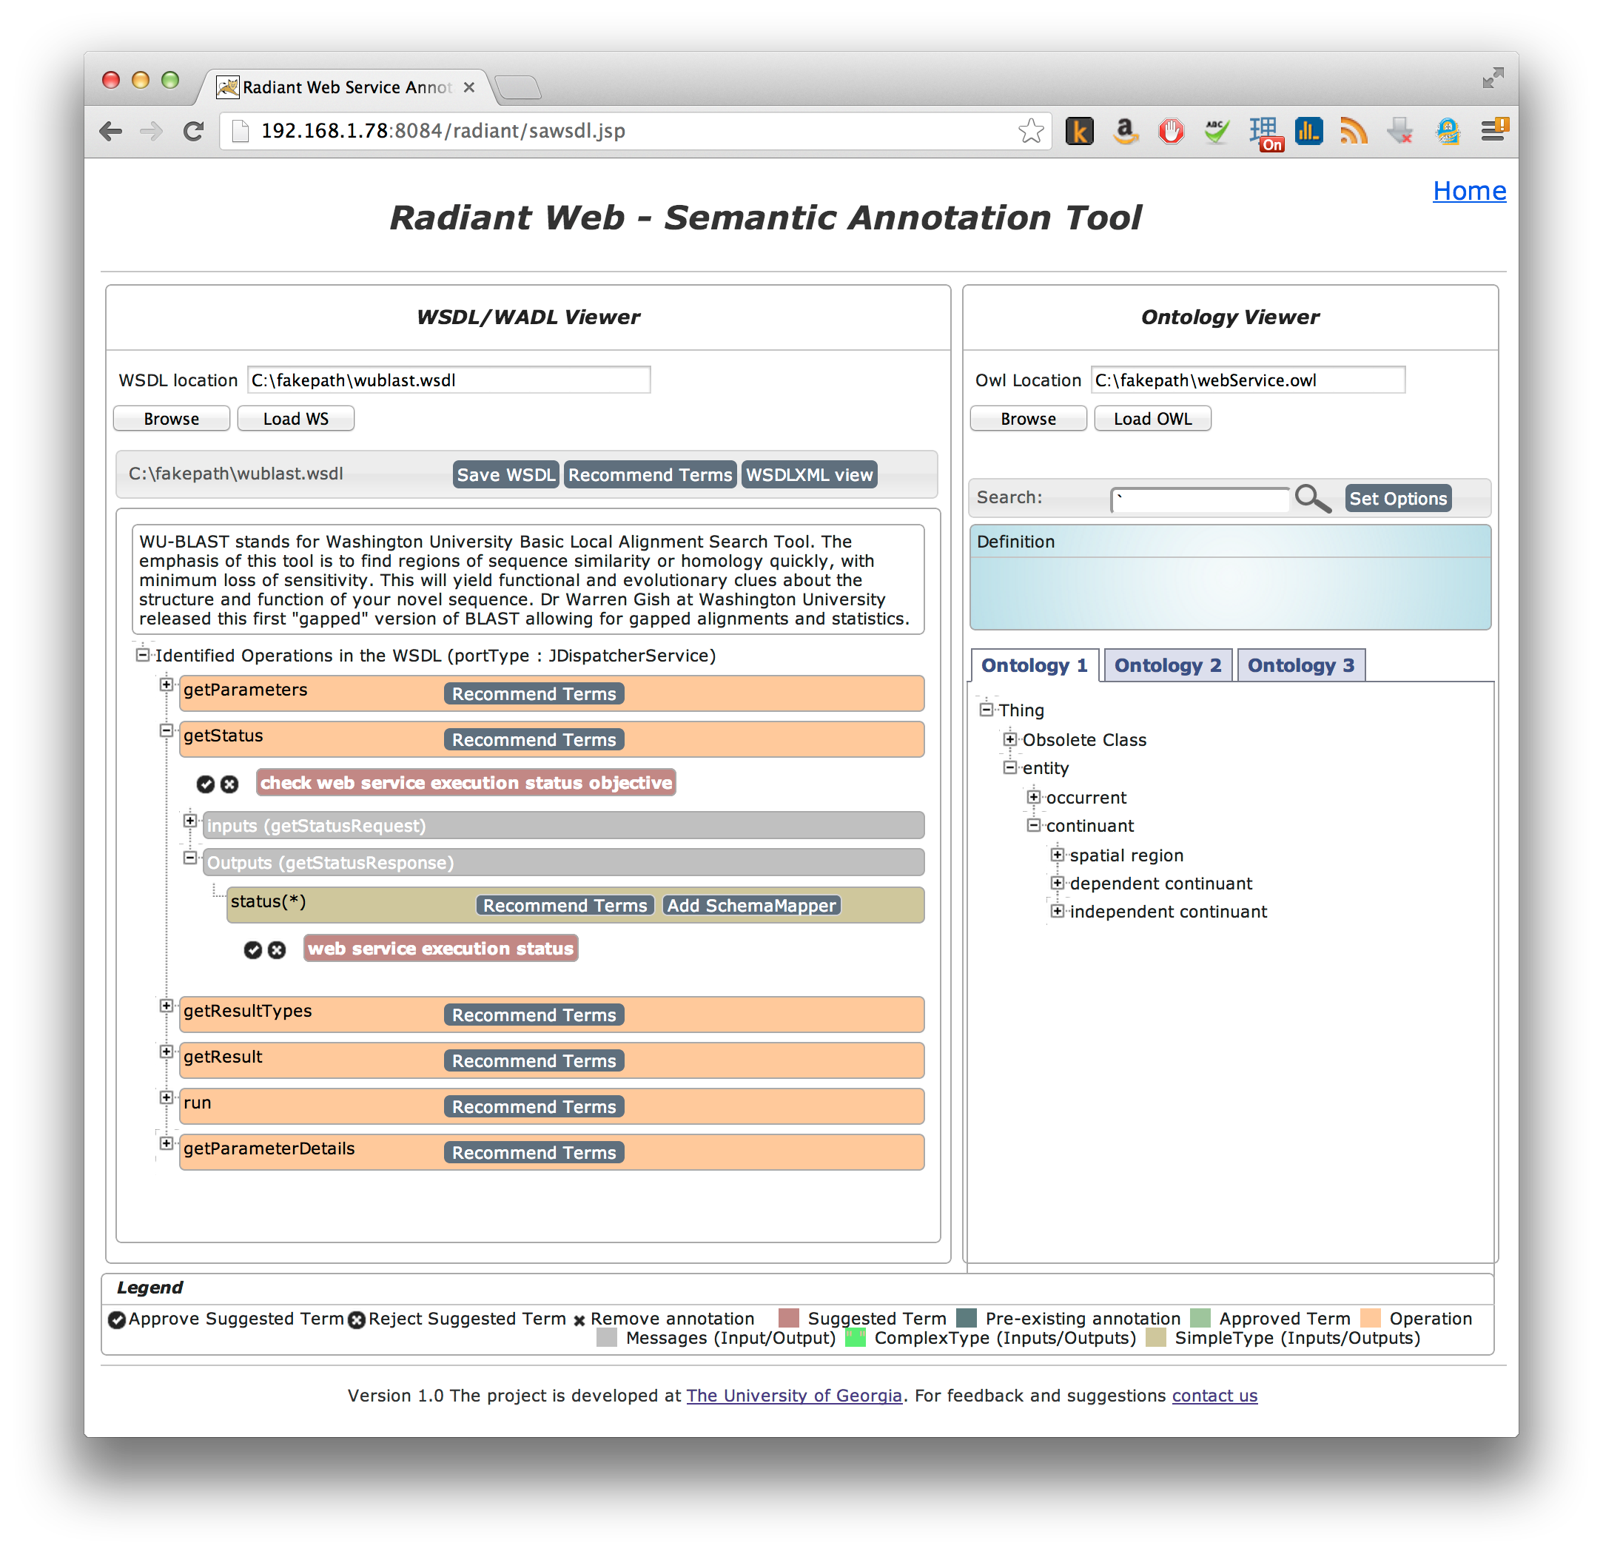
Annotating Services with RadiantWeb
Simplified View
of XML File
Tree View
of
Ontology
Notes:
On the left, you have a simplified view of the service description document that you want to annotate. If the user wishes, he or she can view the raw XML by clicking on a button.
On the right, you have the ontology viewer. It displays an ontology in a tree view according to the parent-child relationships. When an ontology term/concept is selected, it’s documentation is displayed in the blue box.
The manual annotation process involves selecting the portion of the description document that you want to annotate, finding a term in the ontology, and dragging that term over into the description document.

Slide 32
Annotating Services with RadiantWeb
Annotation Recommendations
Notes:
The easiest way to start annotating a description document is to use the “Recommend Terms” button. This will populate the simplified view with annotation recommendations. Each of these recommendations can be approved or rejected. Once a term is approved, it will change color. The legend for the different colors that an annotation can take on is visible in the bottom of the screenshot.

Slide 33
Annotating Services with RadiantWeb
Documentation
Inputs/Outputs
Notes:
Documentation for the description document is displayed when available.

Slide 34
Adding Web services to Galaxy
Advantages
Disadvantages
Increased tool/database access
Don’t need to wrap the tools/data access
Distribute the load - Utilize someone else’s computers
Further empower the end user
Finding the Web services
Moving data
Hidden analysis step (Get job ID)
All possible result formats (many not compatible with existing Galaxy tools)
Security
Banned from sites (depends on who is viewed as the user)

Slide 35
Adding a Semantic Suggestion Engine
Advantages
Disadvantages
Helps users find Galaxy tools with the desired functionality
Helps with workflow construction
Annotated tools are better documented tools. You will now what that parameter does and understand inputs and outputs
The community needs to annotate its tools
Not all semantic terms will exist
You give up some display area in the history column when the SSE is being used. It can be collapsed when not in use.

Slide 36
Thank you!
http://mango.ctegd.uga.edu/jkissingLab/SWS/

Slide 37
http://www.bioontology.org

