Slide 1

Using Galaxy for Metabolomics
ICG8
2013
Rob L Davidson PhD

Slide 2
Overview
Metabolomics
Galaxy
Birmingham Workflow
Galaxy Implementation

Slide 3
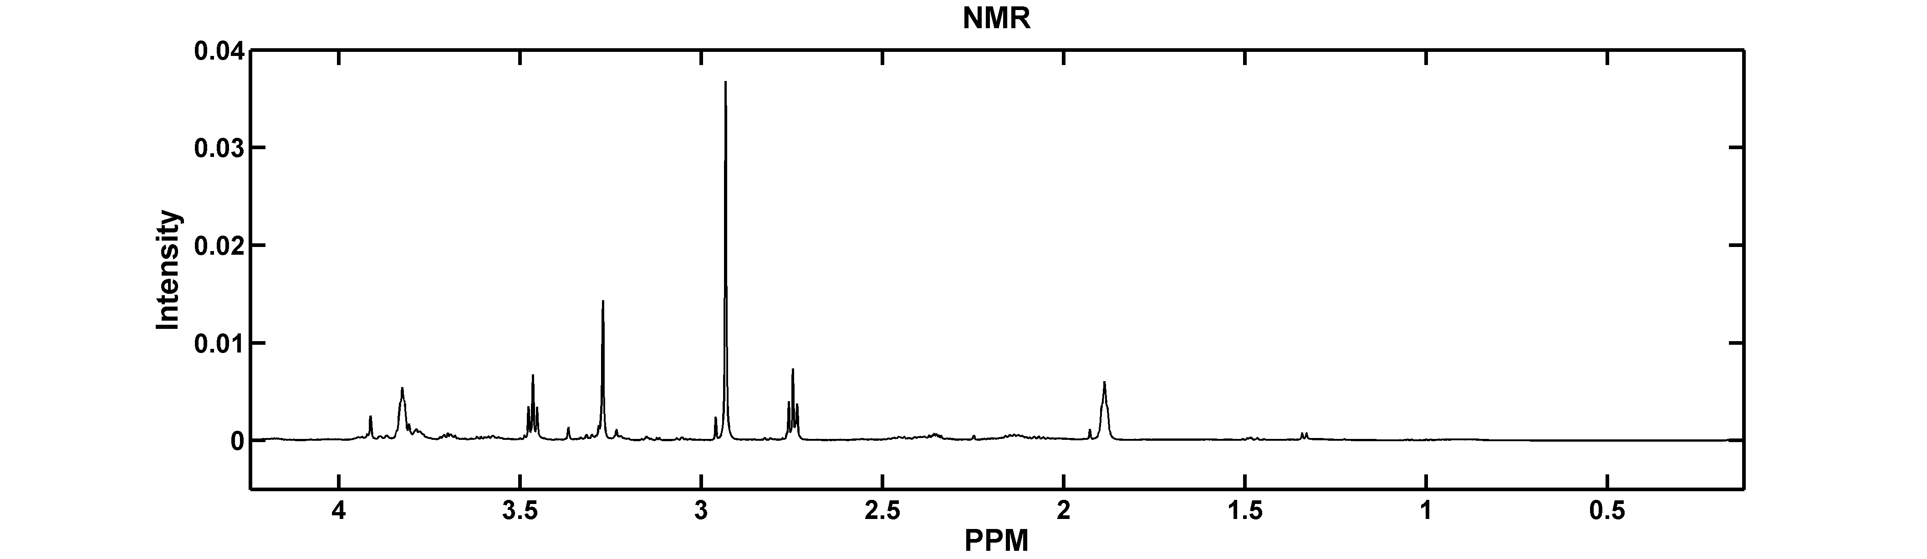
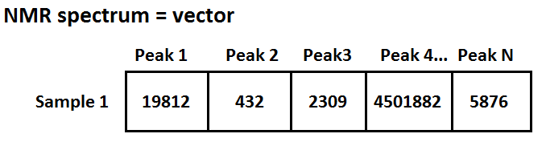
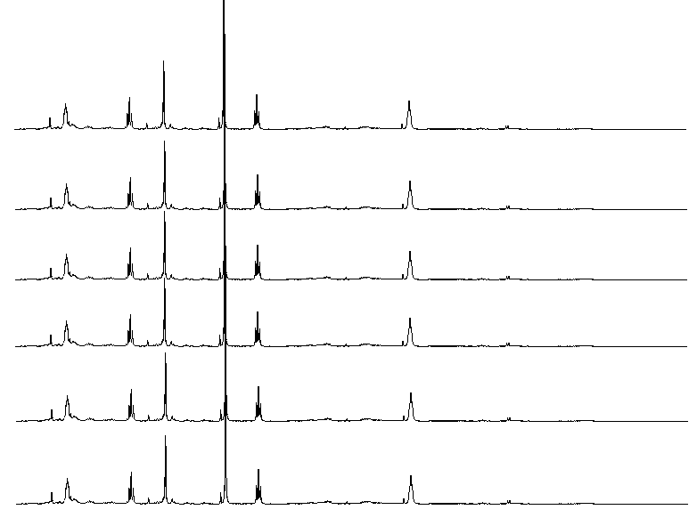
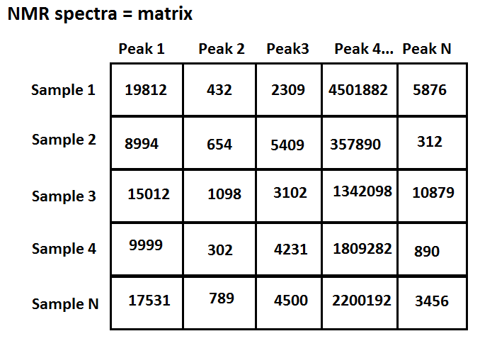
Metabolomics - data
Copyright NBAF-B 2013

Slide 4
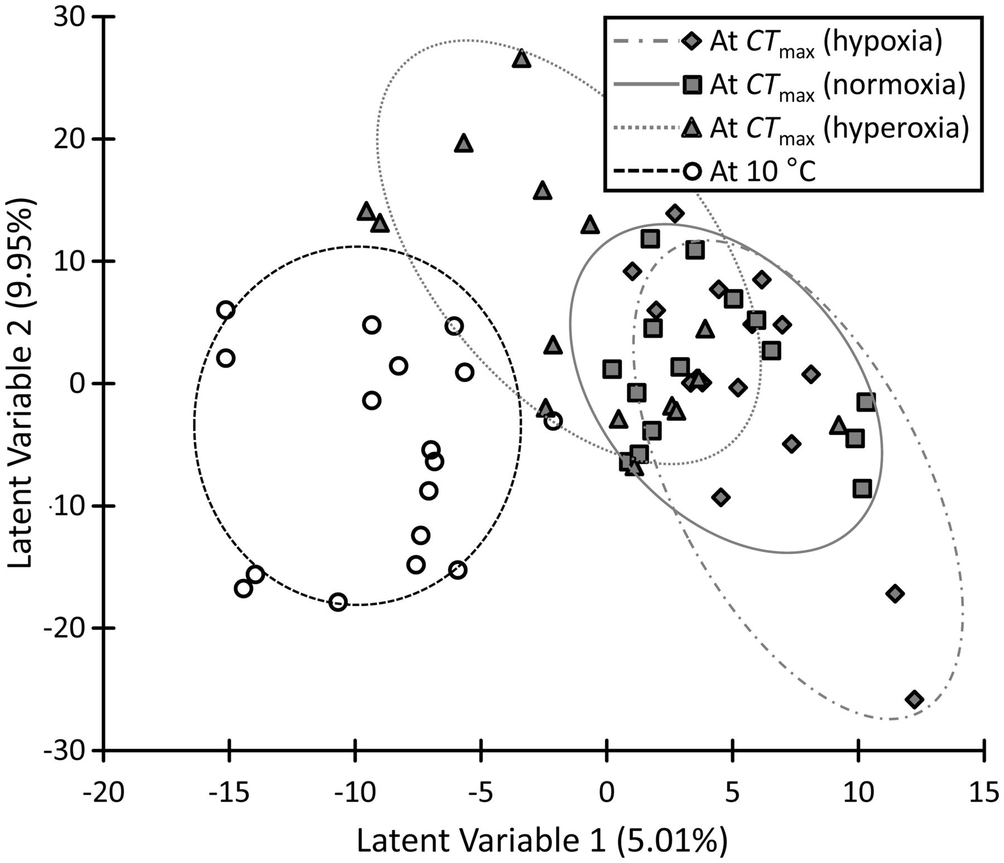
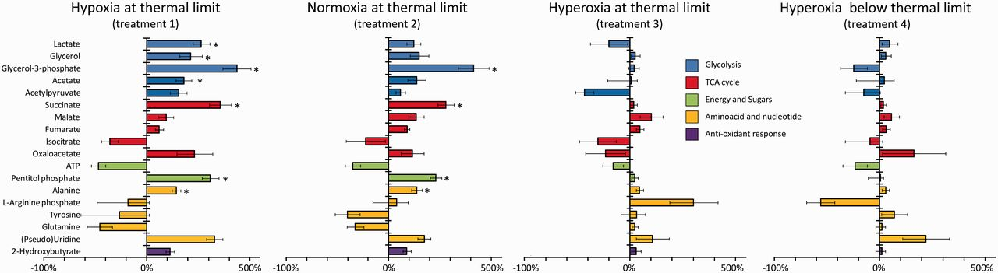
Metabolomics - tools
Copyright NBAF-B 2013
Verberk WCEP, Int&Comp Biol. 2013

Slide 5
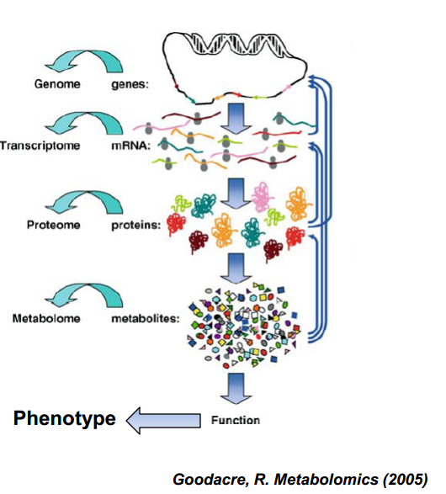
Metabolomics - future
Identify metabolite profile
Link to pathways etc
Correlate with other ‘omes
Trans-omics!
Copyright NBAF-B 2013

Slide 6
Galaxy
Copyright NBAF-B 2013

Slide 7
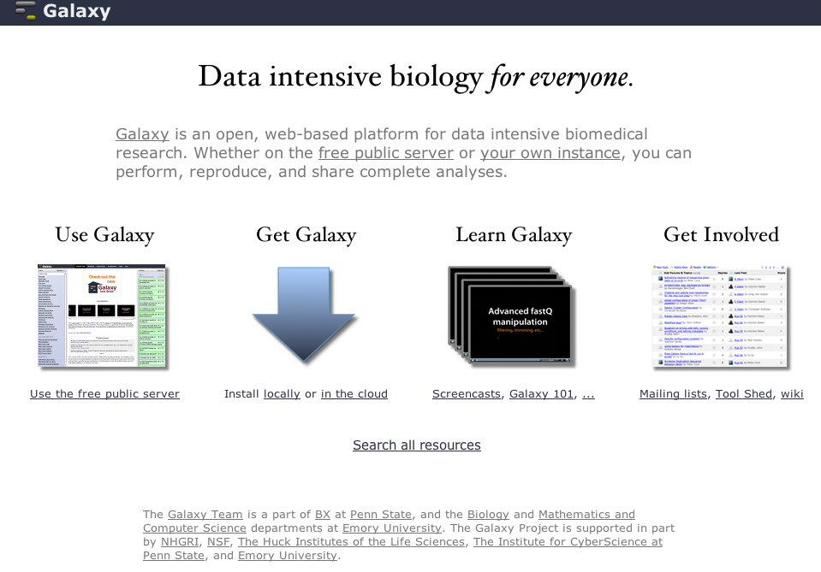
Galaxy
Open source
Over 20,000 main
Galaxy server users
Over 1200 papers
citing Galaxy use
45+ public Galaxy servers
http://galaxyproject.org
Copyright NBAF-B 2013

Slide 8
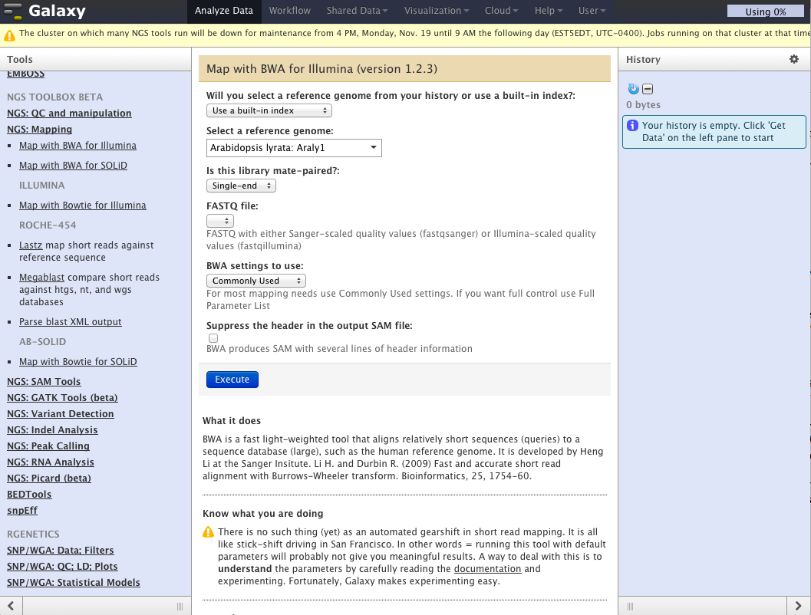
Galaxy - interface
Tool parameterisation
Results panel
Tool list
Copyright NBAF-B 2013

Slide 9
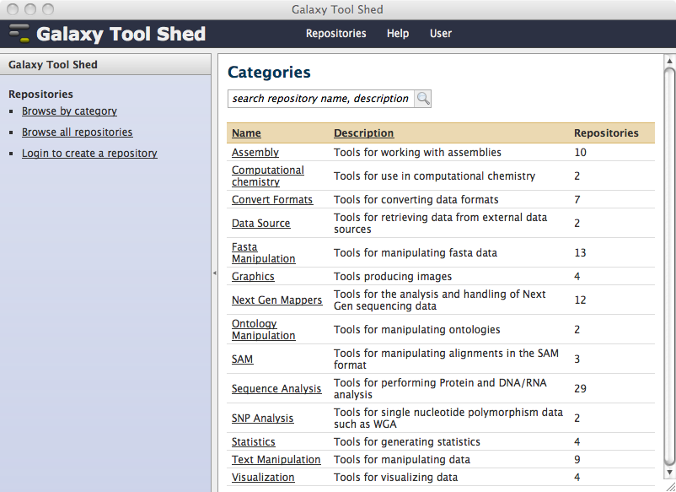
Galaxy - toolshed
Lots of tools ->
Good for trans-omics
But no metabolomics
…yet
http://toolshed.g2.bx.psu.edu/
Copyright NBAF-B 2013

Slide 10
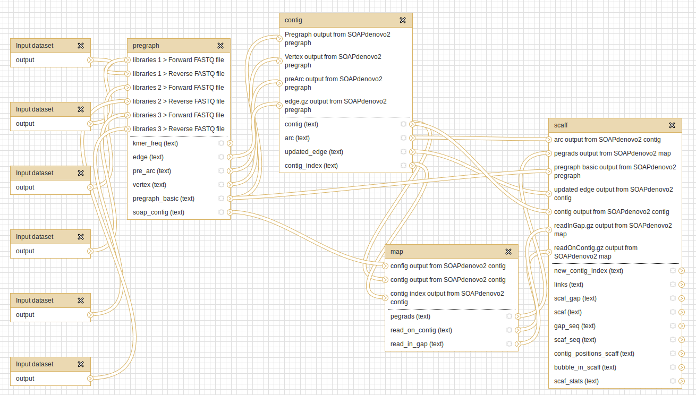
Galaxy - workflows
Copyright NBAF-B 2013

Slide 11
Metabolomics Workflow
Copyright NBAF-B 2013

Slide 12
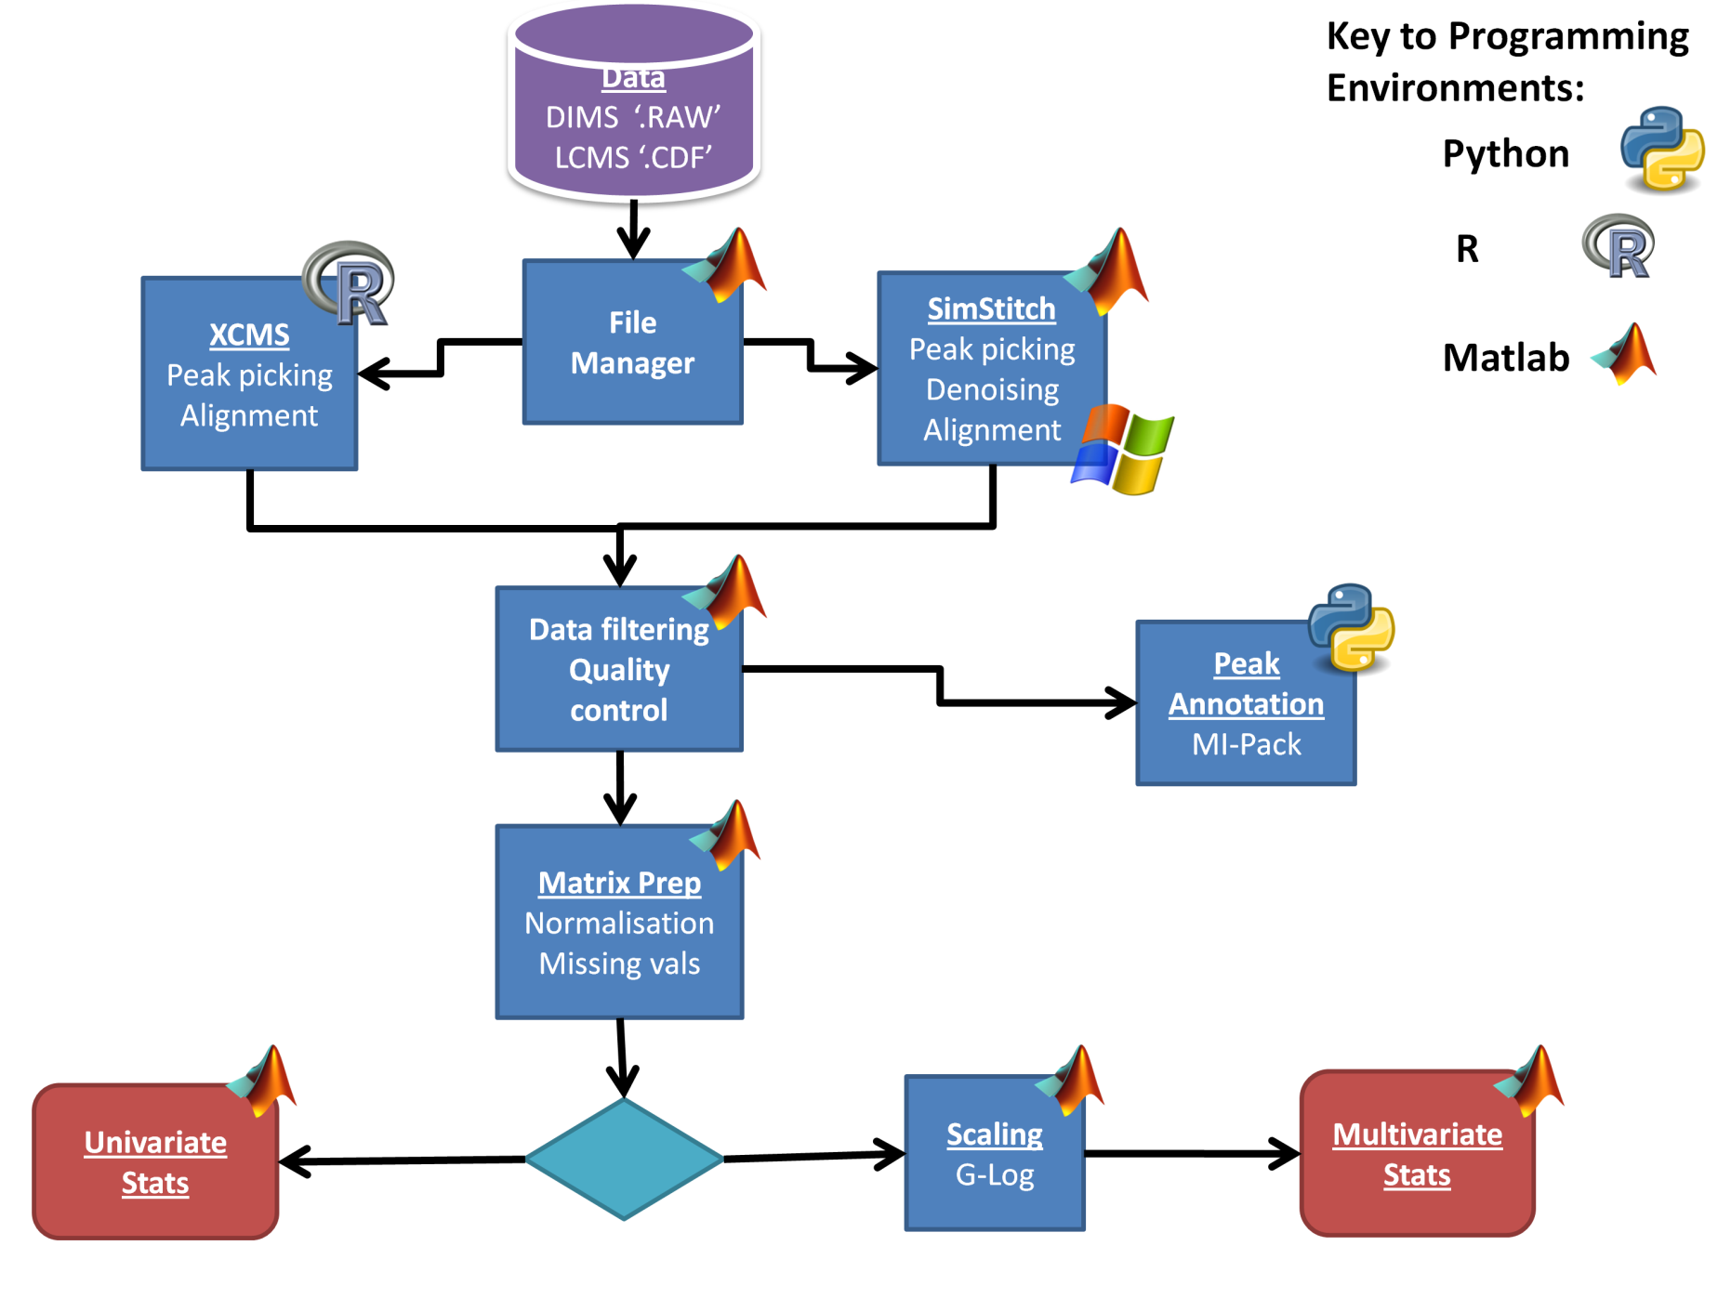

Metabolomics Workflow
Met ID:
coming soon
Copyright NBAF-B 2013

Slide 13
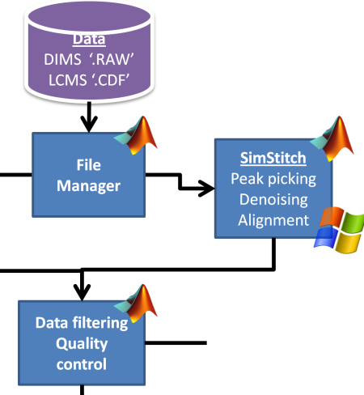
Metabolomics Workflow
Copyright NBAF-B 2013
SimStitch
  FTICR-DIMS data
  RAW format ; NB: requires MS Windows!
  Stitches together short MZ ranges for greater accuracy
  Picks peaks/removes noise, aligns samples
  Applies filters to technical replicates, blanks and samples for greater robustness
Southam AD, Anal Chem. 2007;79(12):4595-602.

Slide 14
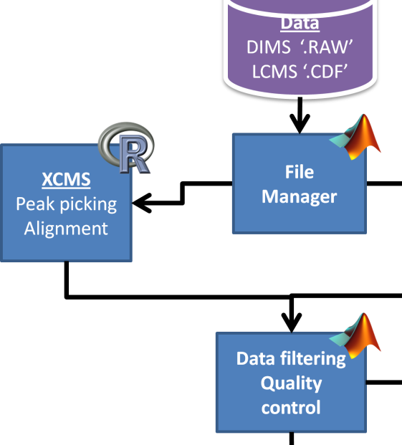
Metabolomics Workflow
XCMS
  LC-MS (also does GC-MS etc)
  netCDF format (also does MZML etc)
  Picks peaks/removes noise, aligns samples
Smith CA, Anal. Chem. 2006 78:779-787
http://www.bioconductor.org/packages/2.12/bioc/html/xcms.html
In our pipeline, we call XCMS (in R) using Matlab...
  To make use of our FileManager Structure
  Because we also use Matlab for post-XCMS processing
Copyright NBAF-B 2013

Slide 15
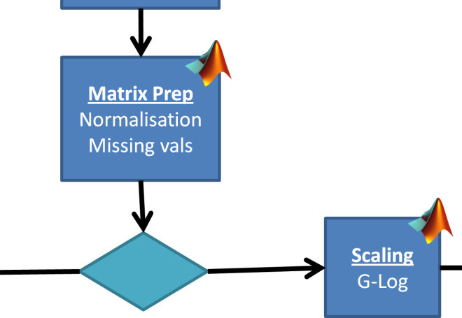
Metabolomics Workflow
Matrix Prep:
  PQN Normalisation
    Dieterle F, Anal Chem. 2006;78(13):4281-90.
  KNN-Missing Value Imputation
    Hrydziuszko O, Metabolomics 2012 8(1):161-174
  G-Log scaling and variance stabilisation:
    Parsons HM,BMC Bioinf. 2007 8:234
  All done using PLS Toolbox data structures in Matlab
Copyright NBAF-B 2013

Slide 16
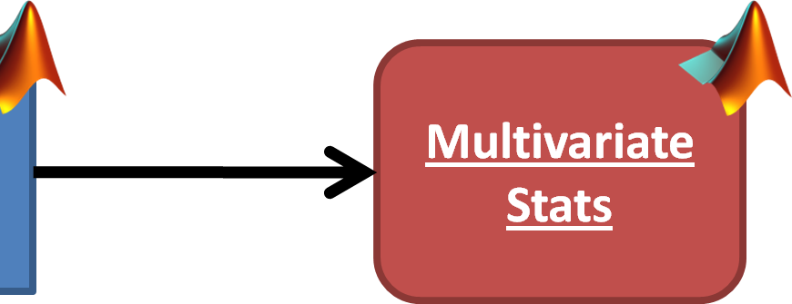
Metabolomics Workflow
Multivariate stats
  PCA with automatic selection of PCs
  2 classes: T-Test on scores on each PC
  3+ classes: ANOVA and Tukey-Kramer
  Output = text file containing these statistics
  a PLS Toolbox ‘model’ is also created and scores plots etc can be viewed in Matlab
Copyright NBAF-B 2013

Slide 17
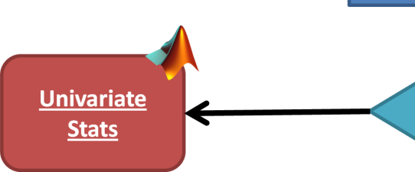
Metabolomics Workflow
Univariate stats
  2 classes: T-Test or Mann-Whitney-U for each peak
  3+ classes: ANOVA or Kruskall-Wallis
  False Discovery Rate correction (Benjamini Hochberg)
  Output = csv file containing these statistics
Copyright NBAF-B 2013

Slide 18
Metabolomics Workflow
Done
  1st end-end metabolomics pipeline in Galaxy
  FTICR-DIMS and LCMS data
To Do
  Add in MI-Pack (underway)
  Add more stats e.g. PLSDA
    possibly merging with Netherlands Metabolomics http://galaxy.nmcdsp.org/ (stats only)
  Replace input file structure with ISA-Tab
    http://www.ebi.ac.uk/metabolights/
Copyright NBAF-B 2013

Slide 19
Metabolomics Workflow
Requires 32bit MS Windows
Data is large (100s Gb per study)
Lots of processing power
Multiple licenses
Copyright NBAF-B 2013

Slide 20
Galaxy Implementation
Copyright NBAF-B 2013

Slide 21
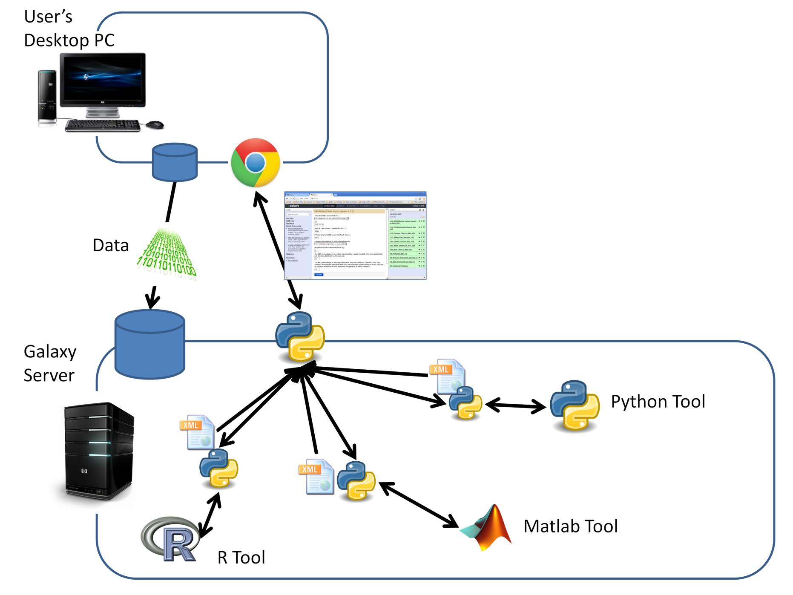






Standard Galaxy
BUT!
Copyright NBAF-B 2013

Slide 22
Metabo - Galaxy
Requirements
  Allow Galaxy access to MS Windows
    for FTICR-DIMS RAW file processing
  Avoid passing large data over LAN
    slow
  Minimise cost of Galaxy implementation
    make use of existing processors, storage and licences
Copyright NBAF-B 2013

Slide 23
Metabo - Galaxy
Solution
  Use Galaxy’s Light Weight Runner (LWR)
  Install LWR client on user’s desktop
  Adjust Python wrappers to send tools via LWR
  Run all tools on User’s desktop (MS Windows)
  No need for
    extra licenses
    central storage/file transfer
    powerful server
Copyright NBAF-B 2013

Slide 24
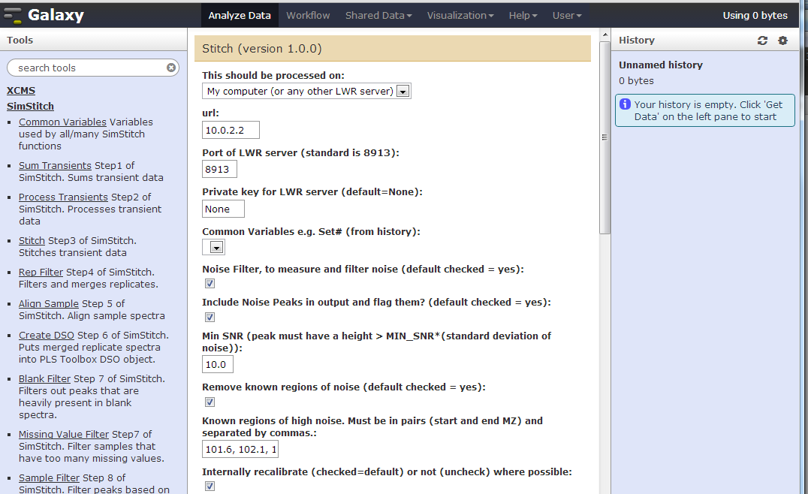
Metabo - Galaxy
New Input type
Pre-fills user’s IP
Uses REMOTE_ADDR header
Copyright NBAF-B 2013

Slide 25
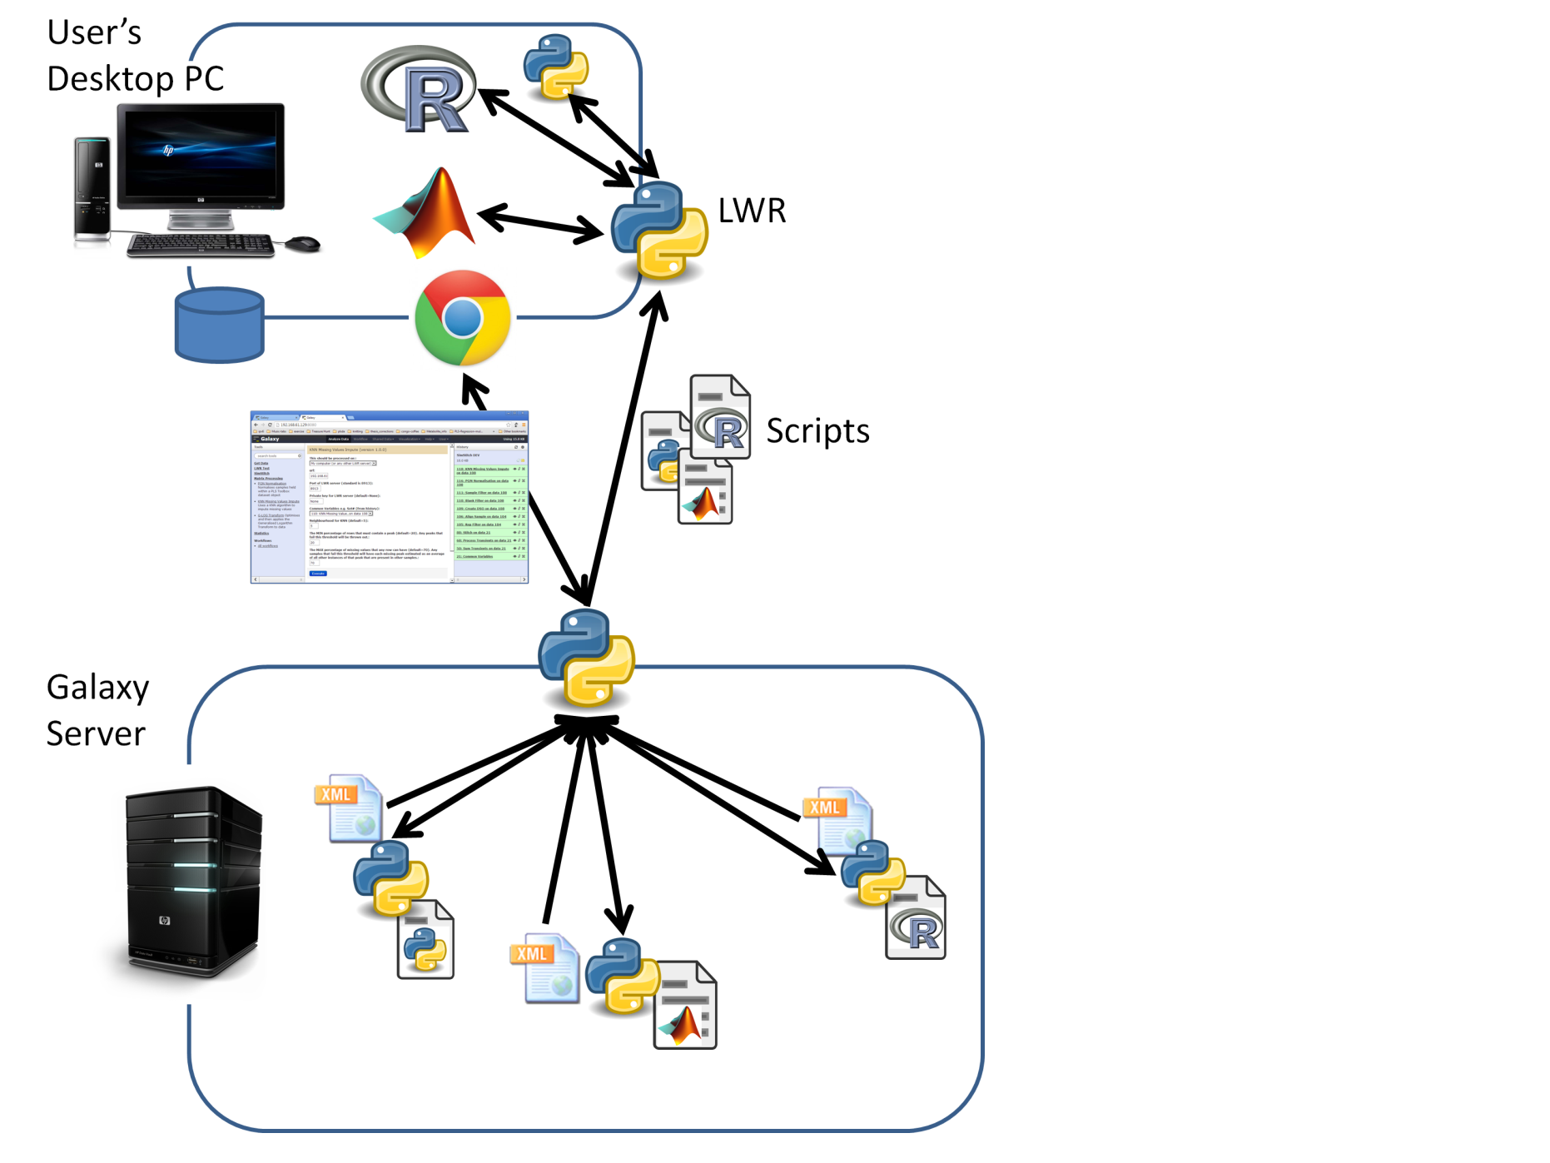
Metabo - Galaxy
Makes use of
existing proc. power
licenses
user’s MS Windows (RAW)
Still acts as
version control
workflow manager
GUI
Copyright NBAF-B 2013

Slide 26

Metabo - Galaxy
That said...
Working with GigaScience
  http://www.gigasciencejournal.com/
To be hosted on GigaGalaxy
  http://galaxy.cbiit.cuhk.edu.hk/
Using normal setup
  (all processing/licenses on Galaxy server)
Downloadable version to include both options
Copyright NBAF-B 2013

Slide 27
Summary
Copyright NBAF-B 2013

Slide 28
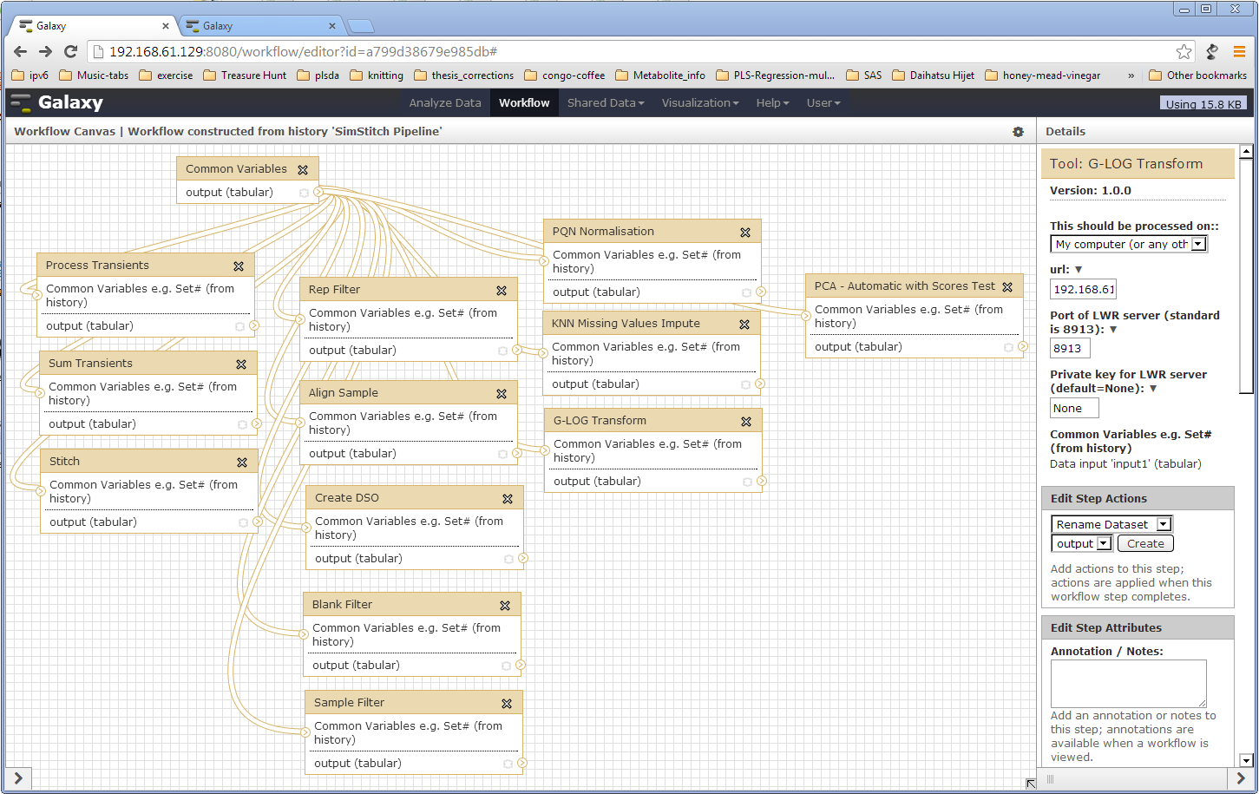
First RAW -> stats Galaxy Pipe
Copyright NBAF-B 2013

Slide 29
Summary
Metabolomics has entered Galaxy!
Can be expanded BY COMMUNITY!
Can merge more easily with other ‘omics
Have developed Galaxy in a new way that allows
  Use of existing hardware
  Use of existing licenses
  Less slow transfer of large data
Copyright NBAF-B 2013

Slide 30
Acknowledgements
Copyright NBAF-B 2013
University of Birmingham
  Ralf Weber, Ulf Sommer, Mark Viant
Gigascience
  Pete Li
NERC Discipline Hop scheme

Slide 31
End
Questions?
r.l.davidson@bham.ac.uk
Copyright NBAF-B 2013

