Slide 1
Michael Reich
Broad Institute of Harvard and MIT
July 14, 2012

Slide 2
Need: Insights through integrative studies
Gene mutation causing Leigh Syndrome French Canadian Type (LFSC) and 8 other mitochondrial diseases
Integrate: candidate genomic region, mitochondrial proteomic data, and cancer expression compendium
Authors: Mootha et al. 2003, Calvo et al. 2006
Discovery of 3 new genes involved in Glioblastoma Multiforme (NF1, ERRB2, PIK3R1); Confirmation of TP53, PTEN, EGFR, RB1, PIK3CA
Integrate: DNA sequence, copy number, methylation aberrations and expression profiles in 206 glioblastomas
Authors: TCGA Research Network 2008
Subtle repression of oxphos genes in diabetic muscle: role for mitochondrial dysregulation in diabetes pathology; new computational approach Gene Set Enrichment Analysis
Integrate: Gene sets/pathways & processes with expression profiles
Authors: Mootha et al. 2003, Subramanian & Tamayo et al. 2005
~3000 novel, large non-coding RNAs with functions in development, the immune response and cancer
Integrate: Genome sequences from 21 mammals, epigenomic maps, and expression profiles
Authors: Guttman, Rinn et al. 2009
Characterization of disease subtypes and improved risk stratification for medulloblastoma patients
Integrate: Copy number, expression, clinical data for 96 medulloblastoma patients
Authors: Tamayo et al., Cho et al. 2011
IKBKE as a new breast cancer oncogene
Integrate: RNAi screens, transformation of activated kinases, and copy number from SNP arrays of cell lines
Authors: Boehm et al. 2007
Notes:
Success stories from integrative genomics studies
**********************
What’s preventing these analyses from becoming more widespread?
However, integrative analysis of multiple data types remains an enormous challenge
The key reason is the growing gap between the need to use a variety of different analysis and visualization tools, and the difficulty of getting tools from different sources to work together.

Slide 3
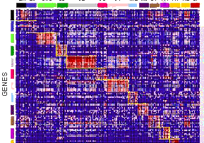
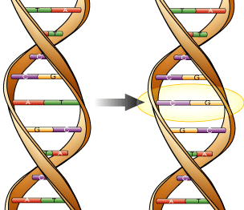
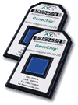
Translational Research Example
GenePattern
Cytoscape
IGV/UCSC
Genomica
CMAP
iii
Compendium
1
Differentially Expressed Genes
GCT → GXP
Load compendium Show module map
SIF
Arrests G2/M
ODF → GMT
3
Show network
i
Network
2
GXC → GRP
GSEA test enrichment
HTML
5
Show Chromosome
Extract module
4
Expand +1 (include neighbors)
Idea
NA → gene list
ii
Alterations
Add Transcription Factor track from UCSC
6
Learn p53 site/score on promoter
atcgcgtttattcgataagg
atcgcgttttttcgataagg
Added to GenePattern
Pathway activation
iv
Expression
v
8
Test for similarity of p53 and gene location
7
Looks close to p53 site
GFF → GXA
Conclusion
vi
Notes:
I’m going to think up an experiment, and as I think you’re going to see my thoughts mapped into tool and data space
A biologist wishes to find the molecular basis for the prognostic differences between breast cancers from 2 different grades. She profiles mRNA levels of a collection of breast cancer samples from the two grades:
She identifies genes differentially expressed (CMS in GP)
She probes molecular processes that gave rise to this signature (GSEA in GP)
Finding the P53 pathway is overrepresented, she further explores by finding other potentially implicated genes (export list to Cytoscape, map genes onto network, extract all neighboring genes from network)
View where expanded set of genes lie on genome (export to IGV)
Determine relationship of these genes to recurrent chromosomal aberrations in the same type of breast cancer as well as a catalog of conserved TF binding sites from an analysis of 21 mammalian genomes. (UCSC browser -> IGV)
Explores where aberrations and genes in set intersect and notice p53 site occurs frequently in these regions
Determine if 3 features (genes, aberrations, binding sites) is significant (Genomica)
Also determine that many genes are co-regulated across a compendium of 1975 expression profiles from 23 cancers. (GP => GenomicaModuleMap)
Now she wants to see if this signature has any relationship to the expression profile of perturbation by a drug compound and finds one with drugs that arrest cells at G2/M. (Export Genomica,format for CMAP, load into CMAP)
Knowing that this cell cycle checkpoint is controlled by p53, she evaluates if there are a significant number of genes in the signature with a p53 binding site in their promoter. This requries obtaining all human promoter sequences, formatting the p53 PSSM file, runing the command line tool to score the known PSSM for the p53 binding site, and teting the signature genes for enrichment for the site using Genomica.
Evidence points to p53 controlling different grades of cancer. She confirms this by looking for p53 activation within the original cancer samples’ expression profiles. (Requires use of a new pathway activation algorithm in GP)
Inspecting these results she realizes that some of the lower grade patients have activation of the signature. This leads her to hypothesize that treatment with the G2/M inhibitor might offer an alternative therapy for these patients.
Who would dare to do this now?
Each tool has its own data input and output formats. The problems involved in merely converting the data would likely make this type of research a non-starter

Slide 4
12 steps, 6 tools, 7 transitions
1
i
GenePattern
Cytoscape
IGV
2
3
ii
iii
Genomica
CMAP
UCSC Browser
4
5
iv
v
Analysis step
Analysis conclusion
Within tool
Across tools
6
8
Notes:
The key observation here is that if you can focus on making the transitions between tools easier, you can greatly accelerate the way you can use those tools in concert

Slide 5
The Challenges
Flood of high throughput biological data
genomic sequence, global mRNA expression profiles, copy number and LOH, epigenetic data, protein level and modification status,
metabolite profiles
Proliferation of tools
Databases, visualization, and analysis
Difficulty of getting tools to work together
Access, analyze, visualize each data type separately
Notes:
The key challenge is the growing gap between the need to use a variety of different analysis and visualization tools, and the difficulty of getting tools from different sources to work together.
7-10K bioinformatics tools
Broad alone lists ~60 tools on its external website.
Doesn’t include internal use tools, lims, data processing/mgmt pipelines,
5K public data bases

Slide 6
The Need
A lightweight “connection layer” for a wide variety of integrative genomic analyses
Support for all types of resource: Web-based, desktop, etc.
Automatic conversion of data formats between tools
Easy access to data from any location
Any tool that joins is automatically connected to the community of tools
Ease of entry into the environment
Notes:
6
We know that there are many pitfalls when you’re trying to set up an environment that will allow diverse tools to send data to each other – searching for tools, harmonizing data formats, transferring large data files, etc. – we could do a whole talk just on each one of these.
But are there areas where there are successes that we can emulate?

Slide 7
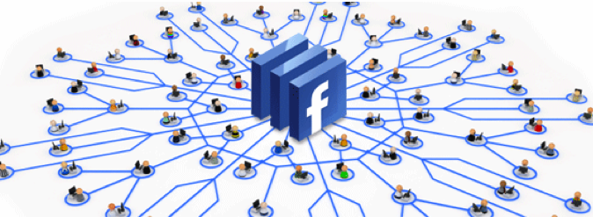
Cloud-based storage
API connectivity layer
Notes:
Data storage in the cloud is being used in a huge number of applications for the cost, scalability and accessibility
And, Web-based APIs have been used to connect disparate Web resources in a very easy way
These were the principles we used when we developed GenomeSpace

Slide 8
Online community to share diverse computational tools
6 Seed Tools
3 Driving Biological
Projects
Cytoscape
Galaxy
GenePattern
Genomica
IGV
UCSC Browser
lincRNAs
Cancer stem cells
Patient Stratification
New tools
New Biological Projects
www.genomespace.org
Notes:
0. GenomeSpace project to build an online community to share, find, and interoperate diverse computational tools. Tools retain their identity and use as stand- alone software and GenomeSpace maintains their native look and feel.
Our goal is to bring the ever-changing wealth of genomic analysis methods and whatever data is required to the fingertips of any biologist
Seeded with 6 popular genomics tools representing diverse architectures
(cytoscape, galaxy, genepattern, genomica, igv, UCSC browser)
Support interoperability through frictionless data transfer with Reproducibility, analytic work flows, comprehensive documentation
Development driven by 3 driving biological projects in (cancer, lincRNAs,, stem cell circuits, and patient stratification)
Live in the Cloud
Next phase starting to
Engage new tools
Engage new biomedical projects
Current participating institutions

Slide 9
GenomeSpace Principles
Aimed towards non-programming users
Support interoperability through automatic cross-tool data transfer
Requires minimal changes to tools
www.genomespace.org

Slide 10
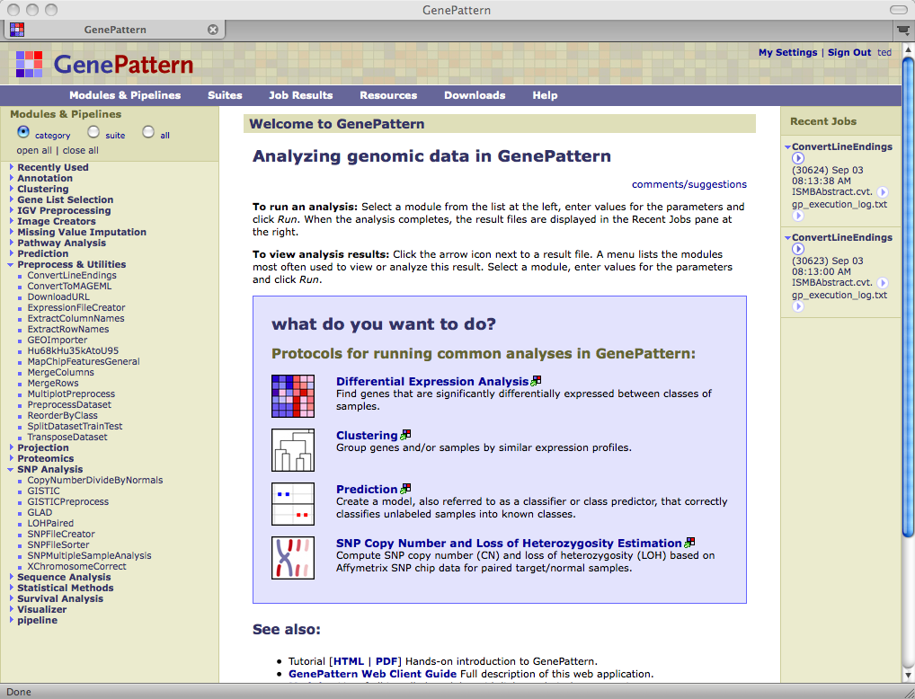
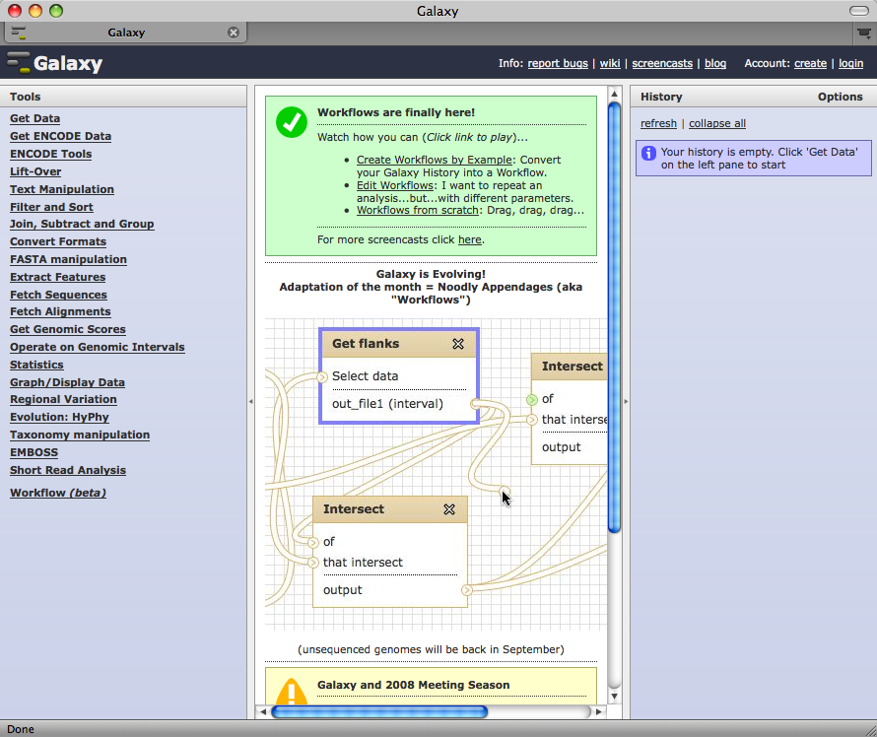
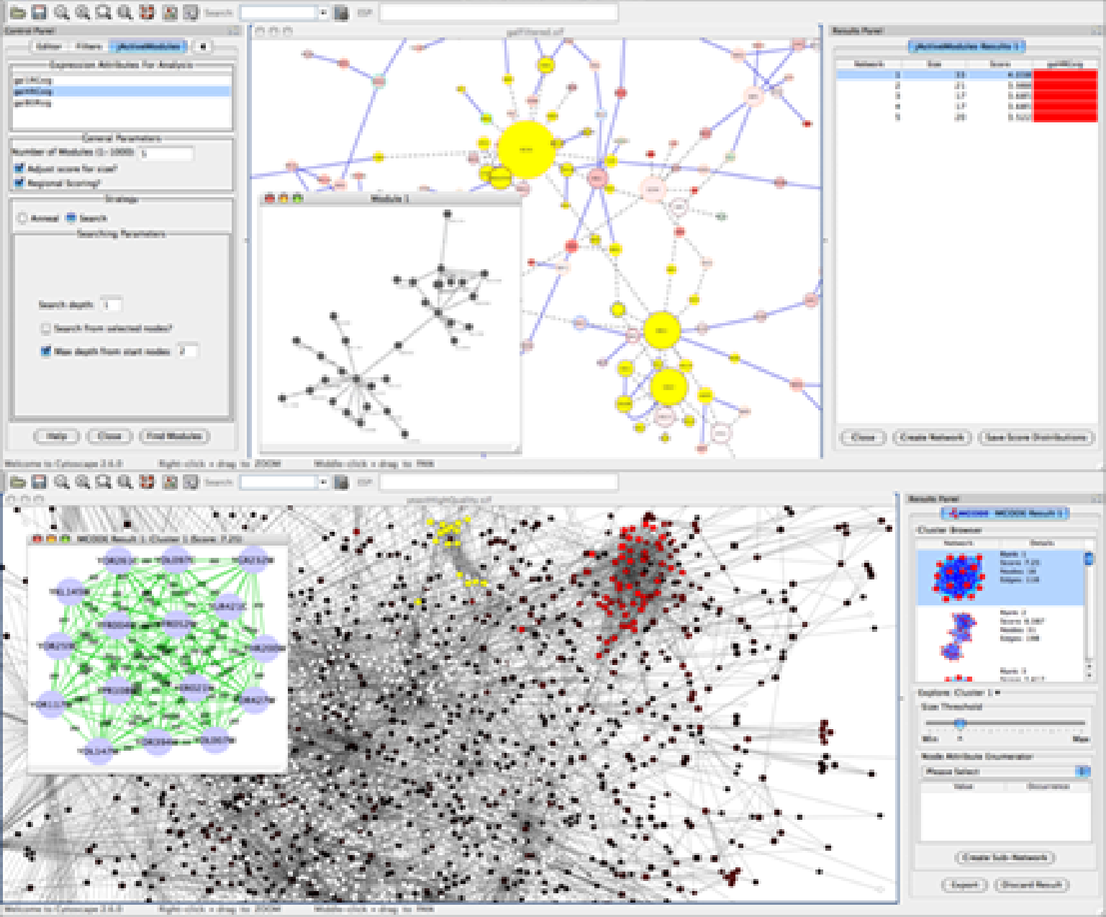
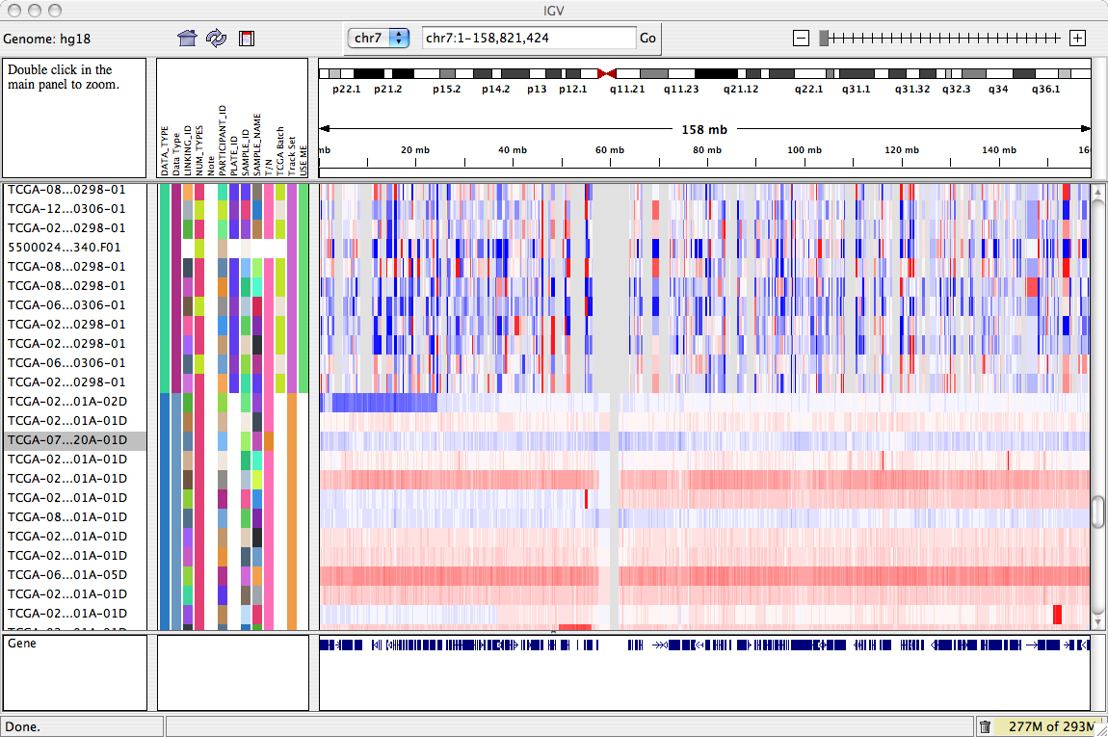
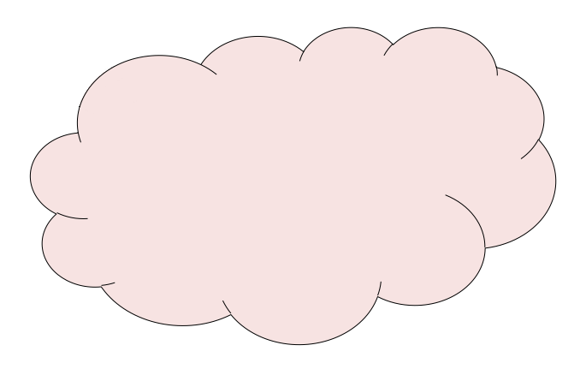
GenomeSpace Components
GenePattern
Galaxy
Cytoscape
Integrative Genomics Viewer
GS Enabled Tools
1
Authentication and Authorization
2
3
Data Manager
Analysis and
Tool Manager
Genome Space
Server
GenomeSpace
Project Data
geWorkbench
External Data Sources & Tools
Notes:
So what IS GenomeSpace:
Server component
- Authentication layer to manage credentials & provide single sign-on
- Analysis/tools manager - Manage tools, their parameters, and the analyses they provide
Data manager – manages data repositories & transparent file format conversions
These are designed to run in the cloud
API component
Client developers’ kit
Restful interface

Slide 11
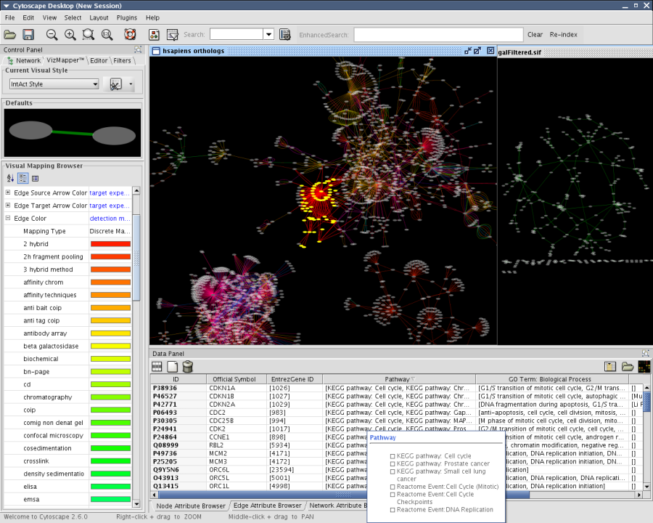
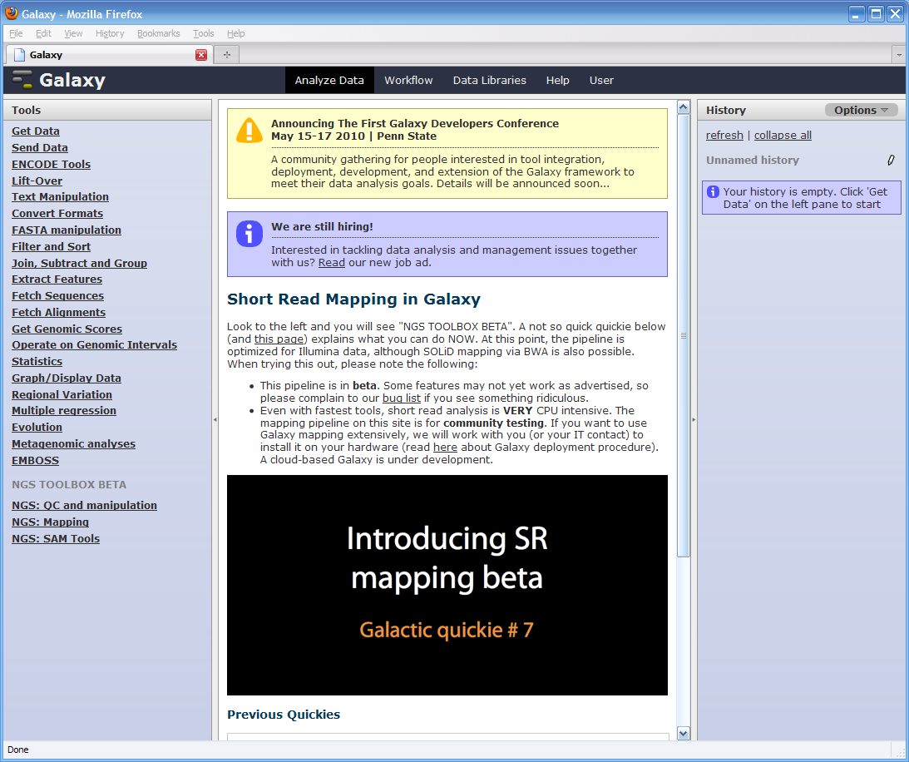
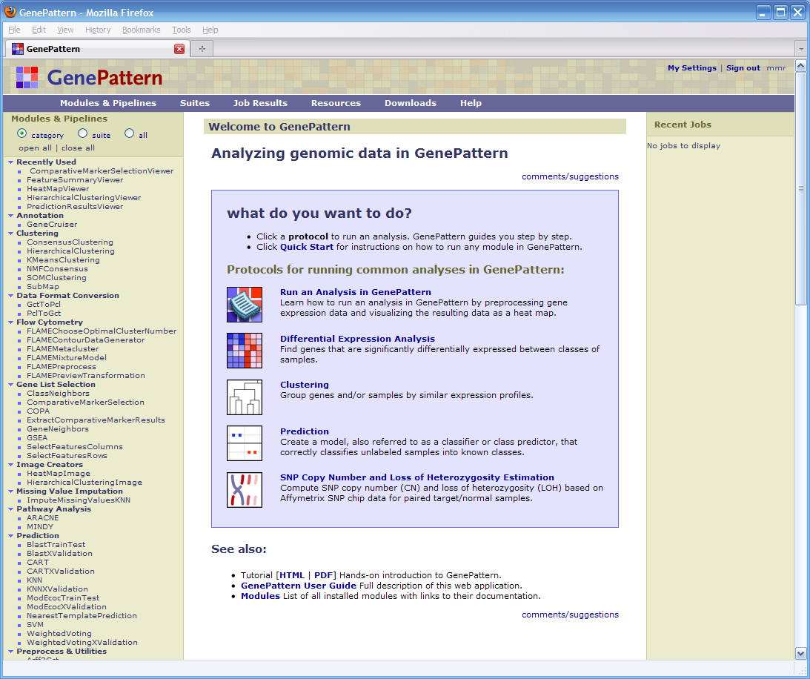
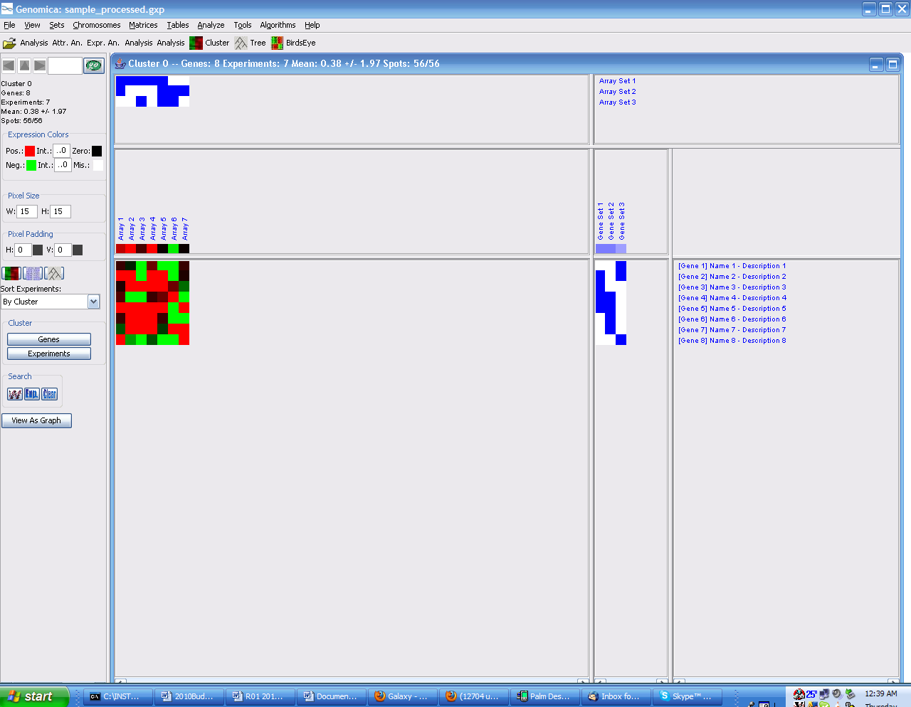
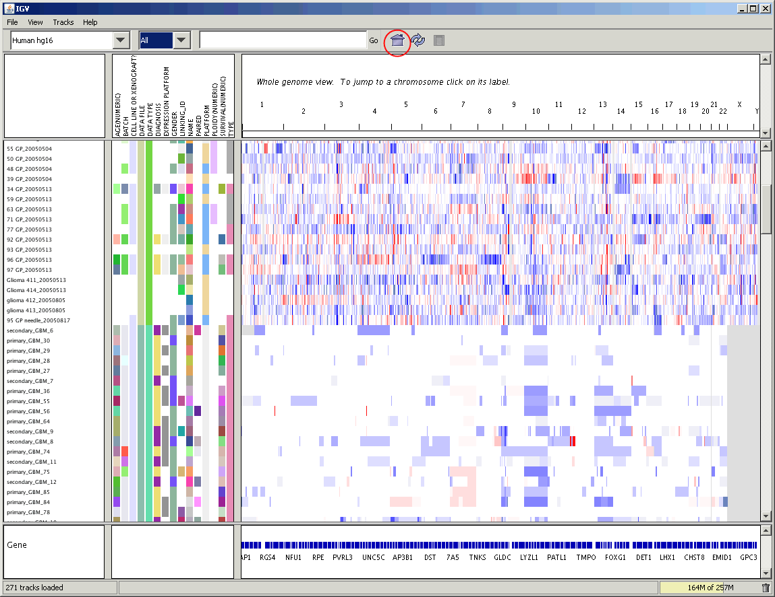
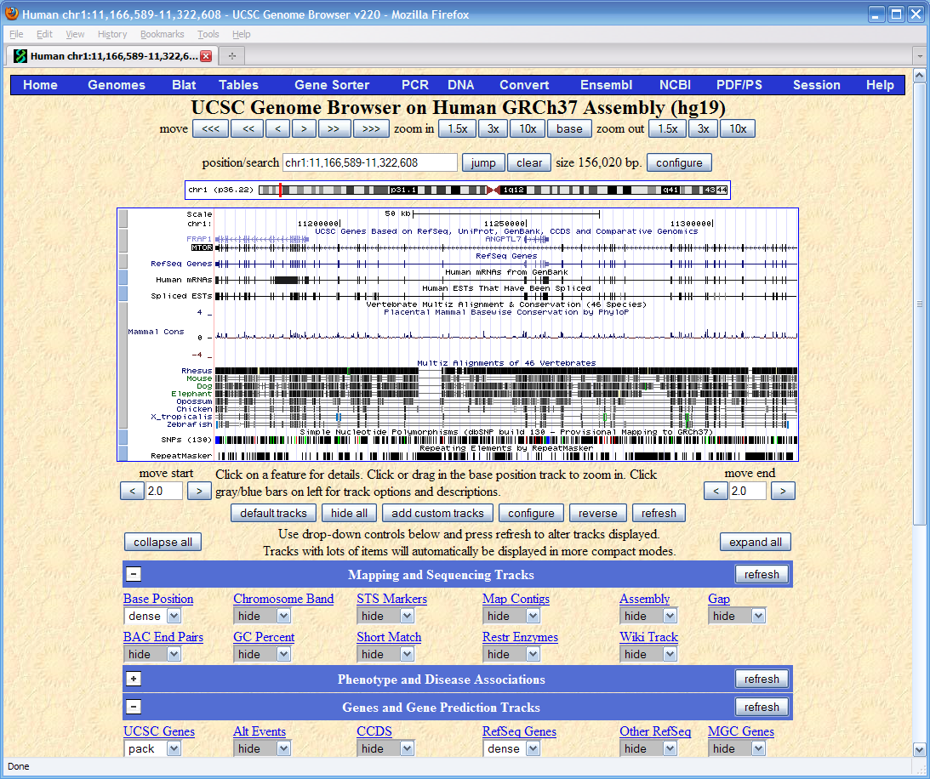
Seed Tools
Cytoscape
Galaxy
GenePattern
Genomica
IGV
UCSC Genome
Browser
Notes:
Seed tools span a wide variety of genomic analysis areas:
Network analysis and visualization
Sequence analysis
Functional genomics analysis
Module map analysis
Integrated genomics and sequence visualization

Slide 12
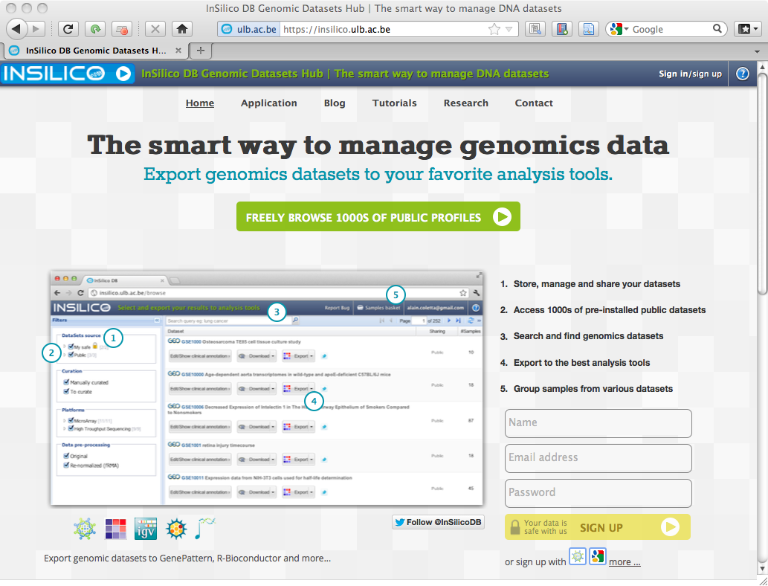
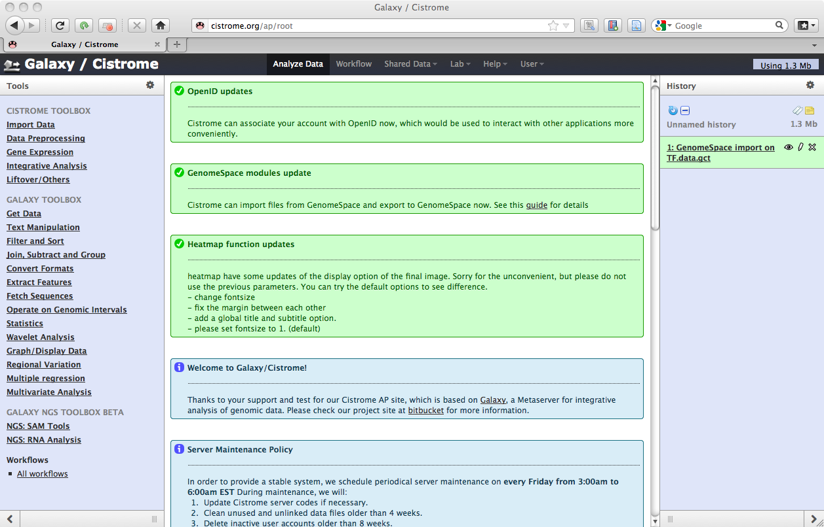
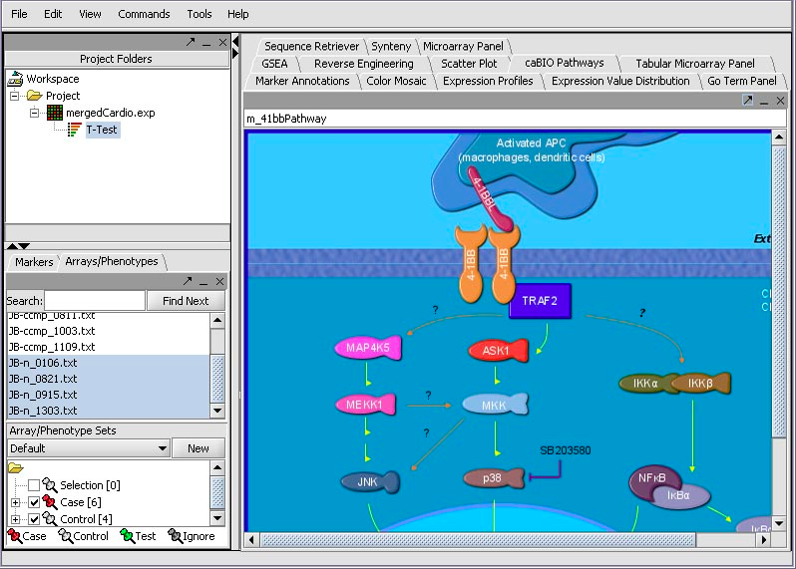
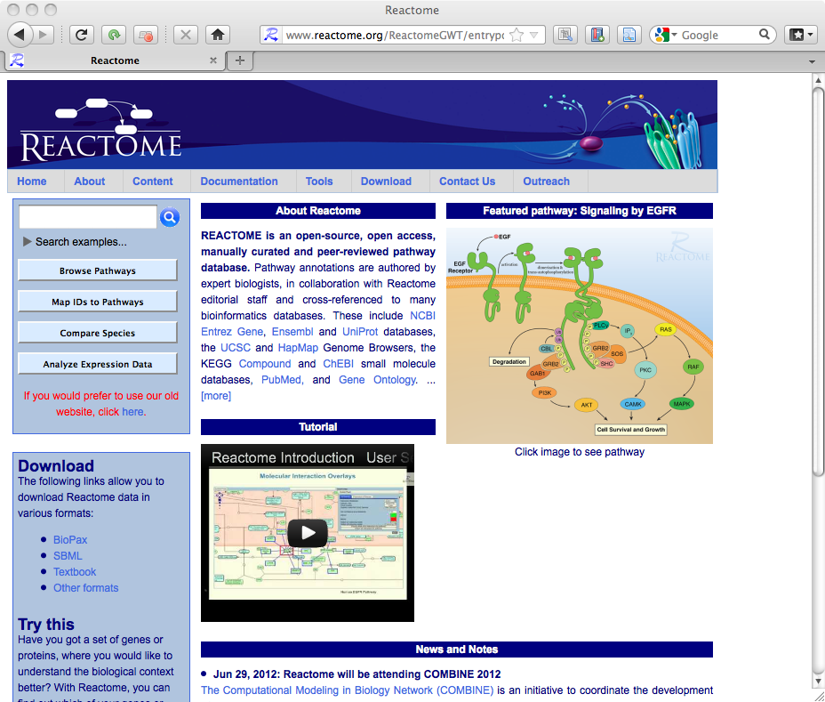
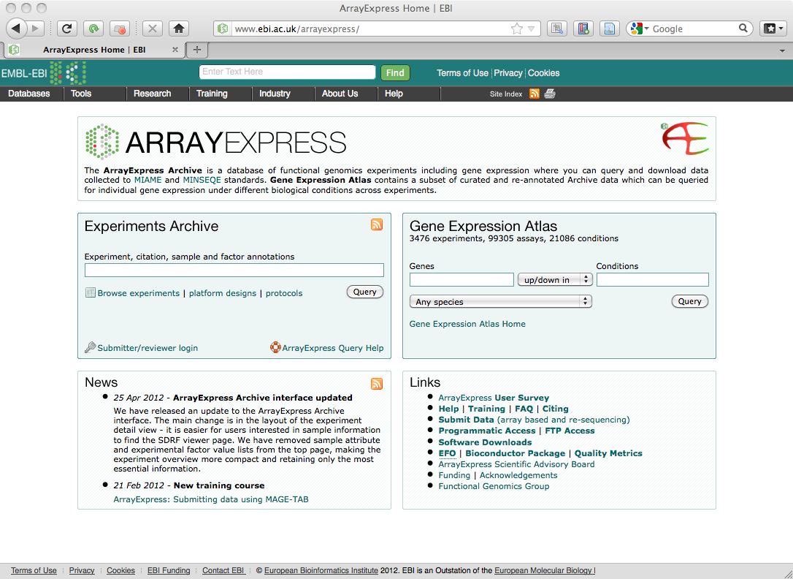
New Tools
Recently added
InSilicoDB
(University of Brussels)
Cistrome
(Dana-Farber Cancer Institute)
In development
geWorkbench
(Columbia University)
Reactome
(Ontario Institute of Cancer Research)
ArrayExpress
(EBI)
Notes:
Seed tools span a wide variety of genomic analysis areas:
Network analysis and visualization
Sequence analysis
Functional genomics analysis
Module map analysis
Integrated genomics and sequence visualization

Slide 13
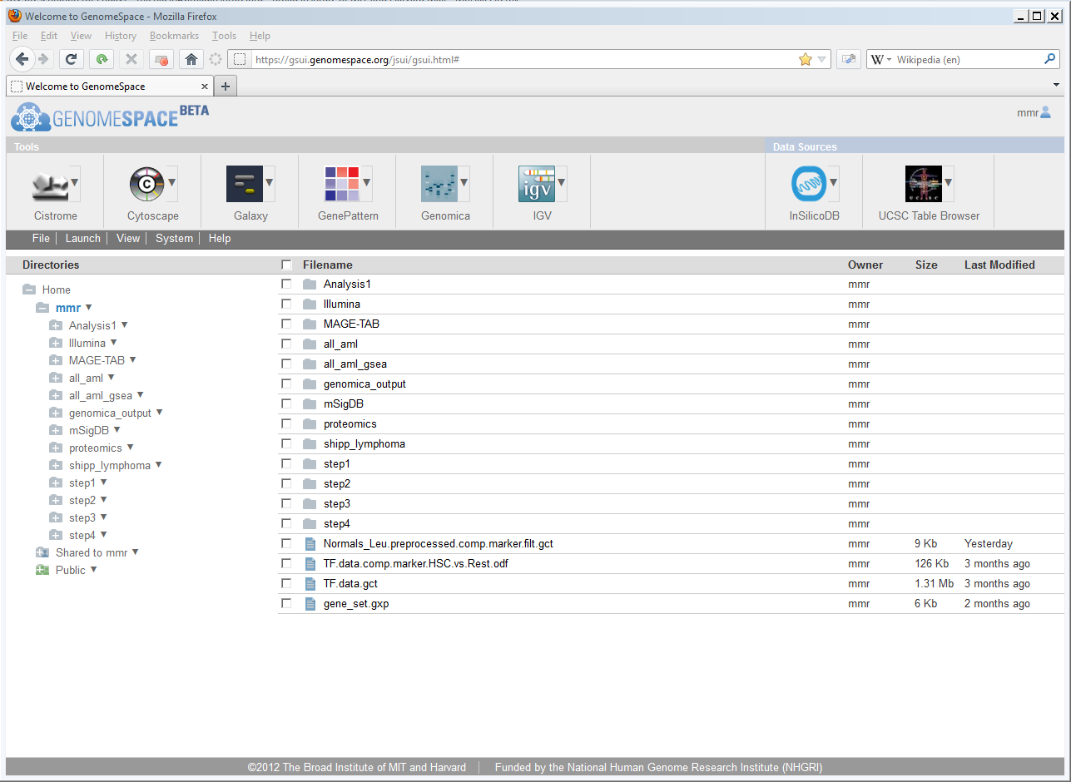
Using GenomeSpace
Tools and Data
Sources
Actions
Cloud-based filesystem

Slide 14
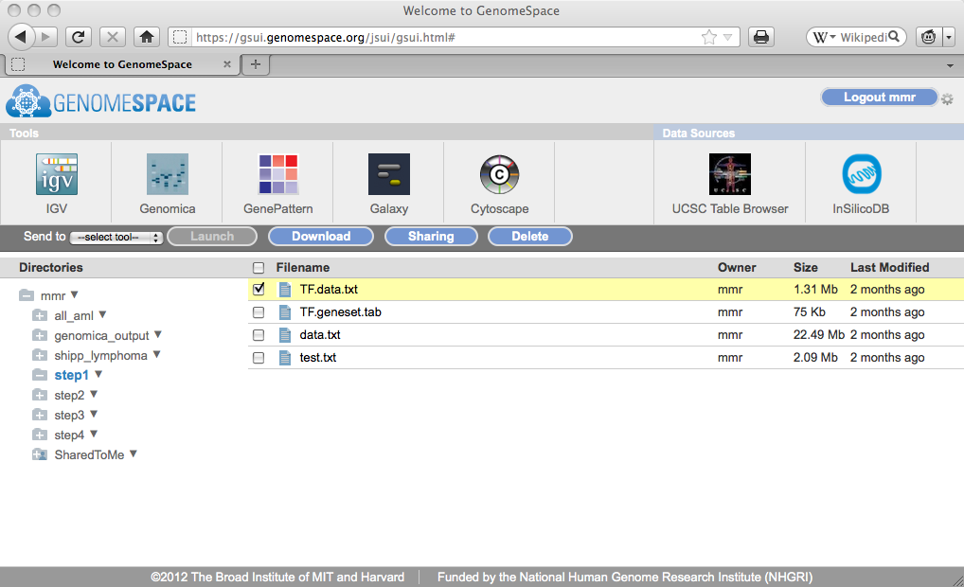
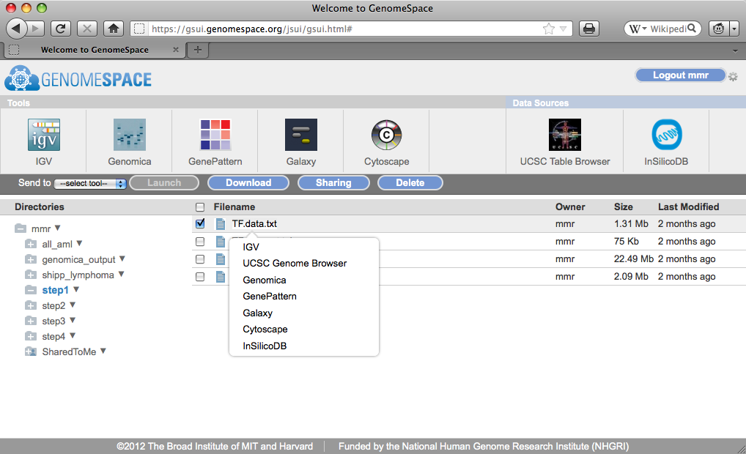
GenomeSpace Actions

Slide 15
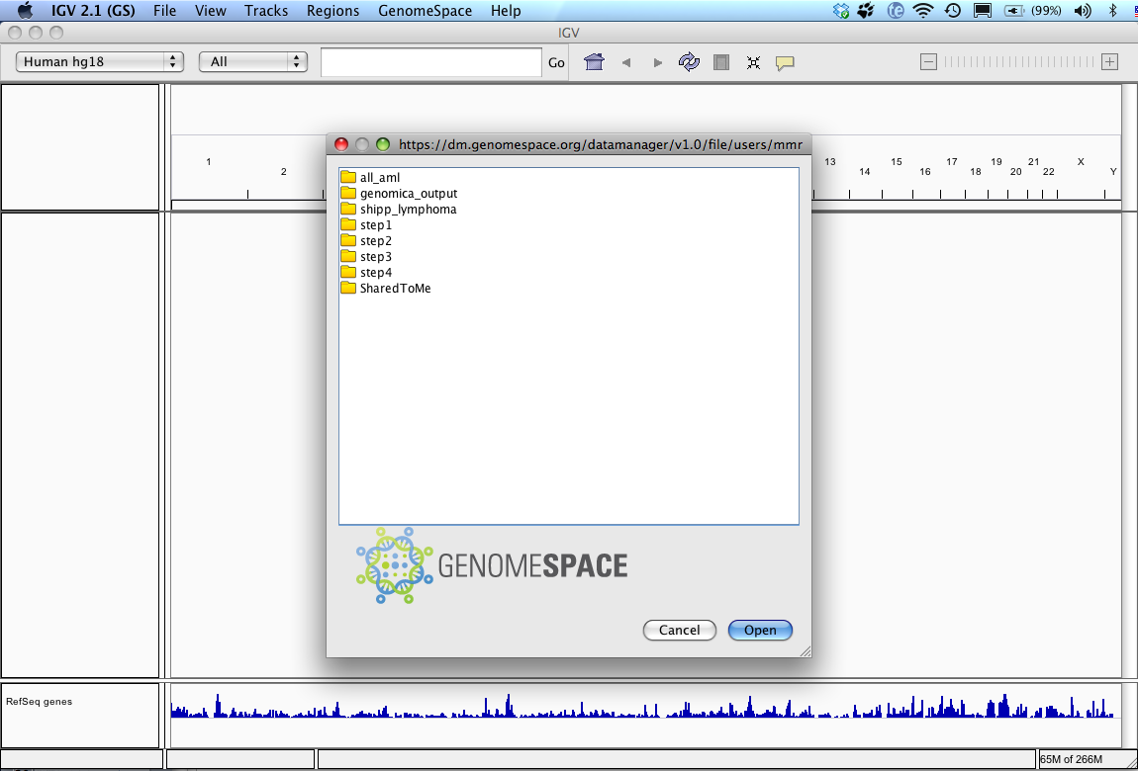
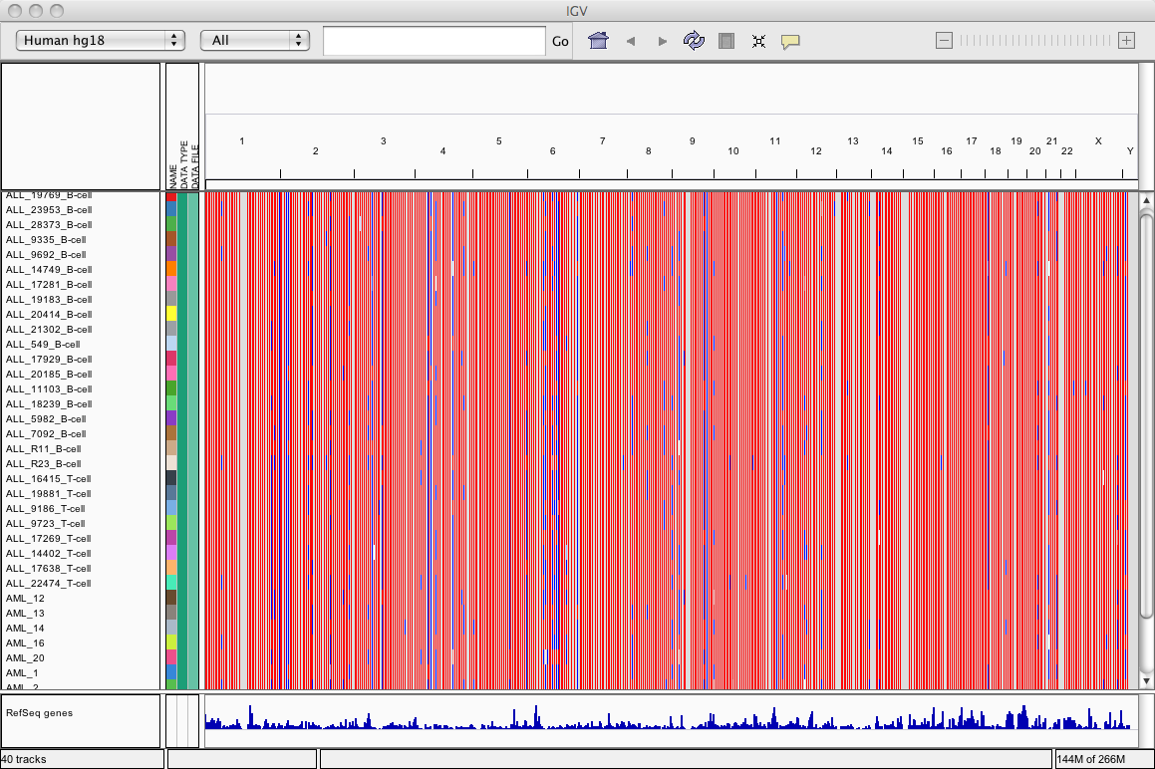
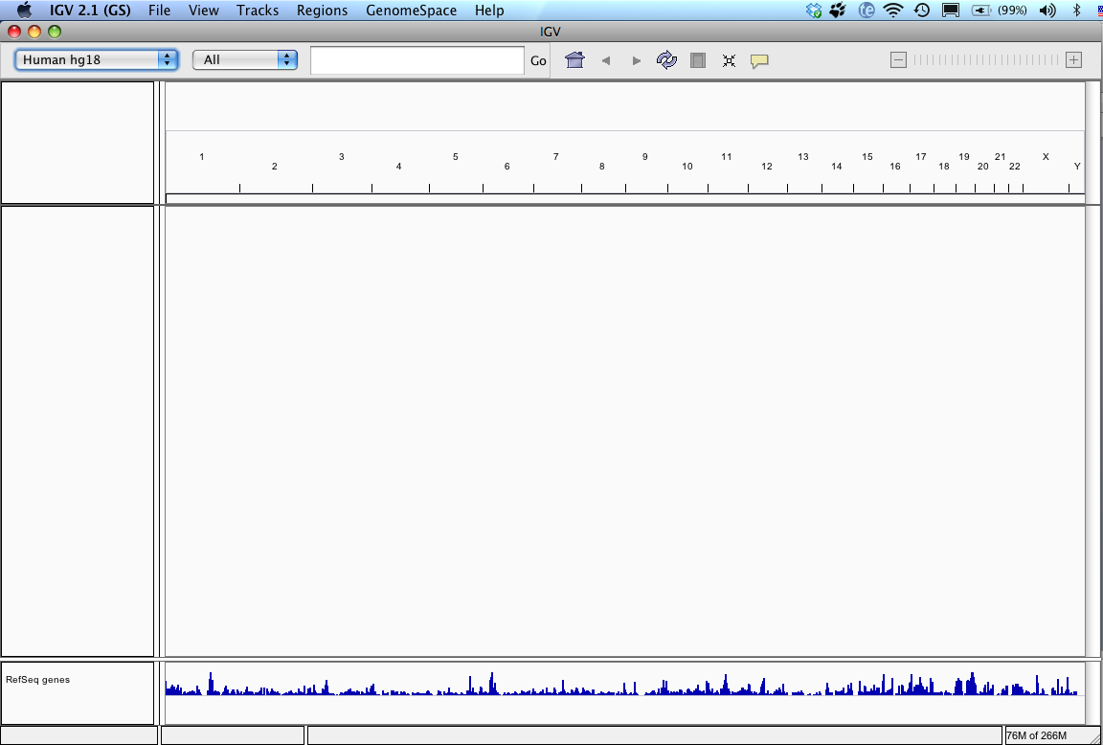
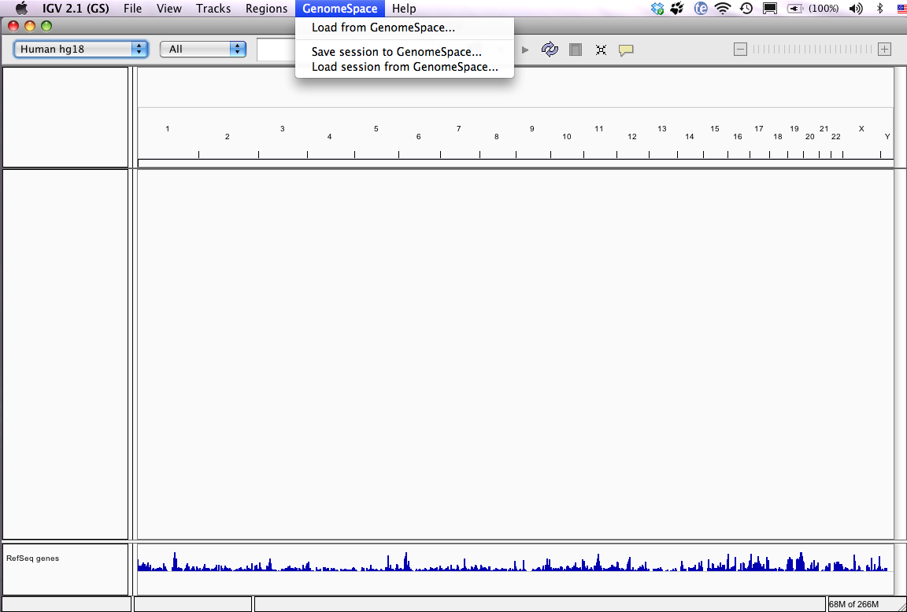
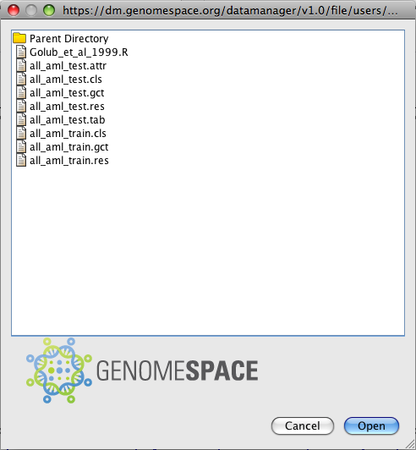
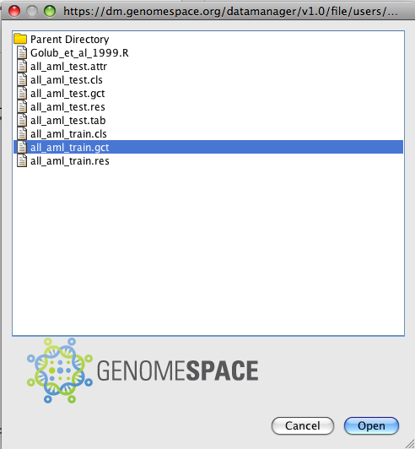
GenomeSpace Tool Enablement: IGV

Slide 16
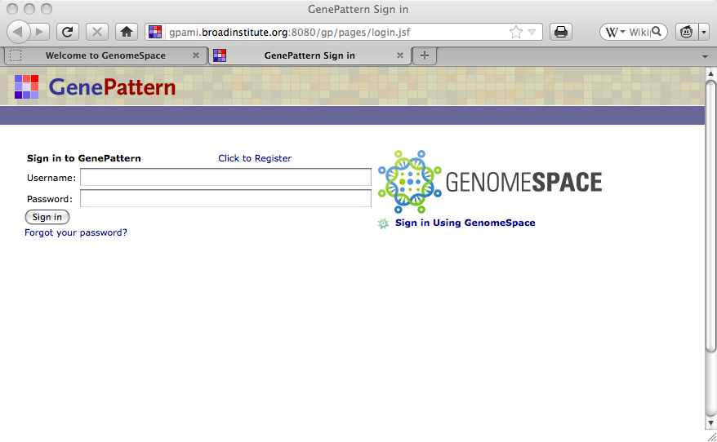
GenomeSpace Tool Enablement: GenePattern

Slide 17
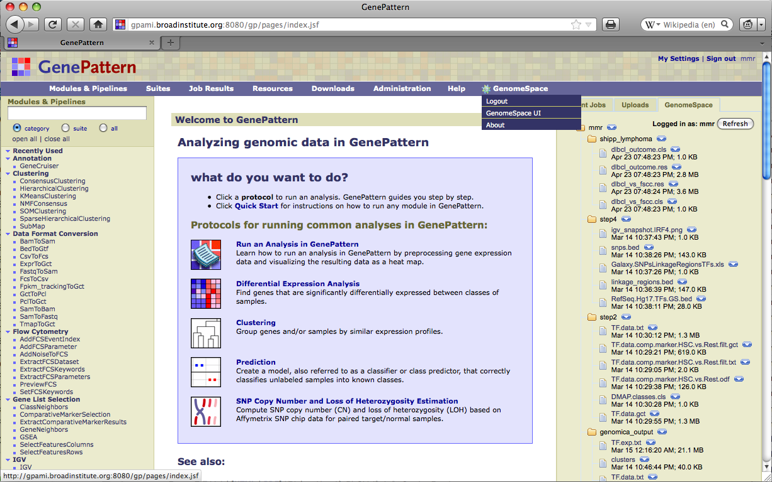
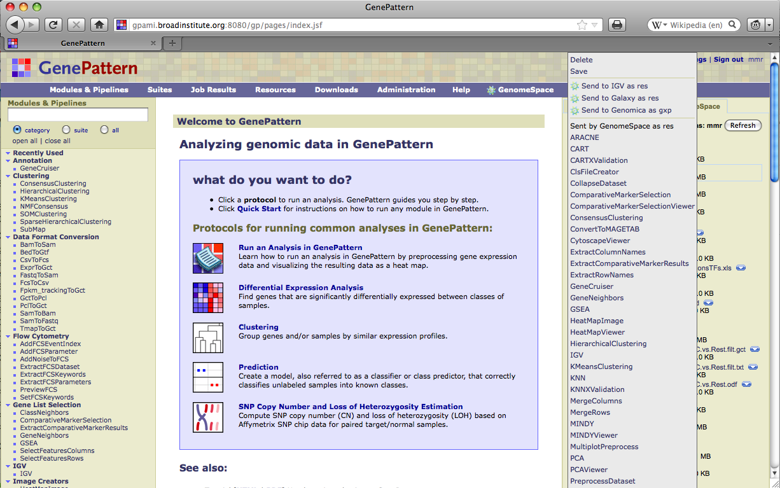
GenomeSpace Tool Enablement: GenePattern
Notes:
View GenomeSpace files from within GenePattern, use a file from GenomeSpace in a GenePattern analysis
Go to the GenomeSpace UI

Slide 18
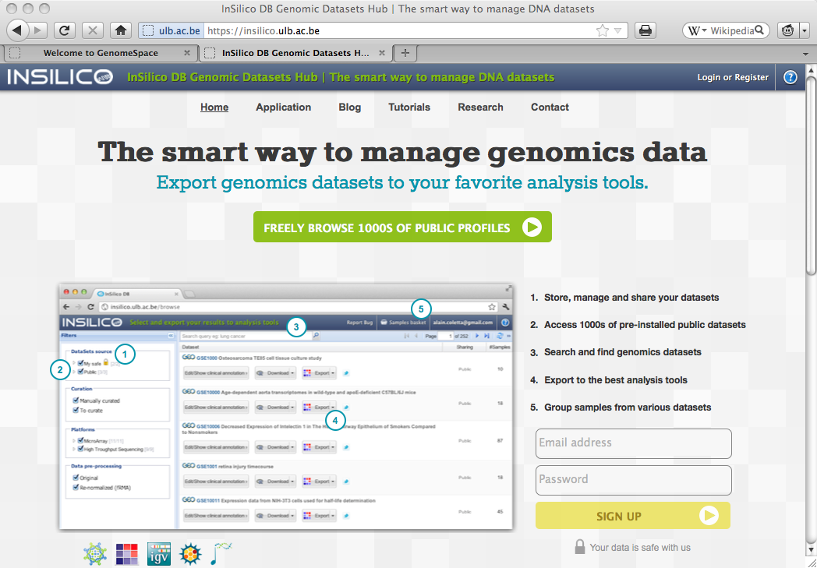
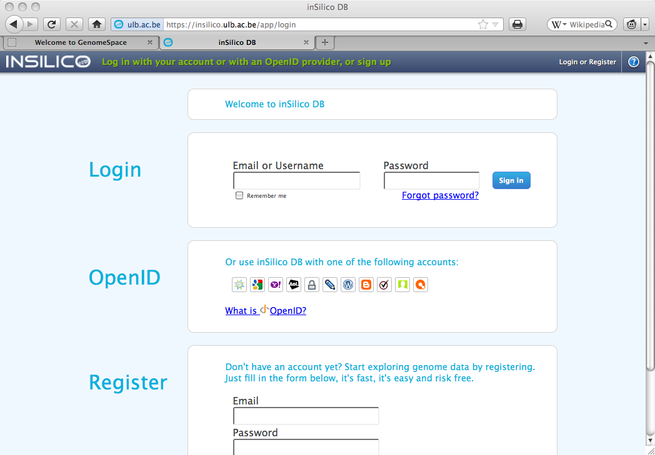
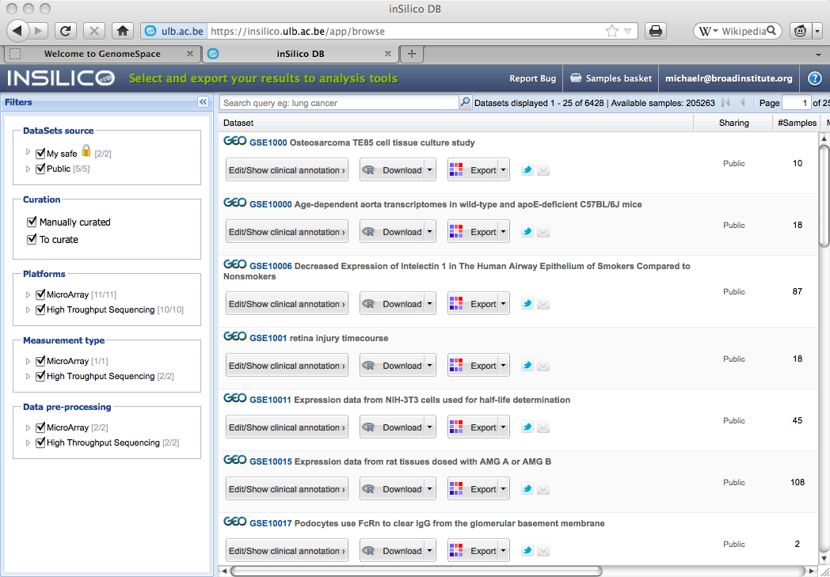
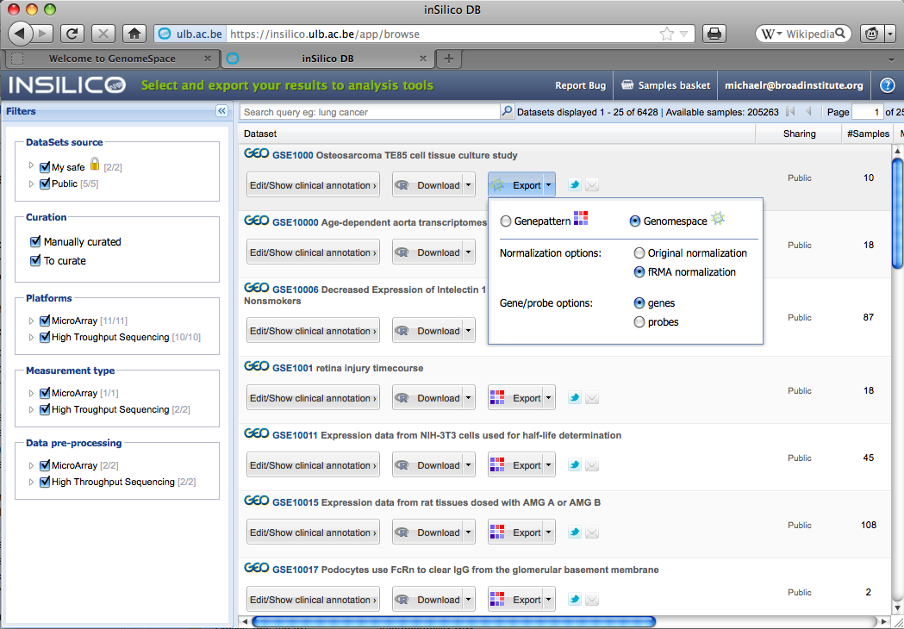
GenomeSpace Data Source Integration: InSilico DB
Notes:
This is a way to get GEO datasets into any tool that will accept gene expression files. You also don’t need to convert from MAGE-TAB.
We are also working with the developers of ArrayExpress to GenomeSpace-enable their repository.

Slide 19
Other collaborating projects
Taverna/MyExperiment (University of Manchester)
National Center for Biomedical Ontology (Stanford University)

Slide 20
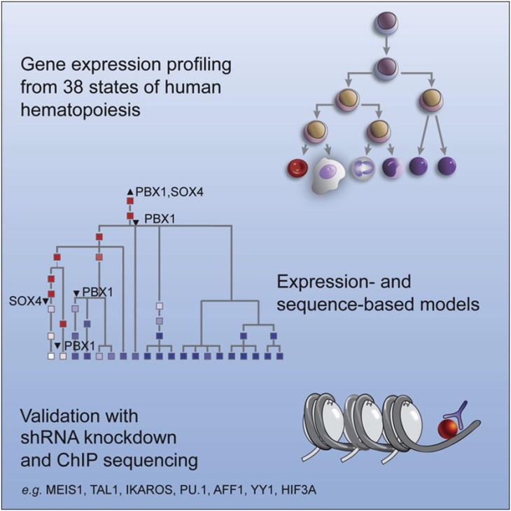
DBP3: Studying the regulatory control of human hematopoiesis
Notes:
Let’s show you how it works. One of the scientific collaborators, Aviv Regev, recently published work on the regulatory control of human hematopoiesis. For this GenomeSpace demonstration, we will show a simplified version of part of this work.

Slide 21
DBP3: Studying the regulatory control of human hematopoiesis – Overview
Part 1: Data pre-processing and quality control
Part 3: Studying the transcriptional program
Part 4: cis-regulatory site analysis
From part 2
Genomica
2
From part 3
3
2
4
GenePattern
3
4
1
2
IGV
To part 2
2
2
1
1
1
From part 2
1
Cytoscape
Galaxy
1
1
1
1
1
2
2
Manual step
3
2
To part 5
1
2
Analysis section
1
Part 5: Finding new transcription factor regulators
4
Analysis step (# steps)
1
1
Analysis conclusion
From part 4
Optional choices
Part 2: Basic analysis
1
Currently integrated
From part 1
To part 3
3
1
2
3
2
Not yet integrated
2
2
1
2
1
3+
2
2
1
2
1
To part 4
Notes:
This is an overview of the analytic workflow of the work done by Aviv and colleagues. This is months of research condensed to one slide.
The analysis can be divided in 5 major parts. The first part comprises data preprocessing and quality control, the second part is a basic analysis, the third part comprises studying the transcriptional program, part four is a cis-regulatory analysis, and part five aims for finding new transcription factor regulators.
Each circle represents work done in one of the seed tools, which you can see here, colored by the identity of the tool. Circles colored in grey represent manual steps. They are manual because the functionality doesn't exist in any of the tools. During this demo, we will mention when we have to do such a manual step. The number inside each circle represents the number of steps that are performed within the tool. And the arrows represent the different paths that can be followed. At certain points, indicated by the blue boxes, there are alternative optional paths that can be followed.
We will now zoom in on part 5 in this demo, which is on finding new transcription factor regulators.

Slide 22
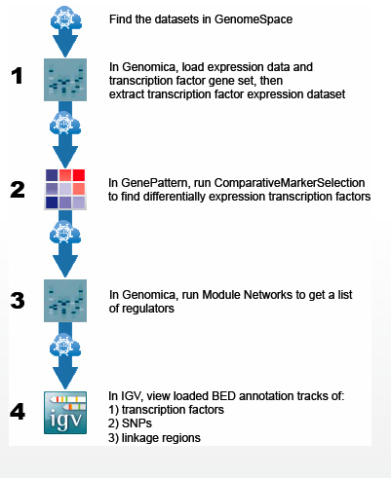
Part 5: Finding new transcription factor regulators
From part 4
Step 1
2
3
Step 4
Step 2
2
Step 3
2
Notes:
What we’re actually doing in this demo is the following. We start from a very broad set of transcription factors. We then find those transcription factors that are significantly differentially expressed in a particular lineage as compared to the other lineages. These we’ll call our lineage-dependent transcription factors. We then infer regulatory programs using Module Networks from Genomica. Regulatory programs consist of modules of coexpressed genes that themselves are coregulated. These regulators we then visualize and validate using previously published GWAS SNPs and linkage regions.
We’re now going to walk you through the steps in this demo.
We first start in Genomica and there we load the full expression data containing more than 200 samples and about 8000 genes together with a gene set that contains the GO transcription factors. The blue squares next to the genes indicate which genes are GO transcription factors. In Genomica we then can save the expression data from only the GO transcription factors into a text file.
In GenePattern we want to refine the GO transcription factors to a set of lineage-specific transcription factors. We do this using the ComparativeMarkerSelection and ExtractComparativeMarkerResults modules in GenePattern. So we basically use a t-test to assess differential expression of transcription factors in each lineage versus the rest of the lineages, and we can use criteria such as an FDR < 0.05 to actually select significantly differentially expressed transcription factors. As an example, we continue with the transcription factors that are specific to the hematopoietic stem cell (HSC) lineage.
Back in Genomica, we run Module Networks on the full expression data, while also loading the lineage-specific transcription factors we just generated in GenePattern. As running Module Networks usually takes a while, we now immediately load our previously saved results. In this case, we have 80 modules of coexpressed genes for which we can generate a list of the potential regulators. This list allows us to browse very easily through the results. Here you see a module that has as top regulator SMAD4. SMAD4 divides the sample space into 2 partitions, while other regulators further subdivide the samples.
As a last step, we want to visualize and validate our list of potential regulators. To do that, we follow 2 approaches in parallel. Both approaches require us to manually create a .bed annotation track that contains the coordinates of the regulators. To validate our regulators, we want to find overlaps between our regulators and previously published GWAS SNPs and linkage regions. We download these SNPs and linkage regions and we manually create .bed annotation tracks for both of them.
The first approach is to visualize our regulators in IGV. This requires us to upload the 3 .bed annotation tracks in IGV. In parallel, we submit the same 3 .bed annotation tracks to Galaxy, where we can do overlap analysis between regulators, SNPs and linkage regions in several steps. From this analysis, we get an excel file that displays the overlaps in table format. Interesting also is that this table contains the pubmed IDs of the papers in which a particular GWAS SNP has been published in relation to a particular disease.

Slide 23
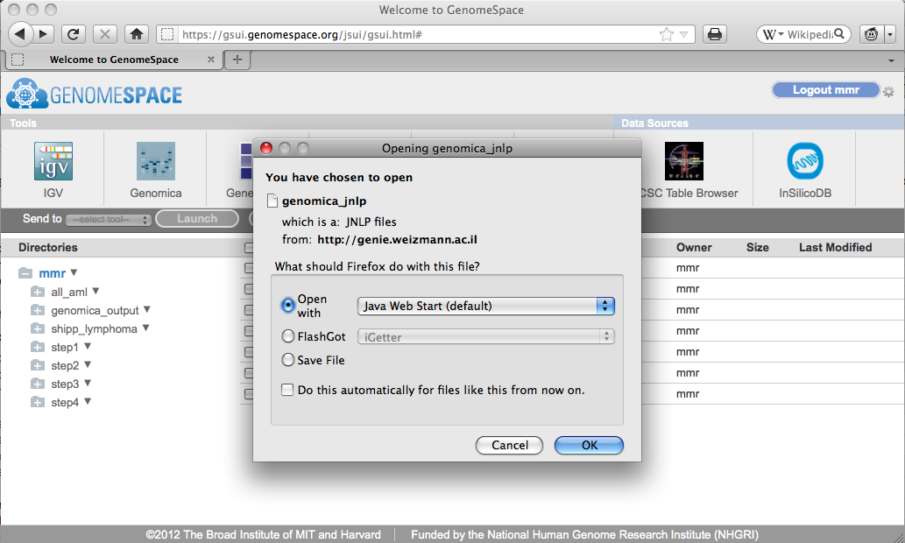
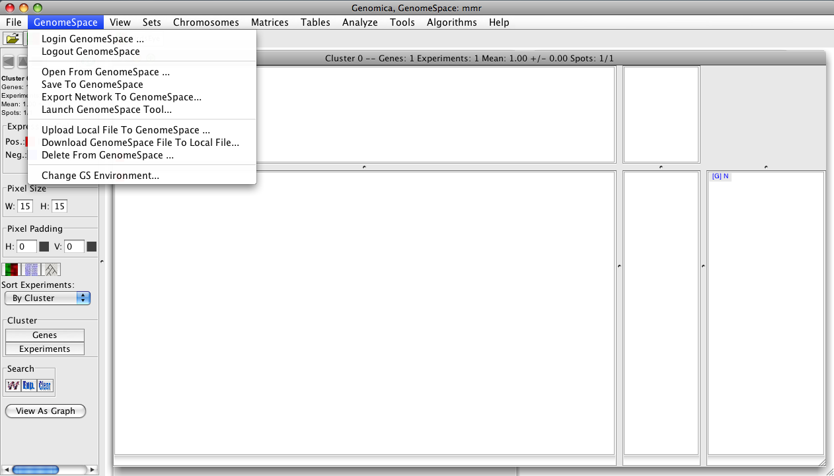
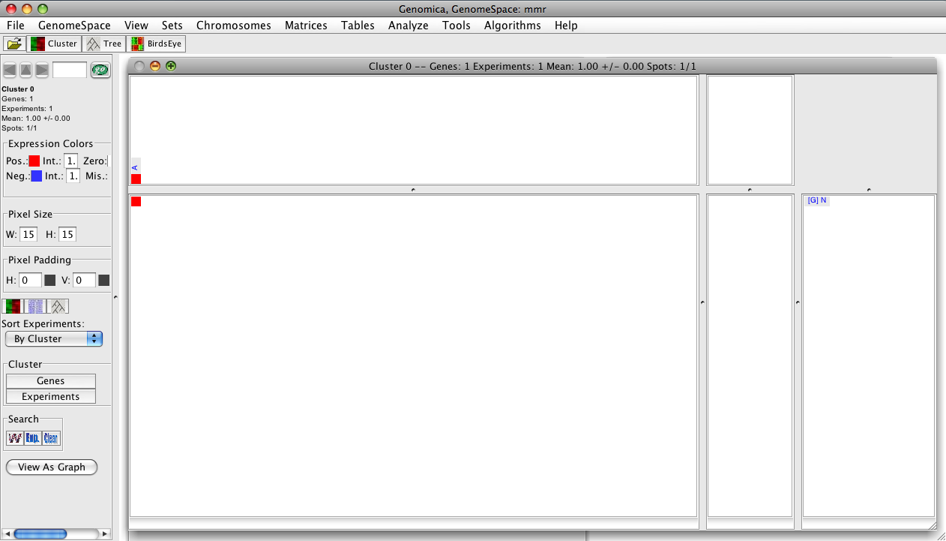
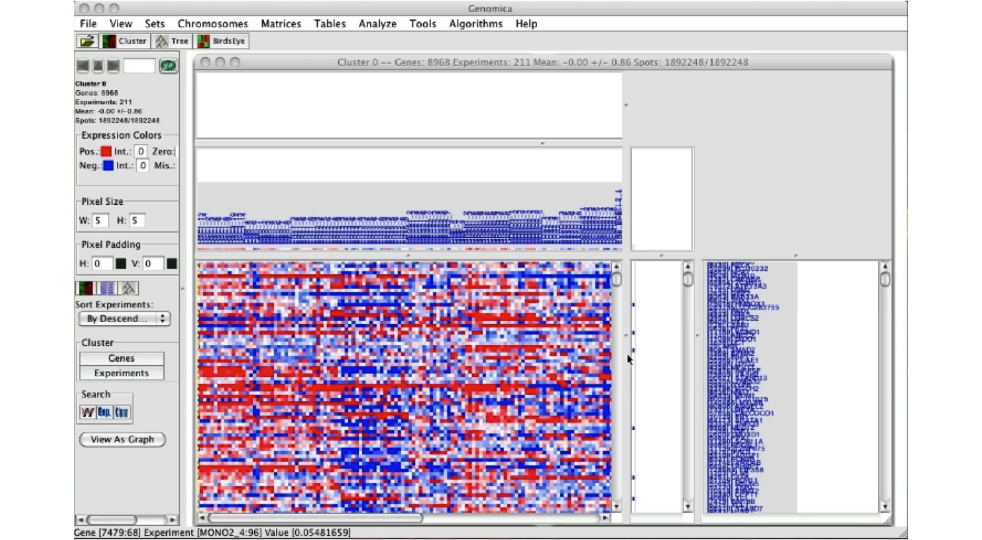
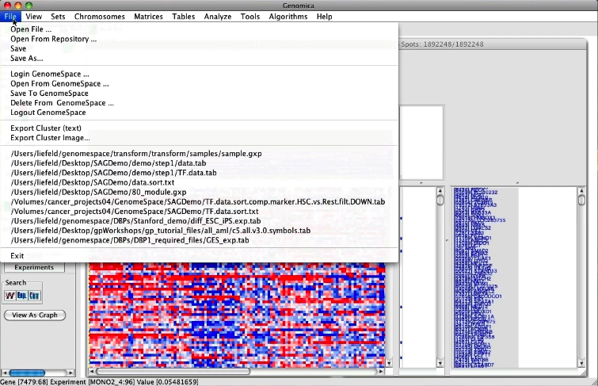
Step 1: Create transcription factor dataset in Genomica and save to GenomeSpace
Notes:
To launch desktop-based tools, we first get the prompt that we’re downloading the application in jnlp format

Slide 24
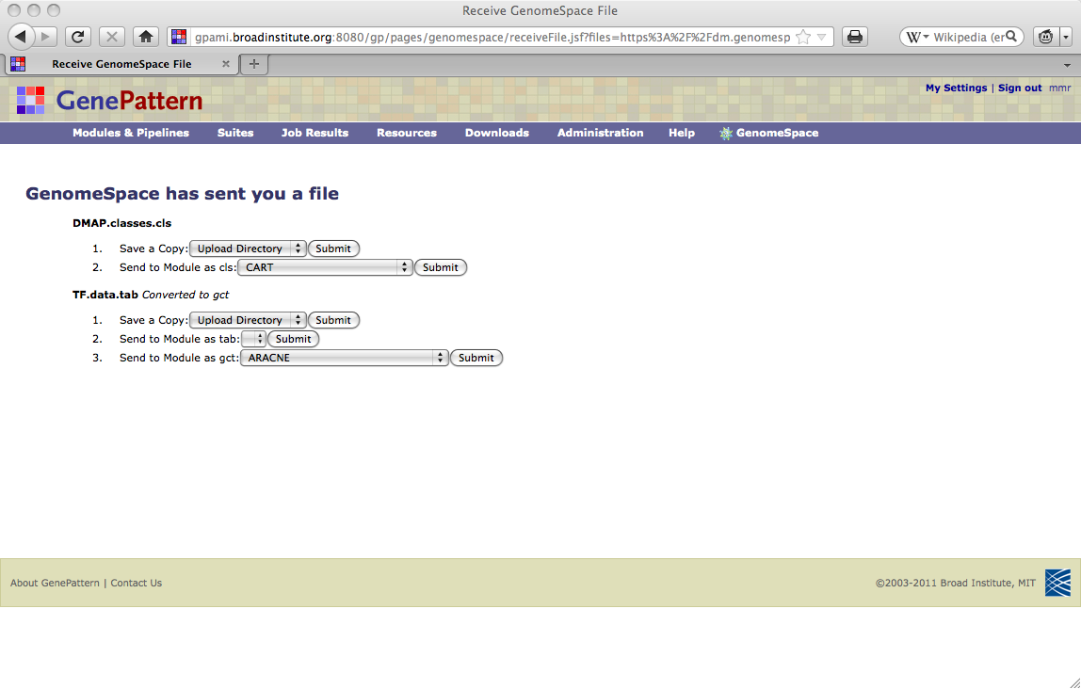
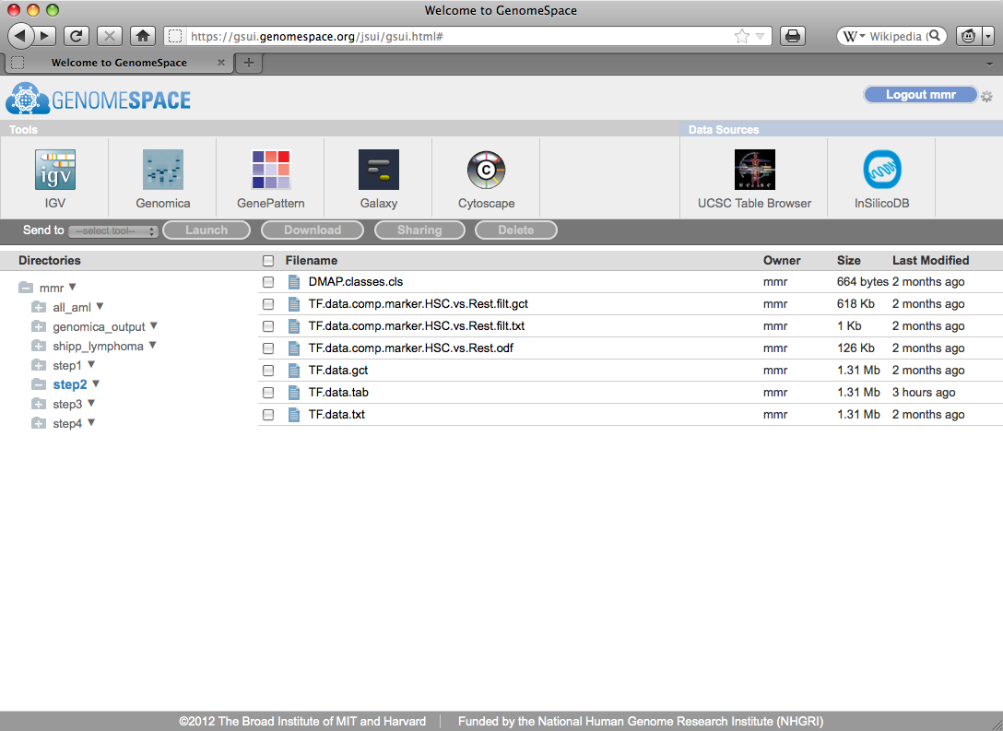
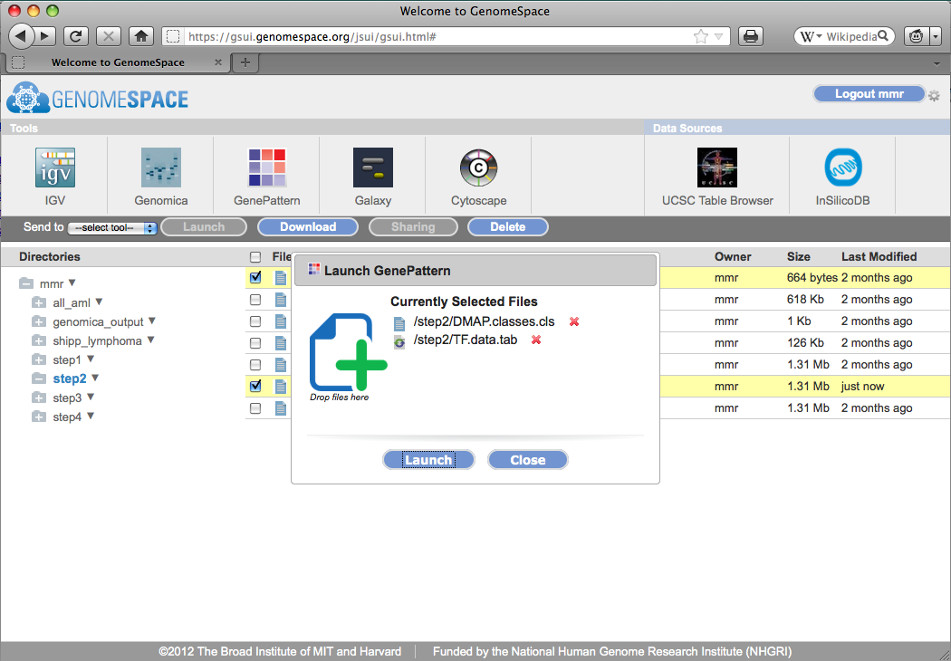
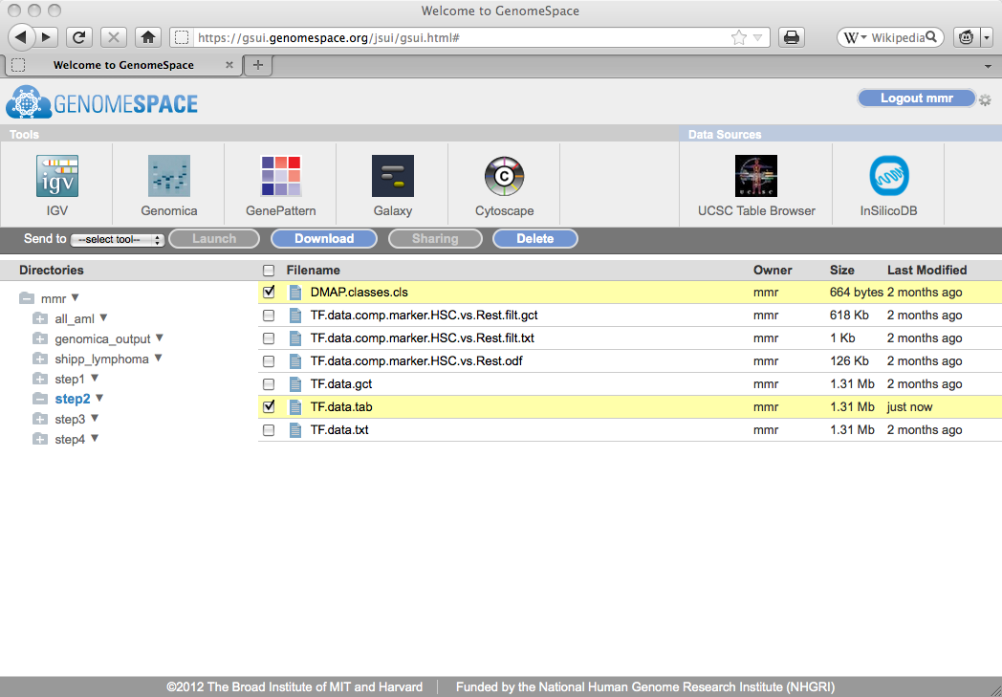
Step 2: Send transcription factor datasets into GenePattern

Slide 25
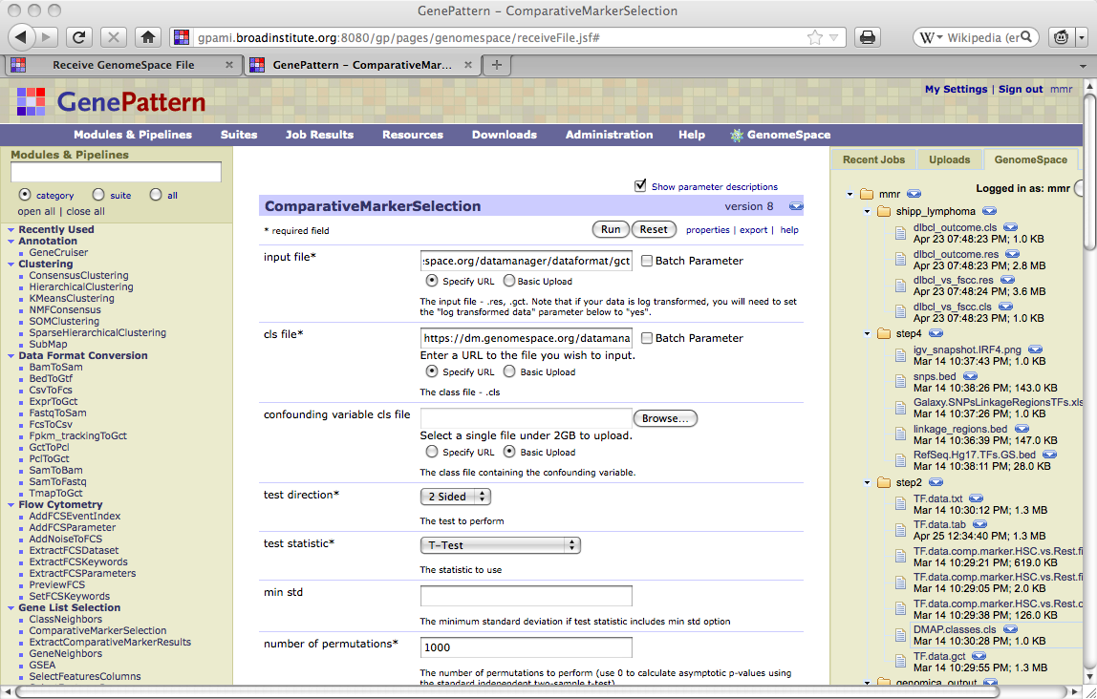
Step 2: Perform differential expression analysis in GenePattern
Notes:
NOTE: The file sent to GenePattern is still a Genomica-formatted file. We specify in the URL what format we want to convert the file to

Slide 26
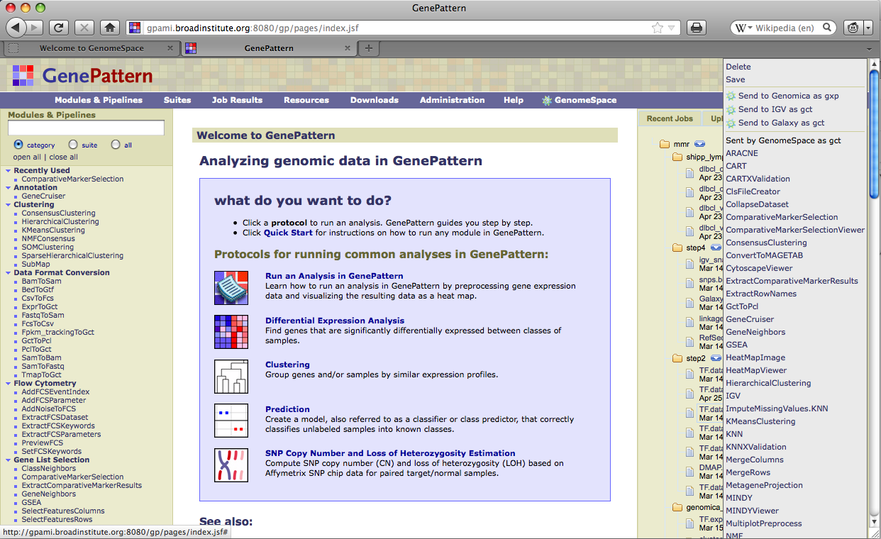
Step 3: Send differentially expressed genes to Genomica
Notes:
We send this file directly from the GenePattern interface to Genomica, now converting it back to a Genomica formatted file

Slide 27
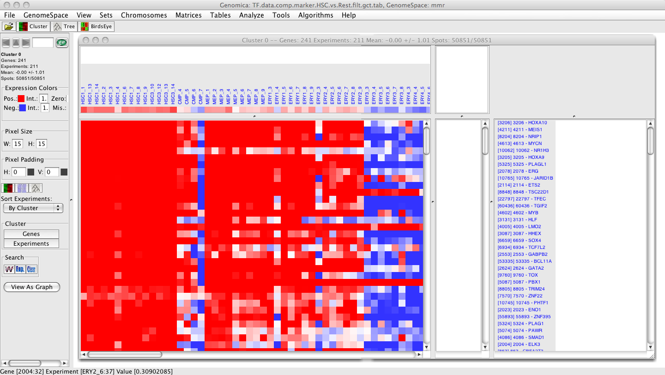
Step 3: perform module network analysis in Genomica
Notes:
We now see Genomica open with the data file, and we perform a module map analysis on this data to determine regulators of module networks, and since we’ll need some other data for the next step, we save the results to GenomeSpace

Slide 28
Step 4: Visualize regulators with known SNPs and linkage regions
Notes:
From the GenomeSpace Ui, we’re going to send these files now to IGV

Slide 29
Step 4: Visualize regulators with known SNPs and linkage regions
Notes:
We now see IGV open with our tracks.
What’s under the covers…

Slide 30
Deployment Architecture
Deployment Architecture and APIs
GS Clients
Amazon
Clustered
GS UI
REST
Identity
Service
(OpenID)
IGV
REST
Clustered
Analysis
Task
Manager
(ATM)
Genomica
CDK
REST
Gene-
Pattern
CDK
Simple
DB
Provenance
REST
Galaxy
Data
Manager
(DM)
REST
CDK
Cytoscape
External
Data
Sources
(e.g., Arrary
Express)
REST
UCSC
S3
File transfers
30
Notes:
30
API component
Client developers’ kit
Restful interface
Provide connections to other GenomeSpace-enabled tools as well as ATM and DM

Slide 31
Join the GenomeSpace community
Researchers with biological projects
Developers
Add your tools
Contribute format converters
Build new infrastructure
Data portals and repositories
Link your resources
Notes:
The beta release is available for use!
A few brave men and women (explorers)

Slide 32
Acknowledgements
GenomeSpace Collaborators
Cytoscape: Trey Ideker Lab, UCSD
Galaxy: Anton Nekrutenko Lab, Penn State University
Genomica: Eran Segal Lab, Weizmann Institute
UCSC Browser Team
GenePattern Team
IGV Team
Driving Biological Projects
Howard Chang Lab – Stanford University
Aviv Regev Lab – Broad Institute
Broad Institute
Ted Liefeld
Helga Thorvaldsdottir
Jim Robinson
Marco Ocana
Eliot Polk
Jill Mesirov, PI
Funding
gs-help@broadinstitute.org
www.genomespace.org

